Slide 1

2024 Pre-registration Examination
Online Workshop

Slide 2
Format of the workshop
Welcome address | Ms M Mokoena, Chief Operating Officer (COO)
Introduction | Ms M Phungo, Manager: Pre-Registration and Exams
Preparing for calculation questions | Prof. J Steenekamp
Examples of calculation questions | Prof. J Steenekamp
Break (10 minutes)
Preparing for general questions | Ms A Augustyn
Examples of general questions | Ms A Augustyn
Remote online examination | Office
Q & A
Notes:
Mulalo

Slide 3






What is the format of the examination?
PRE-REGISTRATION EXAMINATION
120 MCQs
Split over two days
Need to write both sections of the examination
DAY 1 40 Calculation MCQs 2 hours Subminimum of 60% | DAY 2 80 General MCQs 2 hours 30 min Subminimum of 50%
Remember the Practice Pre-registration Examination is COMPULSORY for those writing the Pre-registration Examination

Slide 4
QUESTIONS ARE RELATED TO COMMUNITY, INSTITUTIONAL AND THE MANUFACTURING SECTOR
ALL INTERNS MUST COMPLETE ALL QUESTIONS
EXAMINATION IS NOT SECTOR SPECIFIC
Community
Institutional
Manufacturing
REFER TO DOMAINS AND COMPETENCY STANDARDS AND CONSIDER WHICH SECTOR IT APPLIES TO
Notes:
Mulalo

Slide 5
What the examination is based on
2018 Competency Standards for Pharmacists
Domain 1
Domain 2
Domain 3
Domain 4
Domain 5
Domain 6

Slide 6

Calculations Question (Blueprint)

Slide 7
Types
CS 2.4: Medicines and medical devices safety:
Calculate an appropriate dose
Prepare, concentrate, or dilute compounded medications accurately
Interpret osmolarity, isotonicity, and milliequivalents
Prepare isotonic solutions
Reconstitute dry powders to appropriate concentration
CS 2.5: Therapeutic outcome monitoring:
Dose adjustment
Pharmacokinetics
Creatinine clearance
CS 2.6: Pharmacist-initiated therapy:
Amount of medication required for dispensing
Suitability of doses
Doses based on patient’s weight
Doses based on surface area
Prepare, concentrate, or dilute compounded medications accurately.
Reconstitute dry powders to appropriate concentration (including displacement volume)
Calculation of BMI
Calculation of peak flow reading
CS 1.4: Health Economics:
Cost-benefit analysis
Cost-effectiveness analysis
Cost-minimisation analysis
Cost differential between therapeutic agents
Cost differential between branded drugs and generic equivalents
Cost differential between dosage forms and routes of administration
Cost differential of dosing regimen
Cost differential of alternative treatment plans
CS 2.3: Patient medicine review and management:
Dose adjustment
Pharmacokinetics
Creatinine clearance

Slide 8
CS 3.3: Formulary development
Calculation of costs
Cost-benefit analysis
ABC analysis
CS 3.4: Medicine dispensing
Prescription verification
Amount of medication required for a prescription
Suitability of doses
Dosage
Doses based on patient’s weight
Doses based on surface area
Concentrations
Intravenous injection doses including paediatrics
Reconstitution for oral or parenteral use (including displacement volume)
Rate of infusion
CS 3.5: Medicine compounding
Master formulae
Changing concentrations
Solubility
Reconstitution calculations
Dilutions
CS 4.2: Financial management
% mark-up AND Dispensing fee
Budgeting
CS 3.1 Medicine production according to GxP
NaCl equivalents
Freezing point depression
Solubility
Master formulae
Changing concentrations
Trituration
Molecular weight
Reconciliation calculations in manufacturing operations (e.g. granulation yields; compression yields)
Reconciliation calculations in packaging operations (i.e. packaging materials reconciliation)
Density calculations in packaging operations (e.g. liquids packaging)
Dilutions
Formulations
Isotonicity calculations
CS 3.2: Supply chain management
Min/max order/reorder levels
Acquisition costs
% mark-up
ABC analysis
Lead-time
Buffer/safety levels
Distribution fees
Patient bonus stock
Batch supply cost analysis
Notes:
Prof Steenekamp/Razeeya

Slide 9
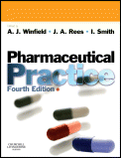

Recommended textbooks for calculations.
  Pharmaceutical Calculations
    H. C. Ansel
  Calculations for Pharmaceutical Practice
    A. J. Winfield & I.O. Edafiogho 4th Edition
  Pharmaceutical Practice
    A. J. Winfield, J.A. Rees & I. Smith
Note: Text books are of more value before the exam than during the exam. BE MINDFUL OF TIME.

Slide 10

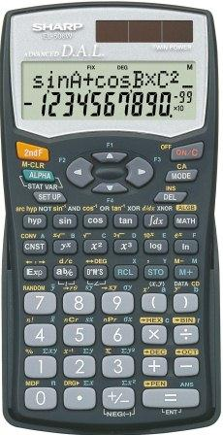
Calculation Tips & Advice:
Tips:
Understand the principle, do not memorise the calculation.
Units:
  What are the SI units?
  Example: % ^{w}/_{v} = g/100ml
Equations:
  Identify the equations you have used while practicing.
  Example: C₁V₁ = C₂V₂
Equipment:
Scientific calculator:
  Use the same one for practice as you will use in the exam
  Check batteries
  Know the settings of your calculator
Paper & pens

Slide 11
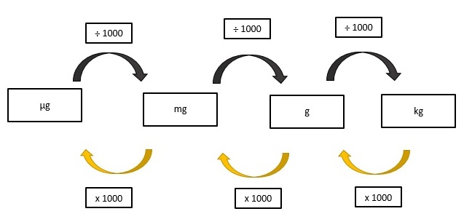
Calculations Tips
Tips:
  Conversion
    Practice converting between units
      Example: 10 ppm can be expressed as 0.001%

Slide 12
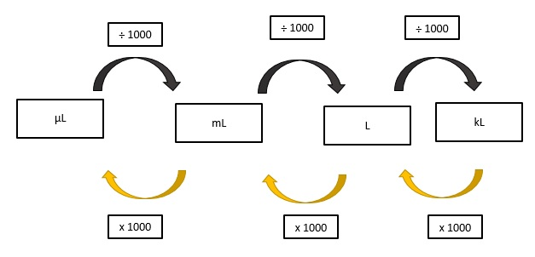
Calculations Tips
Tips:
  Conversion
Notes:
Prof Steenekamp/Razeeya

Slide 13
Helpful tips:
Exam technique:
  Select the correct formula.
  Transcribing - Double check against the question that you have used the correct figures in your formula.
  If possible, estimate a range for your answer.
  Always double check your calculation.

Slide 14

Managing time:
Maximising your time - 120 minutes
  40 MCQs
  Approximately 3 minutes per question
No negative marking.
Do not leave blank spaces.

Slide 15
Calculation: Example 1
A 55-year-old male patient is stabilised on warfarin 5 mg daily at a cost of R 28-80 per month. The patient has his INR monitored weekly at a cost of R117-70 per test, the patient has heard about rivaroxaban from his doctor and wants to know the cost implications. The cost of rivaroxaban 15 mg daily is R637-95 per month. What is the difference in cost between these two options?
Notes:
Prof Steenekamp/Razeeya

Slide 16
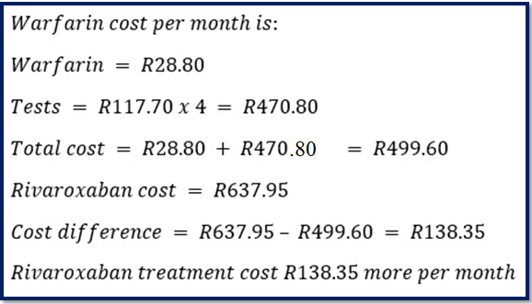
Example 1: Solution

Slide 17
Calculation: Example 2
A patient requires an intravenous infusion of 0.9% ^{w}/_{v} sodium chloride. In your hospital pharmacy department you have Water for Injection BP and 4.5% ^{w}/_{v} Sodium Chloride Solution BP. Assuming no volume displacement effects, what volume of the 4.5% ^{w}/_{v} Sodium Chloride Solution BP need to be added aseptically to an expandable PVC infusion bag containing 100 ml Water for Injection BP to produce the required sodium chloride concentration?
Notes:
Prof Steenekamp/Razeeya
General approach for tackling more difficult dilution questions

Slide 18
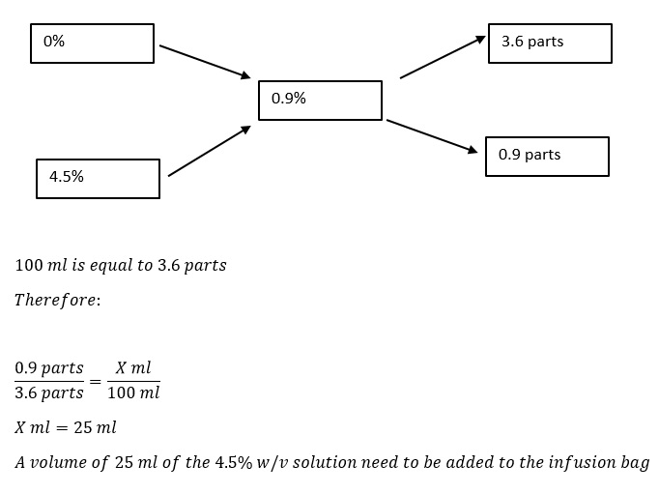
Example 2: Solution
Notes:
Prof SteenekampRazeeya

Slide 19
Calculation: Example 3
Given that the relative molecular mass (RMM) of sodium chloride is 58.5 g/mol, what amount of sodium chloride powder is required to prepare 300 ml of a solution containing 50 mmol/l?

Slide 20
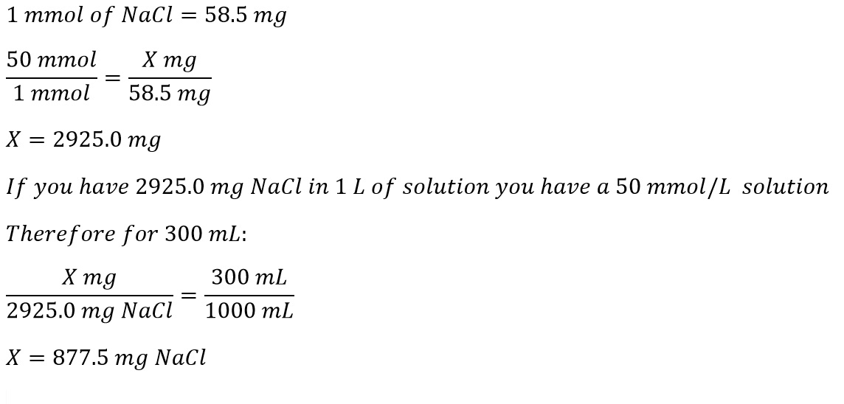
Example 3: Solution
Notes:
Prof Steenekamp/Razeeya

Slide 21
Calculation: Example 4
A pharmacist receives the following prescription:
How many grams of anhydrous dextrose should be used in compounding the prescription to make an isotonic solution?
The sodium chloride equivalent for a 1% ^{w}/_{v} solution of ephedrine HCl is 0.3, and for a 1% ^{w}/_{v} solution of chlorobutanol is 0.24, and for a 1% solution of anhydrous dextrose is 0.18.
Rx | Ephedrine HCl | 0.5 g
 | Chlorobutanol | 0.25 g
 | Dextrose, anhydrous | q.s.
 | Purified water ad | 50 ml

Slide 22
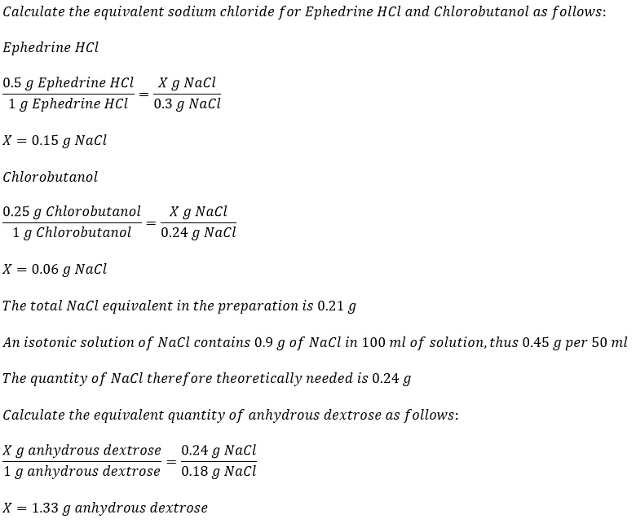
Example 4: Solution

Slide 23
Calculation: Example 5
Calculate the quantity of NaCl (g) that should be added to 150 ml of a 1% ^{w}/_{v} solution of apomorphine hydrochloride to render the solution isotonic with blood plasma.
ΔT_{f} of a 1% ^{w}/_{v} solution of the drug and NaCl is 0.08 and 0.58 °C respectively.

Slide 24
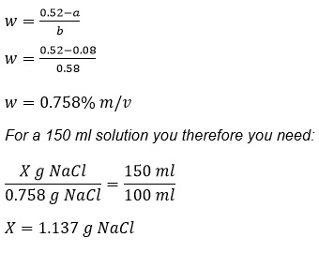
Example 5: Solution
g/100ml
Notes:
Prof Steenekamp
where W=Weight of the added substance (g/100ml);
a=Freezing point depression of the unadjusted hypotonic solution;
b=Freezing point depression of a 1% w/v solution of the adjusting substance

Slide 25
Calculation: Example 6
How many milliequivalents of potassium ion (K⁺) are there in a 250 mg penicillin V potassium tablet?
Note: Molecular weight of penicillin V is 388.48; there is one potassium ion in the molecule, and the valence of K⁺ is one.

Slide 26
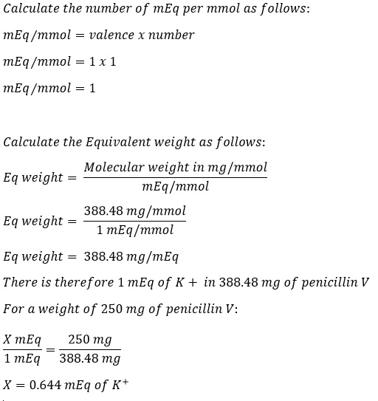
Example 6: Solution

Slide 27

Do you have any questions?

Slide 28

General Questions: (Blueprint)

Slide 29




What references can you use?
References to use:
SAMF
  MIMS / MDR
Online PDF References provided:
  EML and STG – PHC, Paediatric and Hospital.
  Good Pharmacy Practice Manual and associated Rules.
  SA Guide to Good Manufacturing Practice.
  Pharmacy Act, 53 of 1974 (consolidated).
  Medicines and Related Substances Act, 101 of 1965 (as amended).
Is it current?
Is it relevant in the SA setting?

Slide 30
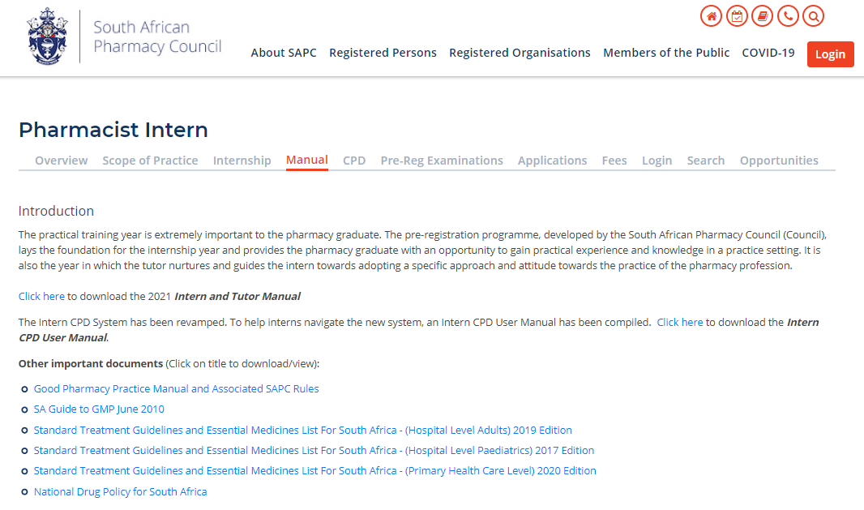

Electronic references
Notes:
Annemarie

Slide 31
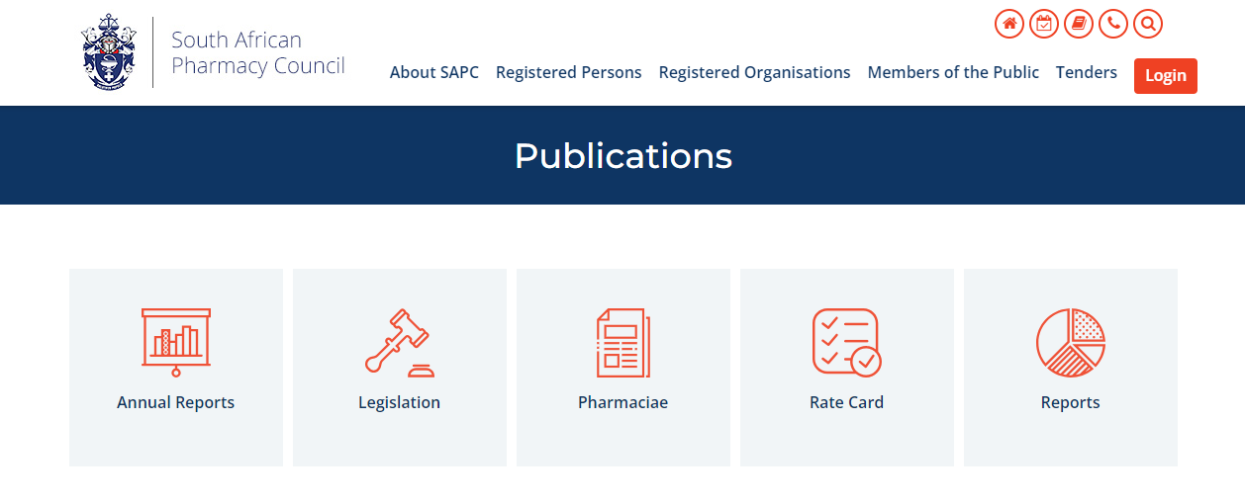
Electronic references

Slide 32
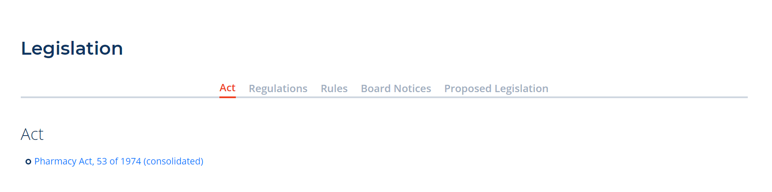
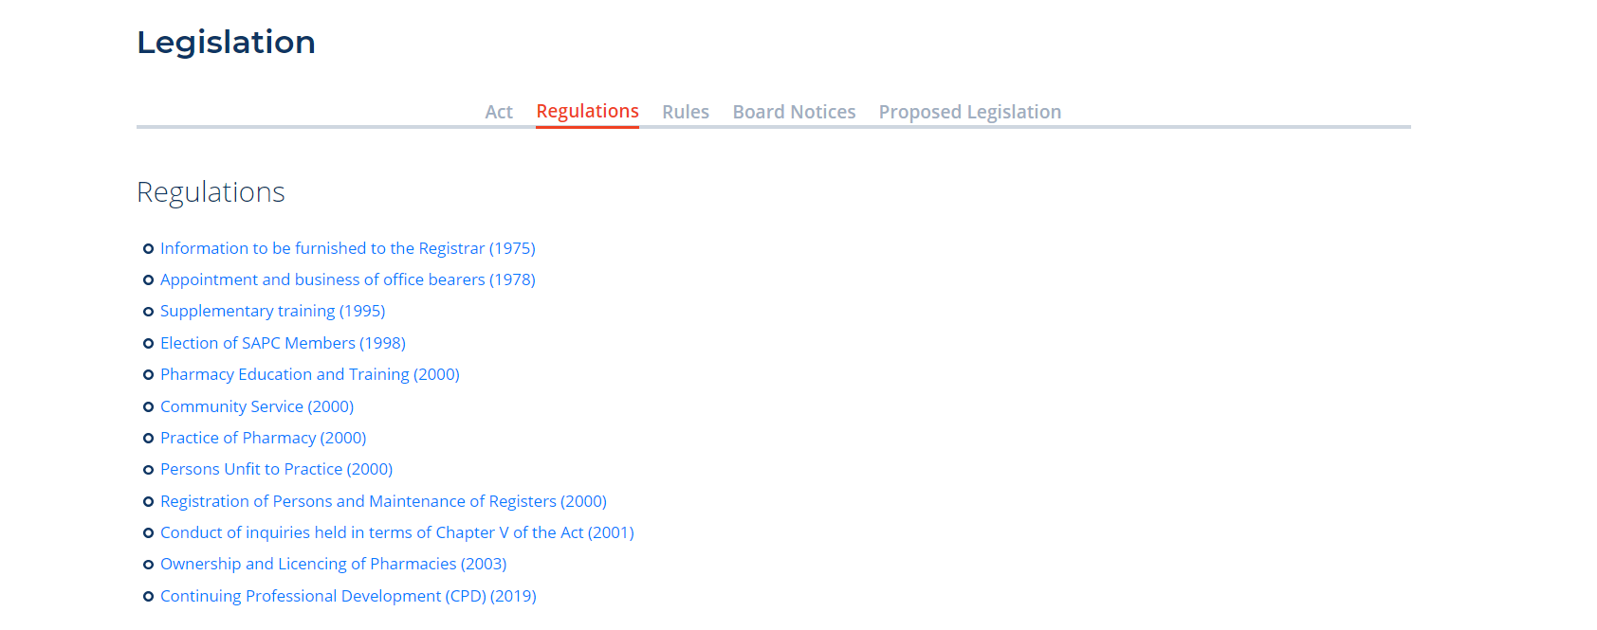
Electronic references

Slide 33
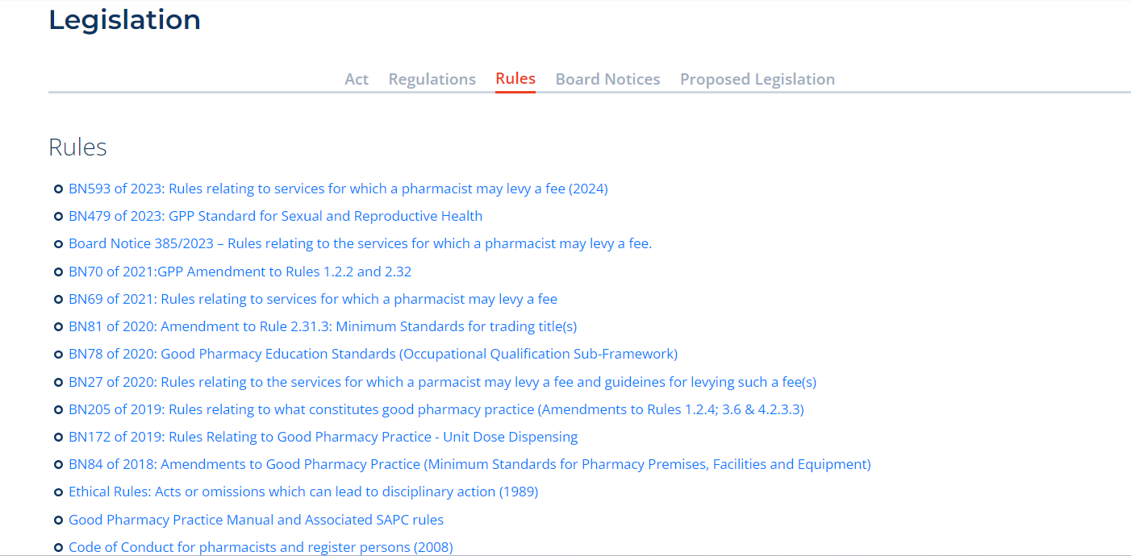
Electronic references

Slide 34
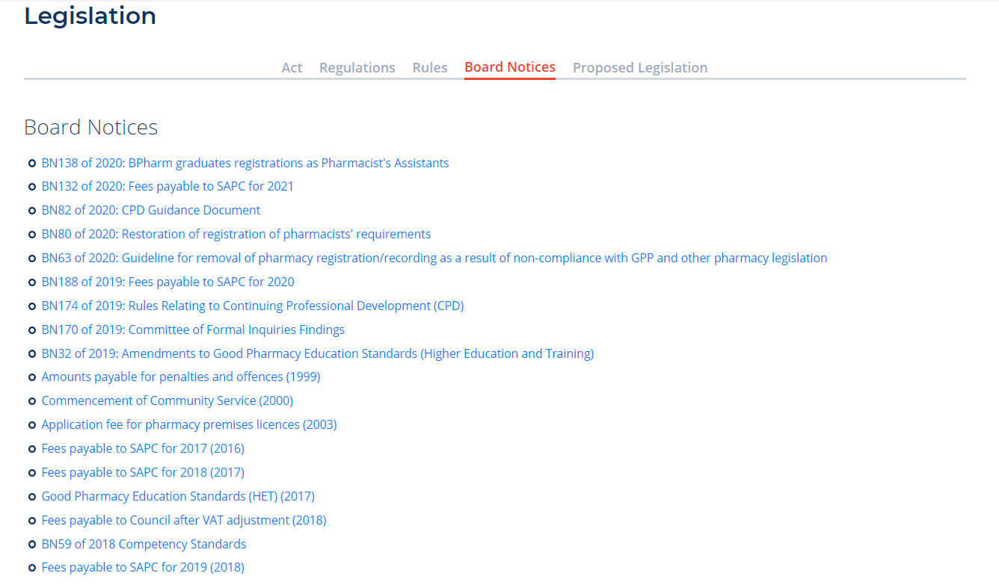
Electronic references

Slide 35


How to use the reference material?
BOOKS:
Learn how to use each reference material
  Where is the index?
  What information can I find in each reference material?
Tips:
  More is not necessarily better,
  avoid using a reference book you have never used before.
  Using notes from University may not help (information may no longer be valid).
ONLINE:
Familiarise yourself with online references.
  Download references before exam.
  Time consuming to search during exam.
Information may not correlate to recommended reference material.
Notes:
Annemarie
Resources to use for formulation questions in which the function of an excipient is asked i.e., Martindale and The Handbook of Manufacturing Excipients

Slide 36




Other useful online resources:
Can I use
apps?
Can I use a second device for resources?

Slide 37
Helpful tips:
!
  “TRUE”, “IS” and “CORRECT”
  “FALSE”, “NOT” and “INCORRECT”
  “MOST APPROPRIATE” implies that more than one answer is possible, thus select the most inclusive answer
  READ the question carefully.
  Identify the statements of which you are sure.
  Confirm (using references) the statements you are unsure of.
  If you can’t complete the question, carry on and when you have time towards the end of the exam come back to it.

Slide 38
Managing time:
Maximise your time – 150 minutes
  80 MCQs
  4 options per MCQ
  Less than 2 minutes per question.
No negative marking.
Do not leave anything blank.

Slide 39
Areas of concern:
Pharmacovigilance;
Handling of Schedule 6 medicines;
Adverse drug reactions;
Scheduling status.
In previous exams, interns have not performed well in questions relating to these topics.
It is recommended that interns revise these topics, and source relevant references to assist them in answering these questions.

Slide 40
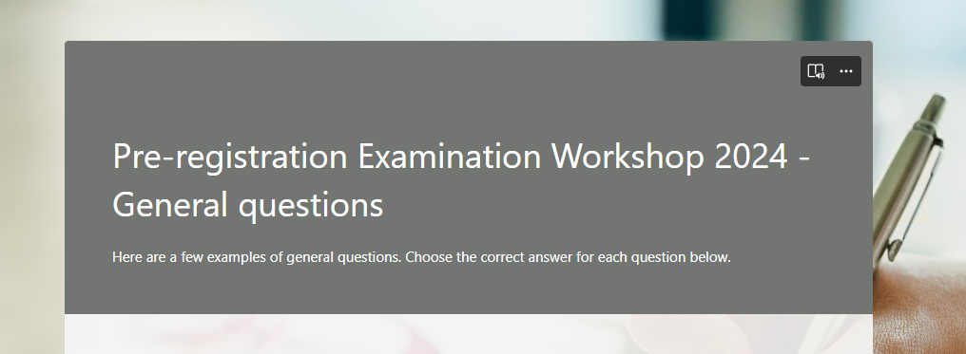

General questions examples:
https://forms.office.com/r/kKbTY2JtX4
All answers are anonymous and CANNOT be tracked back to you
Notes:
Annemarie

Slide 41
Do you have any questions?

Slide 42
Pre-registration Examinations 2024:
PRACTICE EXAMINATION | PRE-REGISTRATION EXAMINATION
30 January Wednesday | 05/06 March (Tuesday/Wednesday)
04 June (Tuesday) | 06/07 August (Tuesday/Wednesday)
10 September (Tuesday) | 22/23 October (Tuesday/Wednesday)
Practice examination may be written on any of these dates –
no entrance criteria apply.
Compulsory to write it once.

Slide 43
Who is eligible to write the examination?
First (1st) time must be in their sixth (6th) month
(completed a minimum of 5 months);
Submit six (6) CPDS & competent in three (3) submissions;
Complete the practice examination;
Tutor must have submitted the three (3) progress reports
*
Interns in the ninth (9th) month or more
(completed a minimum of 8 months)
Submit and competent in six (6) CPDS
Complete the practice examination
Tutor must have submitted four (4) progress reports
MONTHS:
MONTHS:
PLEASE NOTE:
ENTRANCE CRITERIA WILL NOT BE CHANGED IN 2024

Slide 44
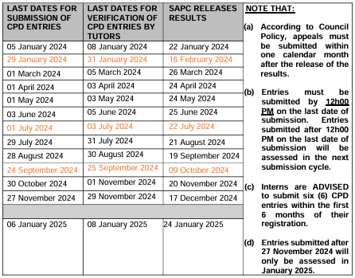
Reminder: CPDs 2024
SUBMIT WITHOUT DELAY!!

Slide 45
Booking for the examinations:
Update your details on your SAPC profile:
  Cell phone number
  Email address
  Profile picture
You will be notified via email and SMS when bookings are open.
IMPORTANT DATES:
Bookings open : | 6 weeks before the exam.
Bookings close: | 4 weeks before the exam.
Late bookings (fee applied): | 4 weeks – 14 days before exam.

Slide 46


Profile picture:
Image uploaded on SAPC need to be:
a colour image;
taken in last 6 months;
of your head and shoulders.
PLEASE NOTE:
Profile picture is used by the invigilator to verify identity of candidate writing the exam.

Slide 47
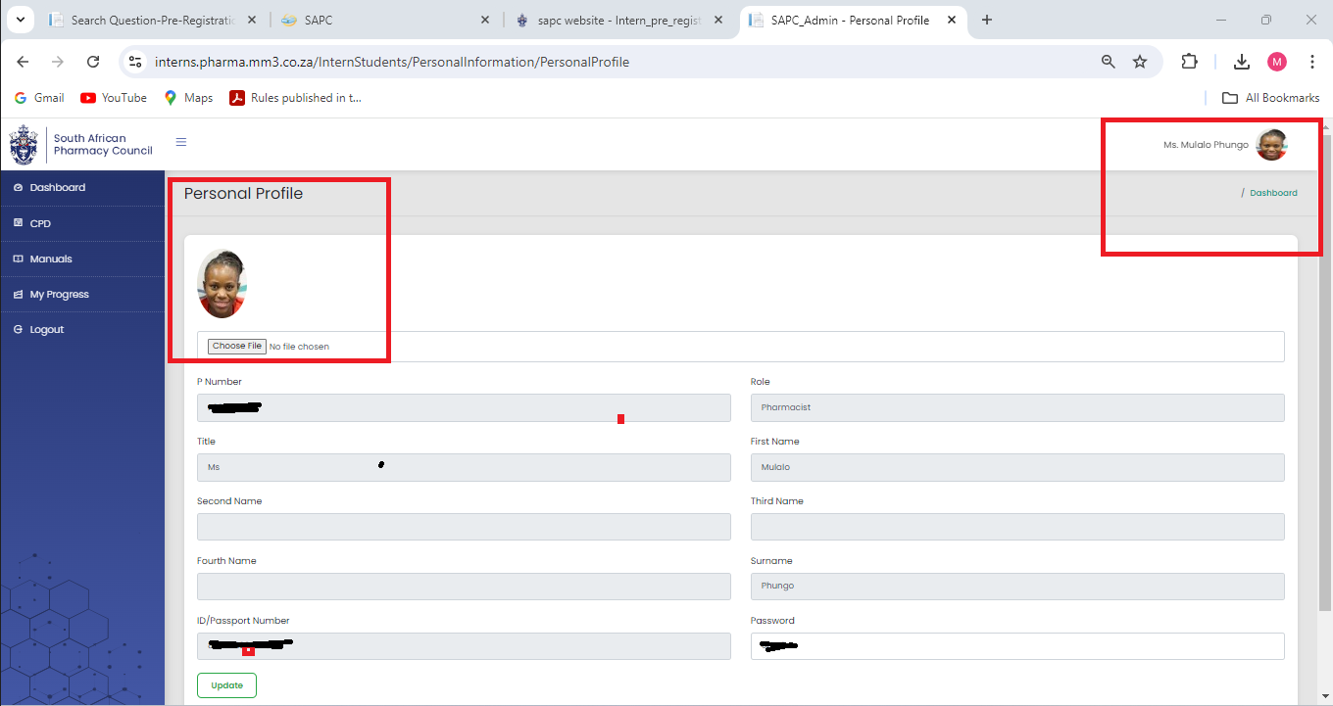


Slide 48
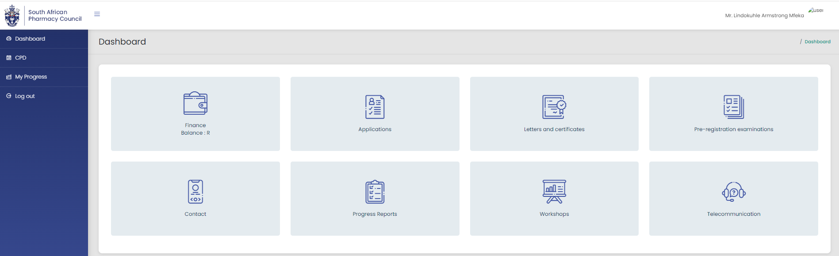
Examination booking

Slide 49
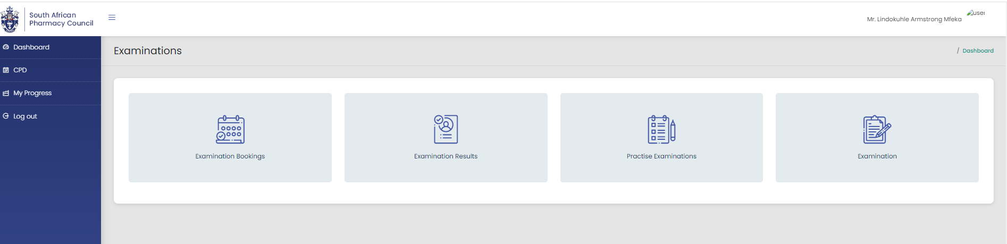
Examination booking (cont.):
Notes:
Mulalo

Slide 50
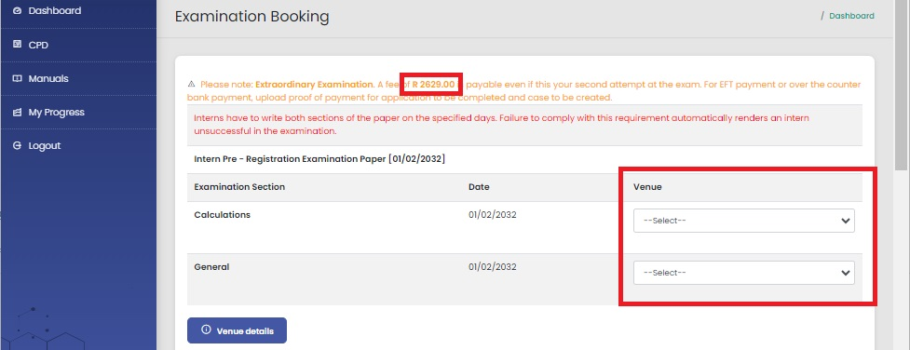
Examination booking (cont.)

Slide 51
Remote examination
RESIDENCE
SAPC
WORK PLACE
Select venue when for booking

Slide 52

Which device will I need?
What will I need during the exam?
How will I communicate with SAPC?

Slide 53





Remote examination:
Find a quiet suitable workplace.
Enough space for device and references.
Keep calm
Communicate with your remote invigilator if you are experiencing any difficulty.
Download electronic references before the examination date.
Ensure you have the equipment you will need,
(i.e. calculator, paper for working out calculations).

Slide 54








Device and connectivity:
SUGGESTED
DEVICES
OR
AND
DEVICE MUST HAVE A CAMERA OR A LINKED CAMERA WITH VIDEO CAPABILITIES.
CONNECTIVITY (MINIMUM 3G).
BROWSERS.

Slide 55
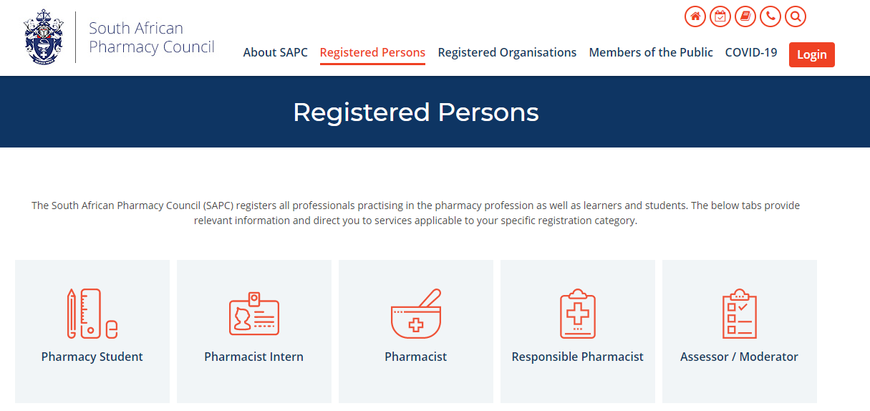
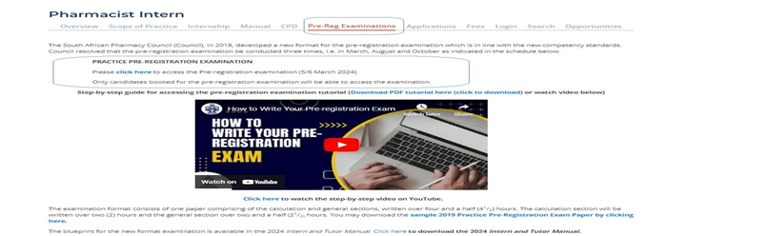
Where do you find the examination?
https://www.sapc.za.org/

Slide 56




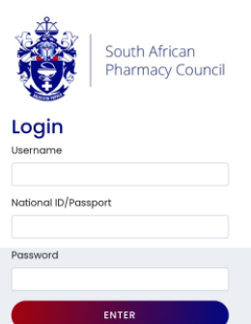
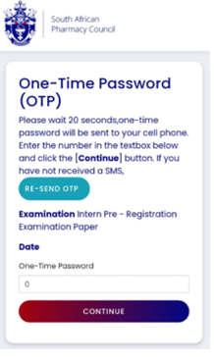
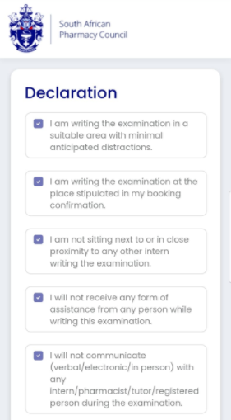

Examination Platform Overview:
Same as SAPC secure site
P number
ID number
Password
Cell number and email on register system

Slide 57




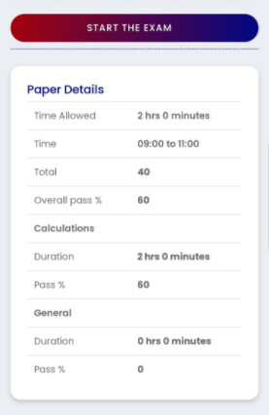
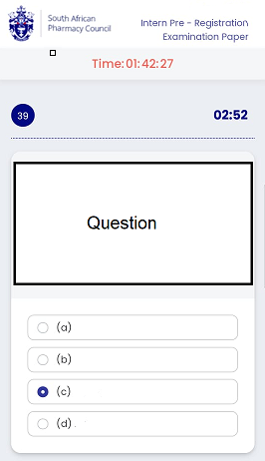
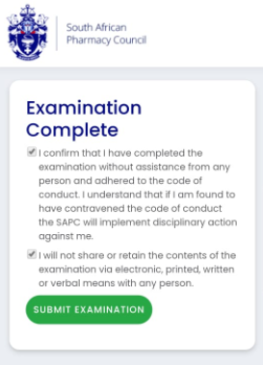
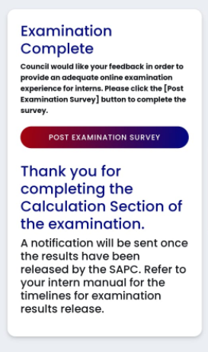
Examination Platform Overview:

Slide 58
STEPS TO LOGIN AND ACCESS THE EXAMINATION PLATFORM ON THE SAPC WEBSITE:

Slide 59
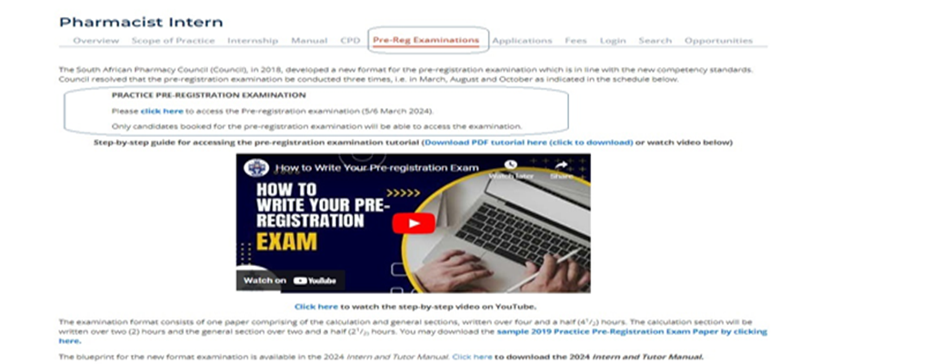
Step 1: Log into the SAPC website:
Preferably use the following browsers; Google Chrome/Firefox/Microsoft Edge.
The examination can be accessed on the SAPC website under Registered persons → Pharmacist Intern → Pre-registrations.
Alternatively use the below URL to connect: https://www.sapc.za.org/Intern_pre_registration

Slide 60
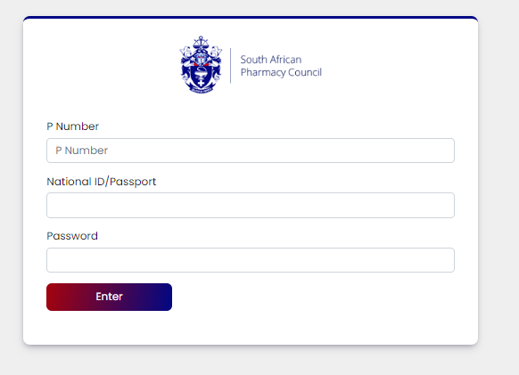
Step 2: Insert your login credentials:

Slide 61
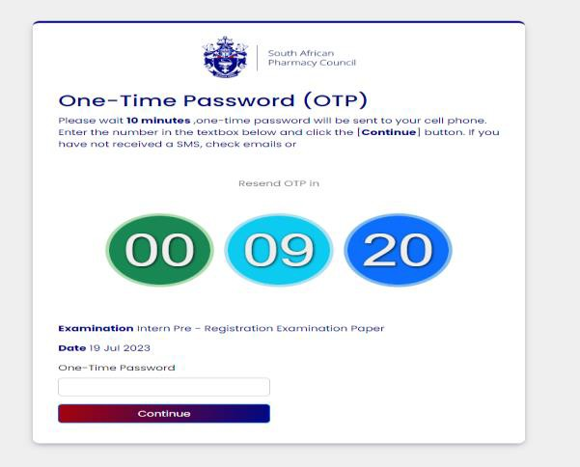
Step 3: Insert your OTP:
The OTP will be sent as an SMS to your cell phone, and also via Email and will be valid for 10 minutes, if unused. A new OTP will be generated for each login.

Slide 62
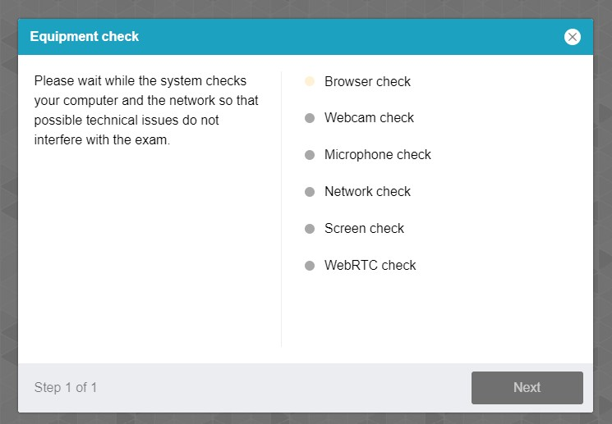
Step 4: Equipment check:
The examination platform will conduct an equipment check to ensure your device is compatible to the examination platform.
Use the following link: https://proctoredu.com/check to test the compatibility of your laptop/desktop

Slide 63
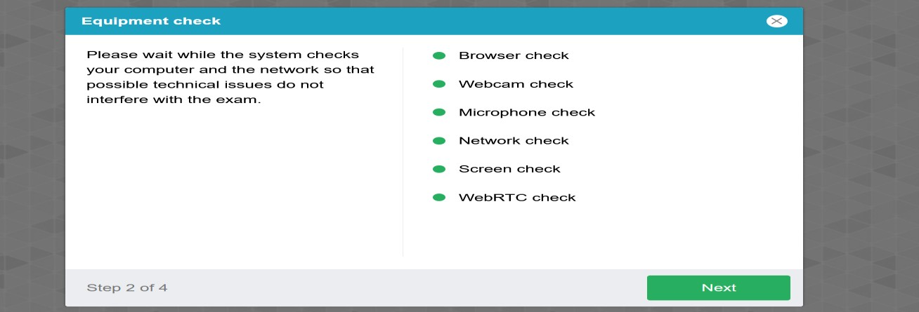
Step 5: Equipment check successfully completed:

Slide 64
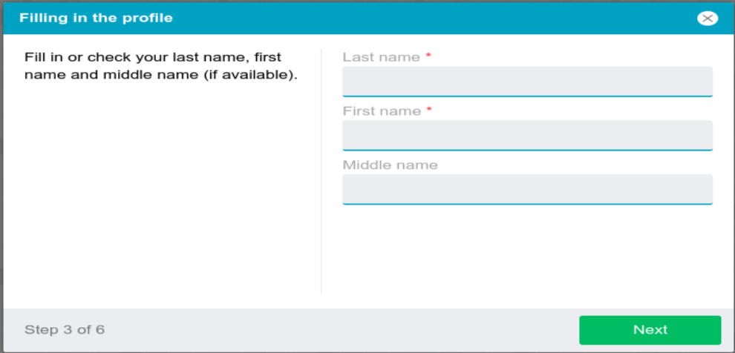
Step 6: Profile check:
Click on NEXT when profile check is completed.

Slide 65
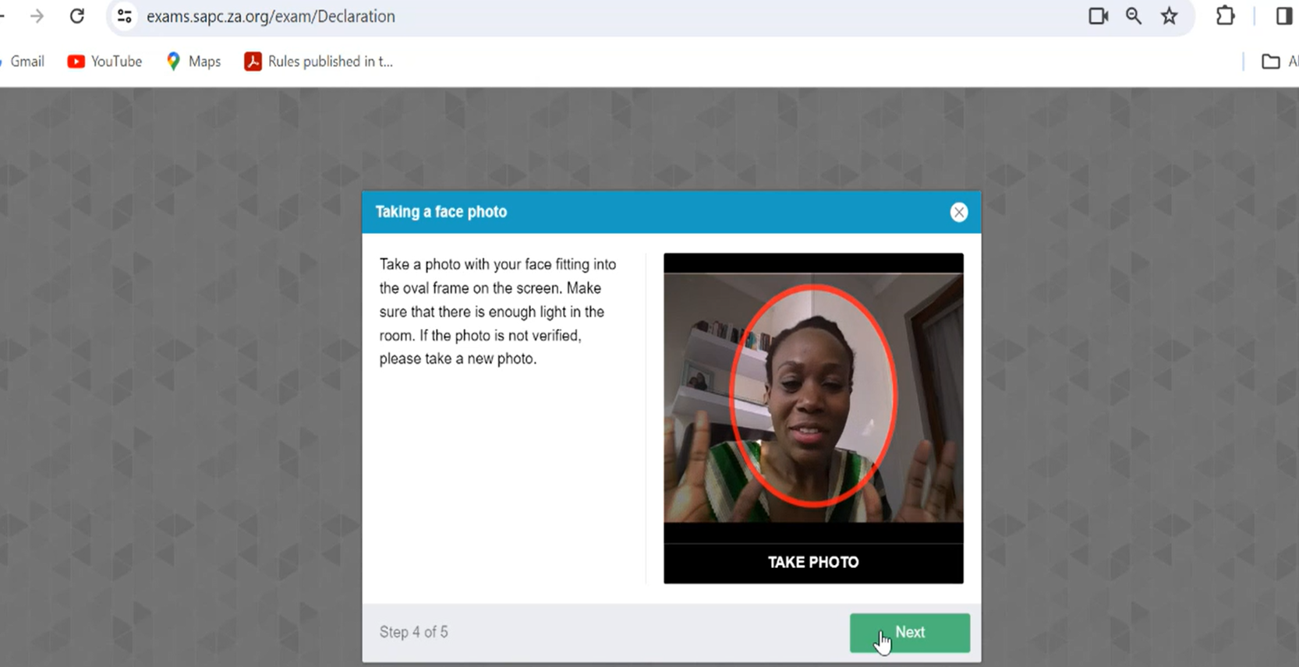
Step 7: verification of the picture:
Click on NEXT if satisfied with the photo

Slide 66
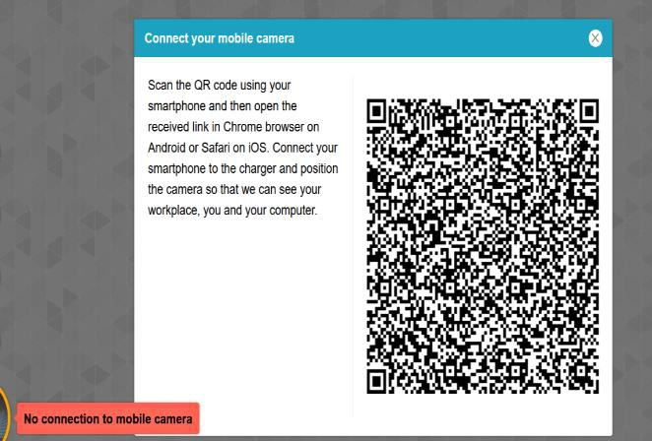
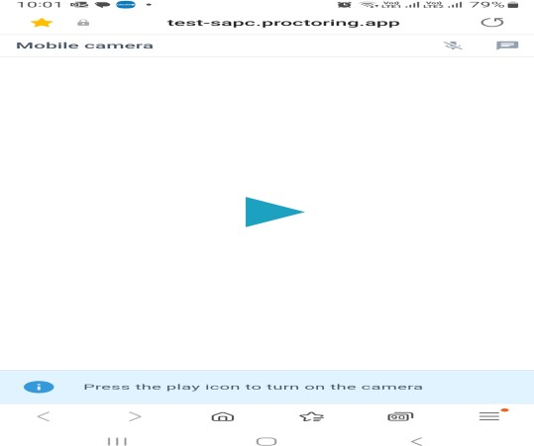
Step 8: Scanning of the QR code
Use a smartphone to scan the QR code to connect the phone to the examination platform for a better view of your workspace and examination room. Click on the play button to and record a short video of your room surroundings.

Slide 67
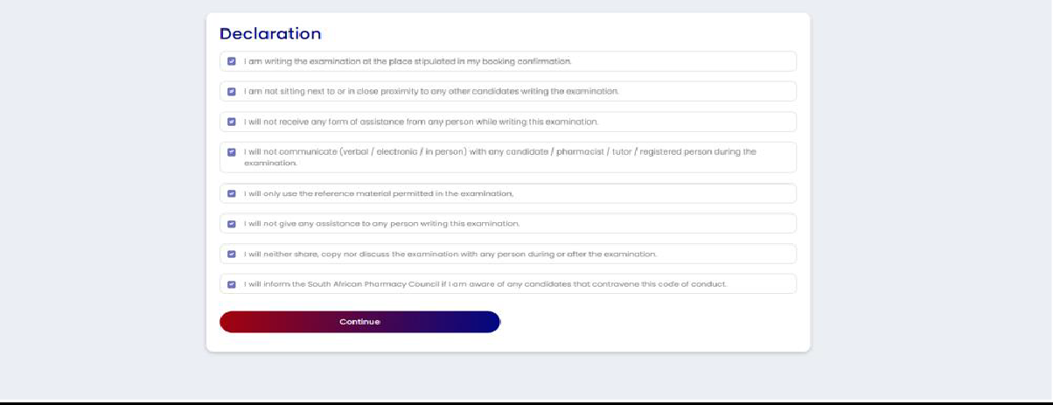
Step 9: Complete the examination declaration prior to starting exam

Slide 68
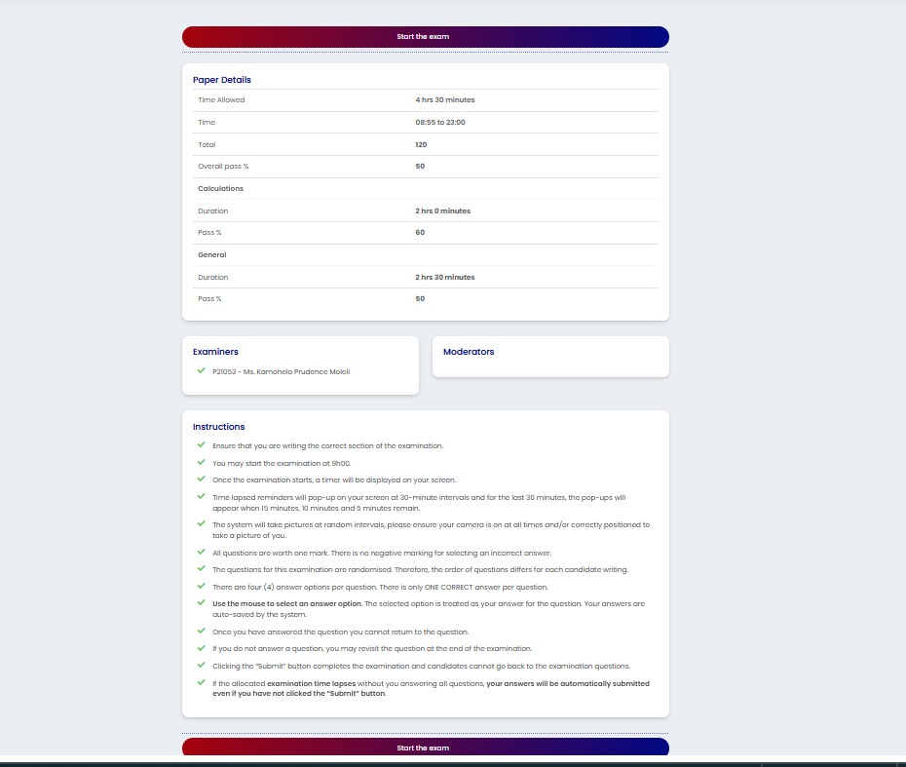
Step 10: Read the examination instructions:
Only click on “start the examination” at 09h00 when the examination is scheduled to start. SAPC will communicate if there are any delays in starting the examination.

Slide 69


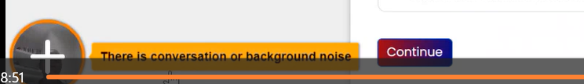
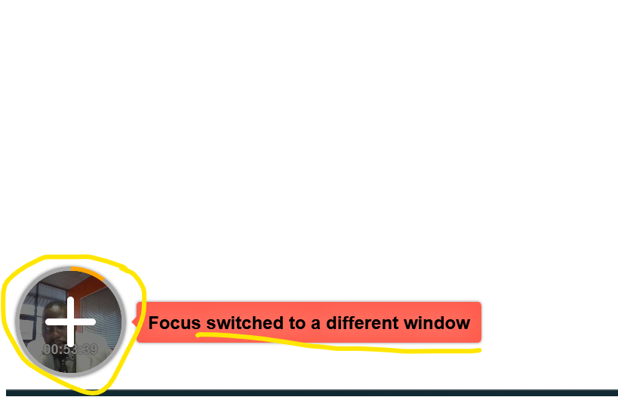
VIOLATION DURING EXAMINATION
Any action undertaken by the candidate to gain unfair academic advantage.
This may include cheating/copying and possession of unauthorised materials
Google to access approved online reference material

Slide 70
Invigilator contacting candidate before start of exam:
Keep your cell phone next to you, ensure that fully charged and you have data.
The invigilator may call or send you a message on the cell phone number you have provided to SAPC.

Slide 71
Exam
Day 1
08h00
Login to the SAPC website & enter one-time pin (sent to your cell phone), to enter the examination
  Complete the declaration
  Read the examination rules;
Examination commences (remote invigilator)
  The exam will be invigilated through remote proctoring system which will have a continuous video feed, and images will be taken throughout the exam.
  Examination ends.
09h00
11h00

Slide 72
Exam
Day 2
08h00
Login to the SAPC website & enter on-time pin (sent to your cell phone) to enter the examination;
  Complete the declaration
  Read the examination rules
Examination commences (remote invigilator) ;
  The exam will be invigilated through remote proctoring system which will have a continuous video feed, and images will be taken throughout the exam
Examination ends
  Complete the post-examination survey.
09h00
11h30

Slide 73

FAQs
Where can I get help during the exam?
Chat function:
  Type your question in the chat function.
  Your invigilator will respond via the chat.
WhatsApp:
  Send a message to the Pre-reg exam WhatsApp line.
  Keep calm invigilator will respond to your message (give him/her a few minutes to respond).

Slide 74
FQAs
What to do if you experience load shedding / loss in electricity?
Keep calm;
Check your load shedding schedule and make an alternate plan;
Ensure laptop is fully charged before the examination;
Ensure alternative Wi-Fi connection (if you are using a fibre connection);
If you are unable to find an alternate Wi-Fi connection, or if you need to be connected to power supply please find an alternative venue, (may not be in a car);
NB! Notify us via the WhatsApp number.
If load shedding happens in the middle of the exam, your work will be saved.
Interns on not successful after their 1st attempt are encouraged to try a different booking venue with the SAPC venue as their first option if affected by connectivity

Slide 75
FAQs
What should I do if my invigilator notifies me that they cannot see me during the exam?
Scan the QR code again to ensure your smartphone is connected to the exam platform.

Slide 76
FAQs
What should I if I need to change exam venues?
All changes to booking venue are to be communicated by email to SAPC.

Slide 77
FAQs
What should I do if disconnected and on login back a pop-up message “ This page was opened elsewhere”?
Close all browsers to login again.

Slide 78
FAQs:
Where should I sit for the exam?
Ensure there is sufficient lighting (for example close curtains or blinds if sitting in front of a window);
Test the lighting beforehand (take a selfie of yourself);
Ensure the camera on your device and cell phone are working;
Dress appropriately – videos and images taken form part of your permanent record;
If the invigilator cannot see you, they will communicate this to you via the chat function.

Slide 79
Examination format:
ONE QUESTION PER PAGE:
  Cannot select which questions to answer first;
RANDOMISATION OF QUESTIONS.
TIMED EXAMINATION.
CANNOT REVISIT ANY QUESTION THAT HAS BEEN ANSWERED.
UNANSWERED QUESTIONS MAY BE REVISITED AT THE END OF THE EXAMINATION.

Slide 80
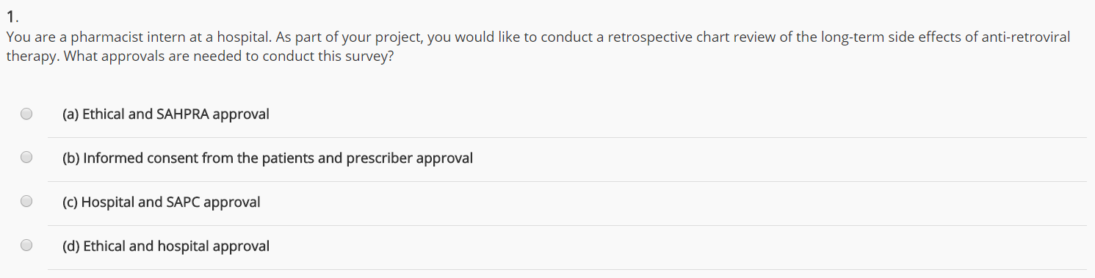
Single best answer
Multiple choice questions:
QUESTION
ANSWER
OPTIONS

Slide 81
FAQs:
How do I submit the examination ?
Your answers are saved as you proceed through the exam. If you lose the WI-FI signal at any time your answers are saved.
Each answer is time-stamped and recorded on the examination platform.
You may only revisit unanswered questions at the end of the exam.
Once you press submit, you will no longer have access to ANY questions.

Slide 82
Declaration for the online/remote exam:
END OF EXAMINATION:
I confirm that I have completed the examination without assistance from any person and adhered to the Examination Code of Conduct. I understand that if it is found that I have contravened the Examination Code of Conduct, the SAPC will implement disciplinary action against me in terms of Chapter V of the Pharmacy Act.
I will not/ have not shared or retained the contents of the examination via electronic, printed, written or verbal means with any person.

Slide 83
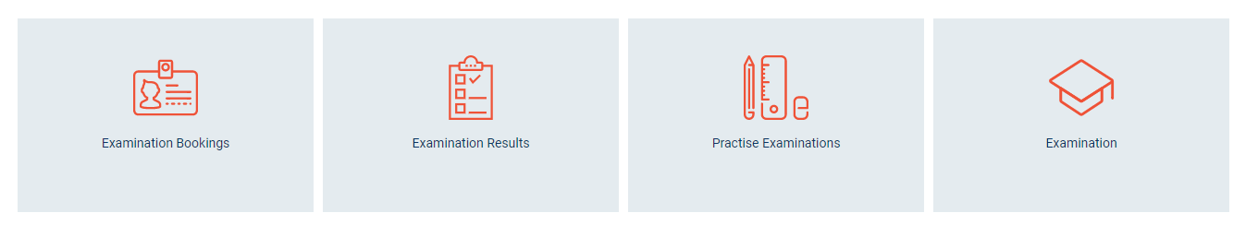
FAQs
When will you receive your results?
Can you view your exam paper?
Can my examination be remarked?
Examination results will be released once the results have been moderated and approved by the Registrar.
Results will be available online.
How to appeal examination results?
You may apply online to review your examination (complete an application form and pay the applicable fee). You will be allowed to view the exam question and the answer you provided. The correct answer will be indicated. You may ask the facilitator for the reference or the steps to the calculation. You are permitted to make notes, however you may not take a copy or photos of the examination.
You may not apply for a remark. The results have been checked and verified before release.
You may submit an appeal against the exam results in writing to Council within 30 days after the results are released.

Slide 84
FAQs
When will you receive your results?
Can you view your exam paper?
Can my examination be remarked?
The exam results will be released once the results have been analysed and verified. This may take some time.
You may apply to review your examination (complete an application form and pay the applicable fee). You will be allowed to view the exam question and the answer you provided. The correct answer will be indicated. You may ask the facilitator for the reference or the steps to the calculation. You are permitted to make notes, however you may not take a copy or photos of the examination.
You may not apply for a remark. The results have been checked and verified before release.

Slide 85
FAQs
What happens if I am unsuccessful at the examination?
ENTRANCE CRITERIA
You may rewrite the examination at the next sitting.
It is compulsory to re-write BOTH sections of the exam, regardless of whether you passed one section previously or not.
Submit AND competent in six (6) CPDS
Complete the practice examination
The tutor must have submitted the relevant progress reports according to the intern’s date of registration.

Slide 86
FAQs:
How is my internship evaluated?
Pre-registration Examination
CPD Portfolio
Progress reports
365 days of supervised practice

Slide 87
ONLINE OPEN BOOK EXAMINATION:
120 questions
1 mark each
NO negative marking
General practice: ± 70%
Calculations: ± 30%
PASS MARK:
General questions = 50%
Calculations = 60%
SIX CPD ENTRIES:
One outcome per Domain
ASSESSMENT:
Results released two months from submission deadline
Results for entries submitted after deadline will be released 2 months from the subsequent submission deadline
RESUBMIT all entries ‘not yet successful’
PROOF OF COMPETENCE
Competent in 6 entries
INSTITUTIONAL / COMMUNITY
Submit 7 progress reports
MANUFACTURING
Submit 9 progress reports
Declaration 400hrs
ACADEMIA
Submit 3 progress reports
Declaration 400hrs
Achievement of Masters Qualification
PROOF OF COMPETENCE
Favourable reports from tutor
PROCTORING

Slide 88
FAQs:
Am I behaving in a professional and ethical manner?
Moving pharmacies for more pay ;
Moving pharmacies for better hours.
The pharmacy has invested in you and your internship;
You have taken an internship position that someone else could possibly have had.
Is the grass ALWAYS greener on the other side??

Slide 89
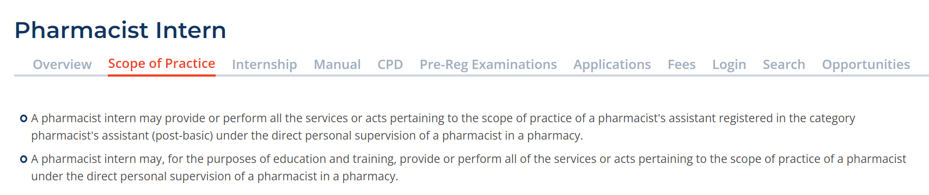
FAQs
Can I locum as a Post-Basic Pharmacist’s Assistant?
Pharmacist Interns may locum, including academic interns.
Refer to the scope of practice for Pharmacist Interns as provided for in legislation.
Pharmacist Interns cannot be provided with a certificate stating that they are registered as a Post-Basic Pharmacist’s Assistant.

Slide 90
FAQs:
Am I registered as a Post-Basic Pharmacist’s Assistant when completing my 400 hours as an academic intern?
Pharmacist Interns have the SAME scope of practice regardless of their sector of registration.
Refer to the scope of practice for Pharmacist Interns as provided for in legislation.
Academic interns completing their 400 hours may perform all of the services or acts pertaining to the scope of practice of a PHARMACIST under the direct supervision of a pharmacist while working in a community and/or hospital pharmacy.

Slide 91
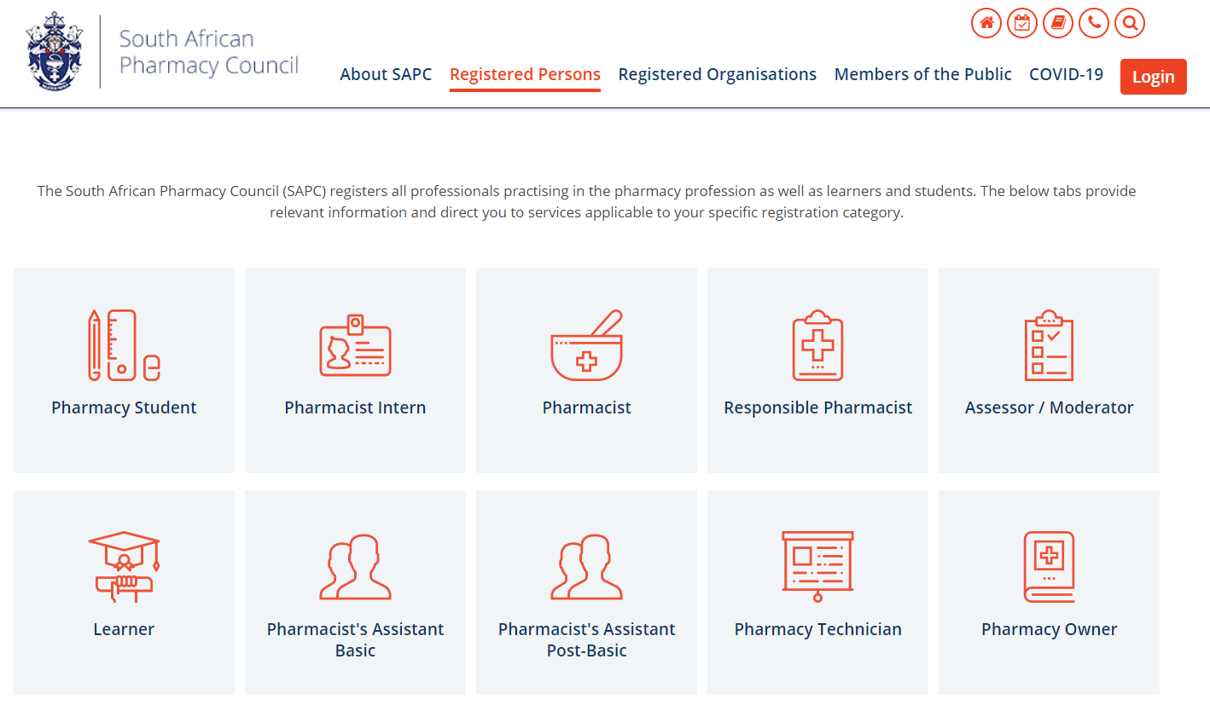
Where to find CSP information on the SAPC website?

Slide 92
Join us for the CSP workshop in October 2024:
Interns are to apply online for community service on https://icspinfo.dhmis.org/
The ICSP will facilitate placement of interns who have met all internship requirements for community service.
Ensure that you meet the requirements.
Further information to follow in the CSP workshop.
https://www.health.gov.za/icsp/

Slide 93
Applying for Community Service:
Interns are to apply online for community service on https://icspinfo.dhmis.org/
The ICSP will facilitate placement of interns who have met all internship requirements for community service.
Ensure that you meet the requirements.
Further information to follow in the CSP workshop.

Slide 94
Do you have any questions?

Slide 95







CONTACT US:
086 172 7200
customercare@sapc.za.org
@OfficialSAPC
www.sapc.za.org
591 Belvedere Street,
Arcadia,
Pretoria
Notes:
Mulalo

Slide 96

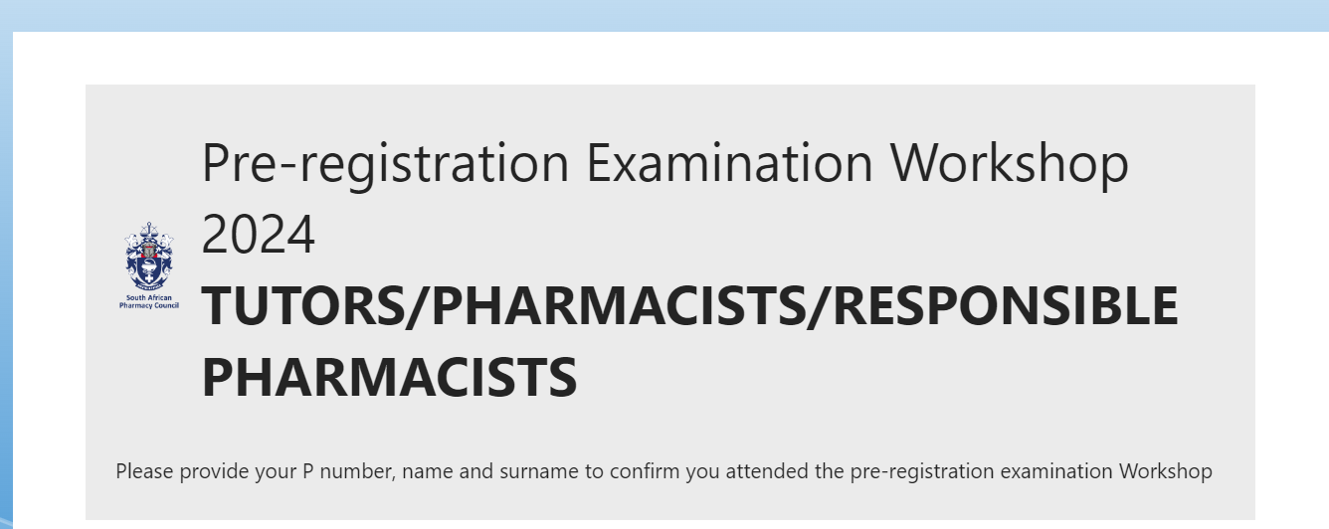
We value your feedback:
COMPULSORY
https://forms.office.com/r/i3nWCLcLKt
https://forms.office.com/r/SnwabrZbE7

