Slide 1
Pharmacy Support Personnel: Pharmacist’s Assistant (Basic) External Integrated Summative Assessment (EISA) Online Workshop, 05 February 2026
PSP

Slide 2
FORMAT OF THE WORKSHOP
Format and content of the examination
Preparing for calculation questions
Preparing for general questions
Examples of calculation questions
Examples of general questions
Remote online examination/assessment
Navigating the Website

Slide 3





FORMAT OF THE EISA EXAMINATION FOR PHARMACIST’S ASSISTANT (BASIC)
Exam
Open book online examination 100 multiple choice questions (MCQs) Overall pass mark 50% No negative marking 3 hours 30 min | 16% Calculation MCQs 16 MCQs Subminimum of 50% | 84% General MCQs 84 MCQs Subminimum of 50%

Slide 4
Community
Manufacturing
Wholesale
Institutional
QUESTIONS ARE RELATED TO EXIT LEVEL OUTCOMES AND BASED ON TASKS TO BE PERFORMED BY CANDIDATES IN COMMUNITY, INSTITUTIONAL, MANUFACTURING AND WHOLESALE SECTORS

Slide 5
EXAM CONTENT: EXIT LEVEL OUTCOMES
ELO 1
ELO 2
ELO 3
ELO 4
Apply basic scientific knowledge to provide technical support in delivering pharmaceutical services
Provide technical support for the receiving, storing, picking, packing and distributing of orders. To perform stock counts and participate in stock-taking in compliance with cGMP, GWDP and GPP requirements
Provide technical support for the manufacture, packaging and re-packaging of non-sterile medicines and scheduled substances in compliance with GMP guidelines under the supervision of a pharmacist
Provide technical support for the compounding, manipulation and preparation of non-sterile medicines and scheduled substances (extemporaneous compounding) in compliance with standards as described in the GPP rules and GMP guidelines under the supervision of a pharmacist

Slide 6
WHAT IS THE EXAM BASED ON?

Slide 7



ELO 1
BASIC- 40%
Candidates should be able to:
Apply legislation related to the relevant scope of practice in pharmaceutical services in the South African context
Demonstrate ethical and professional conduct related to the relevant scope of practice in the provision of pharmaceutical technical support services
Apply basic pharmaceutical terms and concepts concerning non-sterile drug delivery systems and their routes of administration
Apply basic scientific principles and perform basic scientific calculations

Slide 8


ELO 2
BASIC- 25%
Candidates should be able to:
Conduct distribution and control of the stock of medicines, scheduled substances, and medical devices according to SOPs, and per cGMP, GPP and GWDP
Pick, pack and secure orders for medicines or scheduled substances according to all requirements and check that orders are dispatched according to SOPs
Complete documents and maintain records following applicable legislation and SOPs
Participate in stock counts

Slide 9

ELO 3
BASIC- 15%
Candidates should be able to:
Apply pharmaceutical and cGMP principles and legislative requirements in the manufacture, packaging and/or repackaging of non-sterile medicines and scheduled substances
Organise and prepare resources, materials and equipment for the preparation of specific medicines following relevant SOPs and process documentation
Handle materials with due regard for environmental and storage conditions, transport and security requirements
Participate in manufacturing processes for non-sterile medicines and scheduled substances
Pack and re-package medicines and scheduled substances following GMP, ethical principles, relevant legislation, process documentation and SOPs, and authorised by a pharmacist
Complete all documents and maintain records following cGMP guidelines

Slide 10

ELO 4:
BASIC- 20%
Candidates should be able to:
Apply principles of GPP concerning the compounding of non-sterile medicines and substances
Compound a simple solution, suspension and semi-solid following instructions (formulas), relevant SOPs and process documentation, using the principles of cGMP and/or GPP for specific patients
Complete records for each of the preparations produced following legal requirements and organisational policies and procedures
Check and clean equipment, according to SOPs
Perform housekeeping activities according to SOPs
Operate personal computer to generate documents and spreadsheets

Slide 11




TYPES OF QUESTIONS
Analysis, Synthesis and Evaluation
Application
Knowledge and Comprehension

Slide 12
PREPARATIONS
Admin
Prepare
How can I prepare?
Which references do I need?
Exam
How does the online exam work?
How long is the exam?
What do I need to bring?
How do I use the references?
When (date and time) is the exam?
Where (venue/remote) is the exam?
What resources do I need?

Slide 13

TIPS FOR PREPARATIONS
Use the latest reference material
Check the current events (pandemics/epidemics) locally/globally
Keep abreast with the latest developments/ information
Course notes may be irrelevant (check if info is still valid)
Familiarise yourself with each reference material (index/topic)
Never use reference material that you have not used before
Learn from your work environment (SOPs)
Ask for assistance from your colleagues / supervisors

Slide 14

CALCULATION QUESTIONS (BLUEPRINT)
Distribution of calculation questions according to ELOs

Slide 15
TYPES OF CALCULATION QUESTIONS
ELO 1: Basic scientific principles
Basic conversions
ELO 2: Stock management
Stock consumption
Reconciliation calculations in stock management
Cost (value) of stock
ELO 4: Compounding, manipulation and preparation (extemporaneous compounding)
Calculate quantities of ingredients according to a formula to prepare an extemporaneous formulation
Reconciliation calculations in repackaging operations

Slide 16
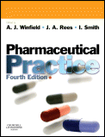
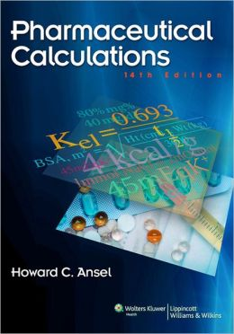
RECOMMENDED TEXTBOOKS FOR CALCULATIONS
Pharmaceutical Calculations
H. C. Ansel
Calculations for Pharmaceutical Practice
A. J. Winfield & I.O. Edafiogho 4th Edition
Pharmaceutical Practice
A. J. Winfield, J.A. Rees & I. Smith
Note:
*Text books are of more value before the exam than during the exam. BE MINDFUL OF TIME
*Not all calculation types in these textbooks may be applicable to the examination you will be writing.

Slide 17

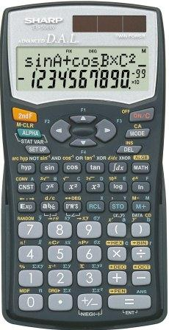
CALCULATIONS TIPS & ADVICE
Tips
Understand the principle, do not memorise the calculation
Units
What are the SI units?
Example: % ^{w}/_{v} = g/100ml
Equipment
Scientific calculator
Use same one to practice as you will use in the exam
Check batteries
Know the settings of your calculator
Paper & pens
Notes:
Examiner / Moderator

Slide 18
CALCULATIONS TIPS
Select the correct formula
Transcribing - Double check against the question that you have used the correct figures in your formula
If possible, estimate a range for your answer
Always double check your calculation
Notes:
Examiner / Moderator

Slide 19
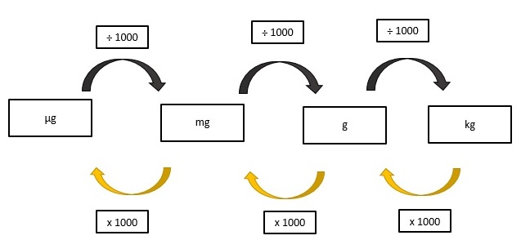
CALCULATIONS TIPS
Tip:
Practice converting between units
Notes:
Examiner / Moderator

Slide 20
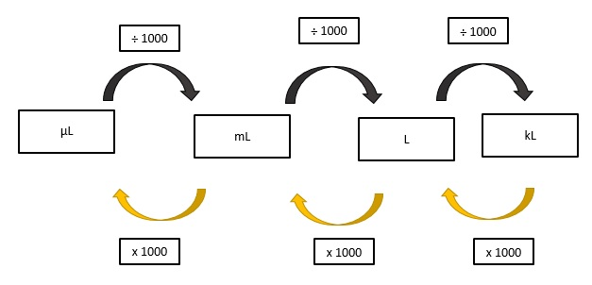
CALCULATIONS TIPS
Tip:
Practice converting between units
Notes:
Examiner / Moderator

Slide 21

CALCULATIONS TIPS
Managing time
Maximising your time:
- 42 minutes
- 16 MCQs
- Approximately 2.6 minutes per question
No negative marking
Do not leave anything blank

Slide 22

CALCULATIONS EXAMPLES
https://forms.office.com/r/fijFBJRmkM

Slide 23


Time for a quick break

Slide 24

GENERAL QUESTIONS (BLUEPRINT)
Distribution of general questions according to ELOs

Slide 25




REFERENCE MATERIALS
You are permitted to use:
Books
PDF copies downloaded and/or printed
Online references
Ensure that the reference you are using is-
applicable to the South African setting; and
provides up to date information

Slide 26






WHAT REFERENCES CAN YOU USE?
Consider using online App’s such as-
Online PDF References provided:
EML and STG – PHC, Paediatric and Hospital
Good Pharmacy Practice Manual and associated Rules
SA Guide to Good Manufacturing Practice
Pharmacy Act, 53 of 1974 (consolidated)
Medicines and Related Substances Act, 101 of 1965 (as amended)
Is it current?
Notes:
Examiner / Moderator

Slide 27
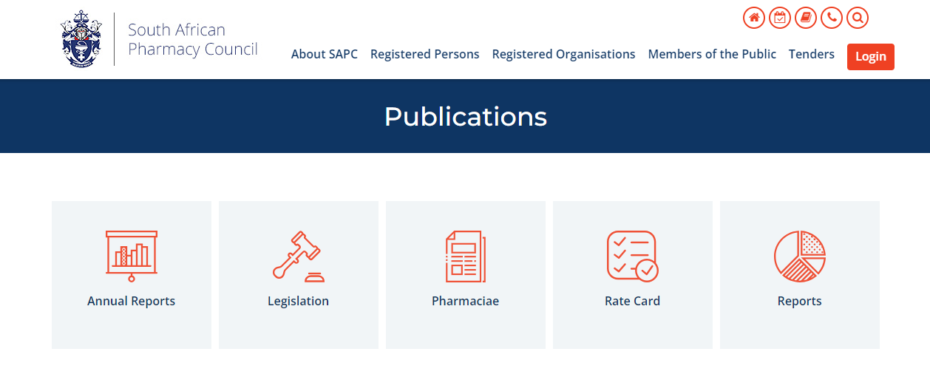
ELECTRONIC REFERENCES

Slide 28
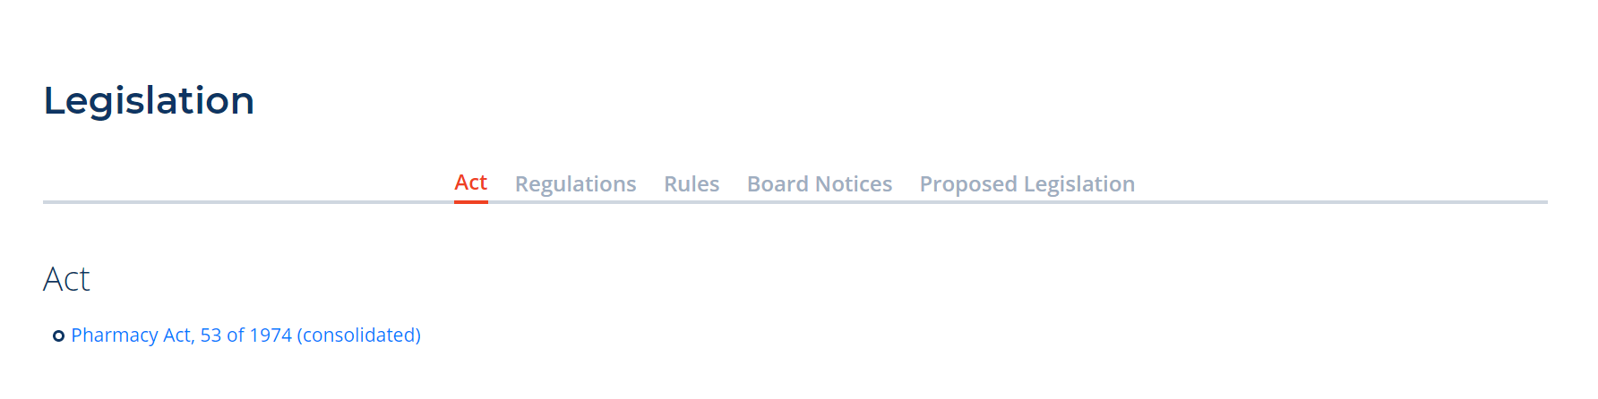

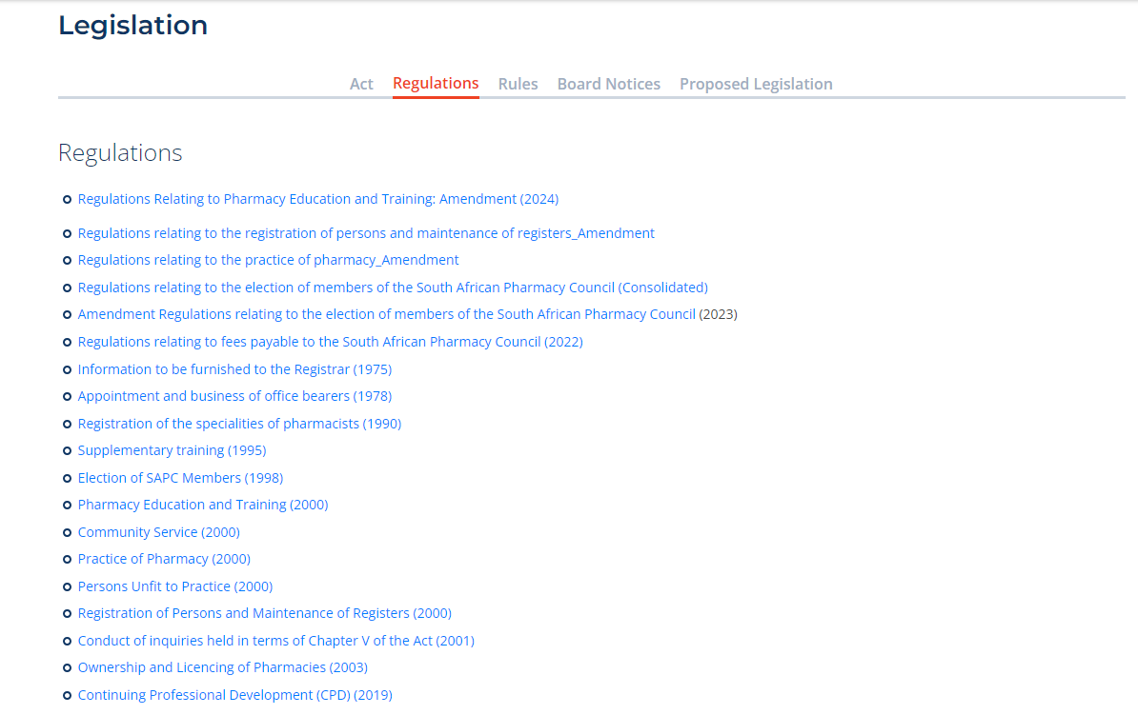
ELECTRONIC REFERENCES

Slide 29
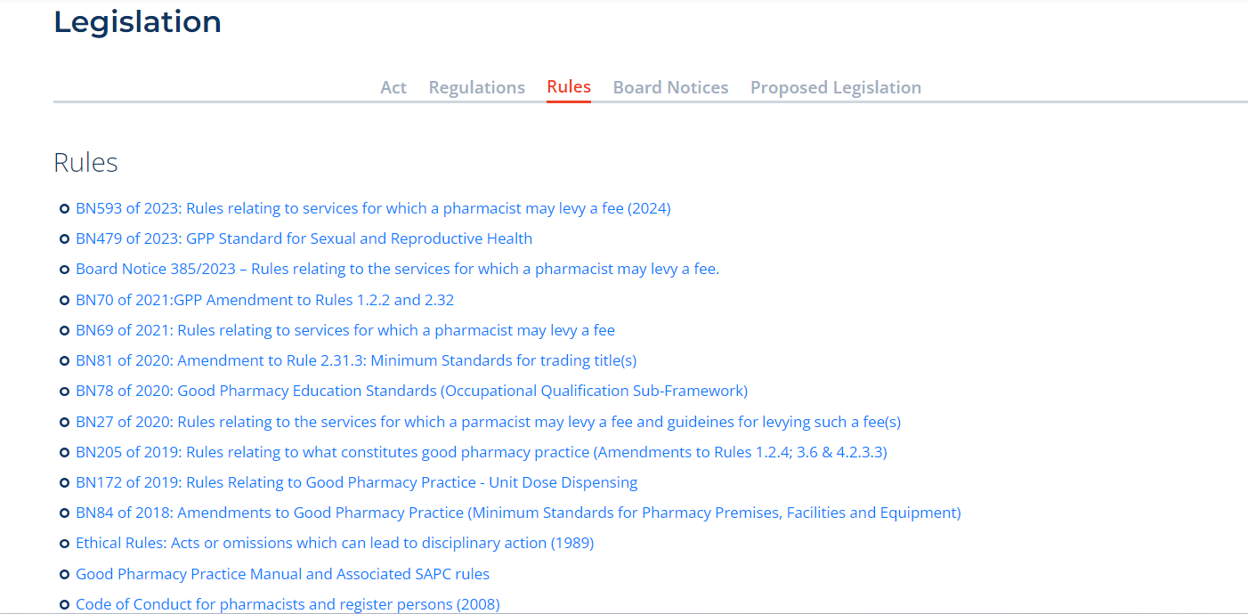
ELECTRONIC REFERENCES

Slide 30
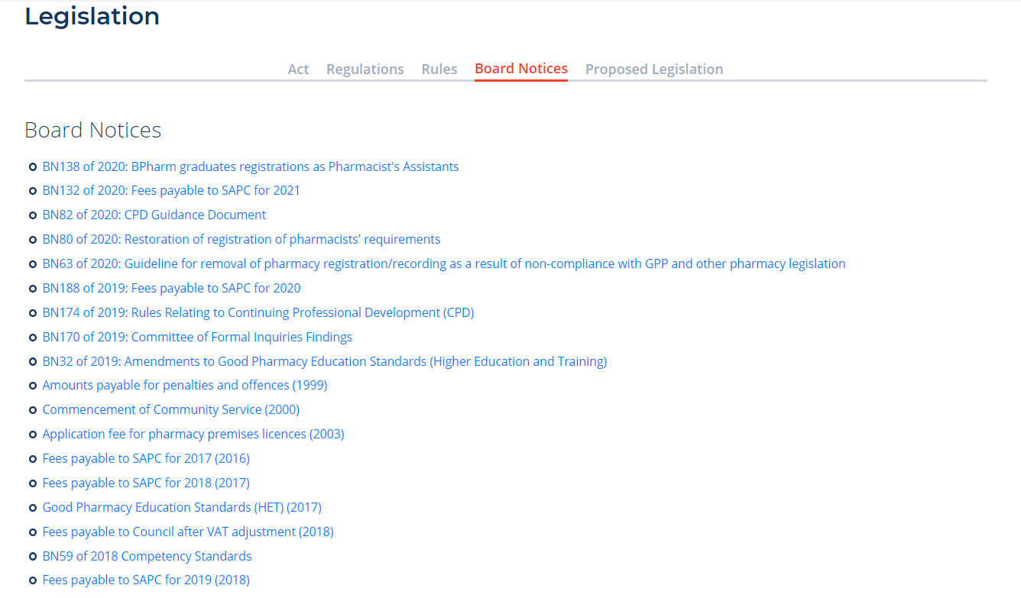
ELECTRONIC REFERENCES

Slide 31




HOW TO USE THE REFERENCES MATERIAL?
BOOKS
Learn how to use each reference material
Where is the index?
What information can I find in each reference material?
Tips:
More is not necessarily better
Avoid using a reference book you have never used before
Using notes from University may not help (information may no longer be valid)
ONLINE
Familiarise with online references
Download references before exam
Time consuming to search during exam
Information may not correlate to recommended reference material
Visit these websites and familiarise yourself with the content available-
Notes:
Examiner / Moderator

Slide 32
HELPFUL TIPS
!
“TRUE”, “IS” and “CORRECT”
“EXCEPT”, “FALSE”, “NOT” and “INCORRECT”
“MOST APPROPRIATE” implies that more than one answer is possible, thus select the most inclusive answer
READ the question carefully
IDENTIFY the statements of which you are sure
CONFIRM (using references) the statements you are unsure of
CARRY ON if you can’t complete the question, and when you have time towards the end of the exam come back to it.
Notes:
Examiner / Moderator

Slide 33
MANAGING TIME
Maximising your time:
- 168 minutes
- 84 MCQs
- 4 options per MCQ
- Approximately two (2) minutes per question
No negative marking
Do not leave anything blank
Notes:
Examiner / Moderator

Slide 34
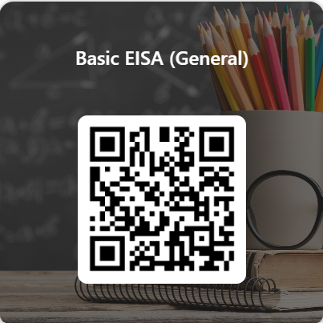
GENERAL EXAMPLES
https://forms.office.com/r/C507YJ9JTe

Slide 35
REMOTE ONLINE EXAMINATION

Slide 36
EXAMINATION ELIGIBILITY CRITERIA
Pharmacist’s Assistant (Learner Basic) registered for the new Occupational Certificate qualification | Learners must have completed a minimum of six (6) months of training with an accredited provider and must have; Successfully completed Knowledge, Practical and Work Experience modules; Received a statement of results from the provider; Completed the practice EISA; and Booked online for the EISA.
Currently qualified Pharmacist’s Assistants (Basic) intending to enrol as Pharmacist’s Assistant (Learner Post-Basic) on the new Occupational Certificate qualification | Registered qualified Pharmacist’s Assistant (Basic); Completed the practice EISA; and Booked online for the EISA.
Pharmacy student who has successfully completed their first year of study and intending to register as Pharmacist’s Assistant (Basic) | Registration as a Learner Basic - Former BPharm student; Completed 400hrs in an approved pharmacy and under the direct personal supervision of a pharmacist; Submitted at least one progress report; Completed the practice EISA; and Booked online for the EISA.

Slide 37
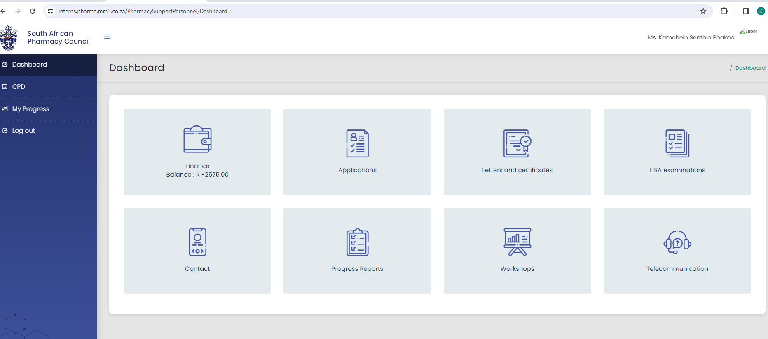
EXAMINATION BOOKING

Slide 38
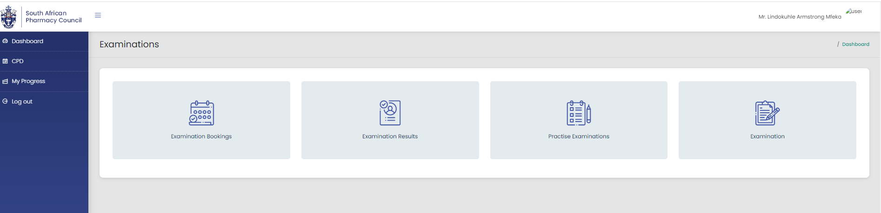
EXAMINATION BOOKING (CONT.)

Slide 39
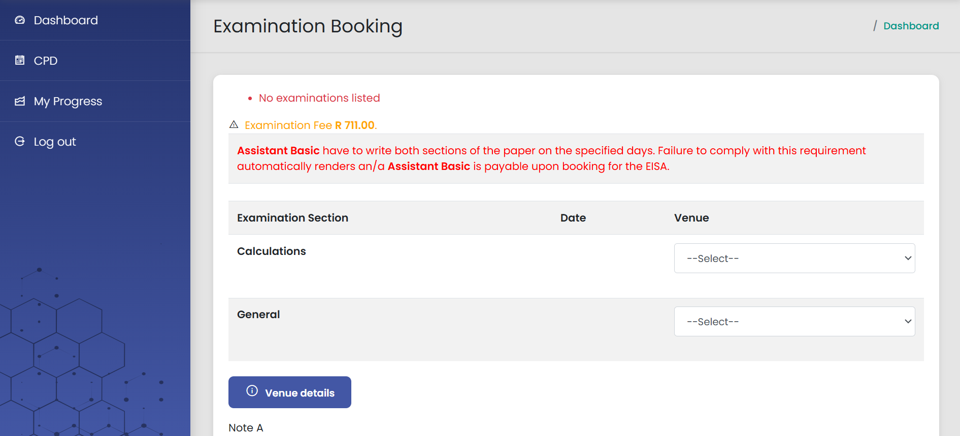
EXAMINATION BOOKING (CONT.)

Slide 40
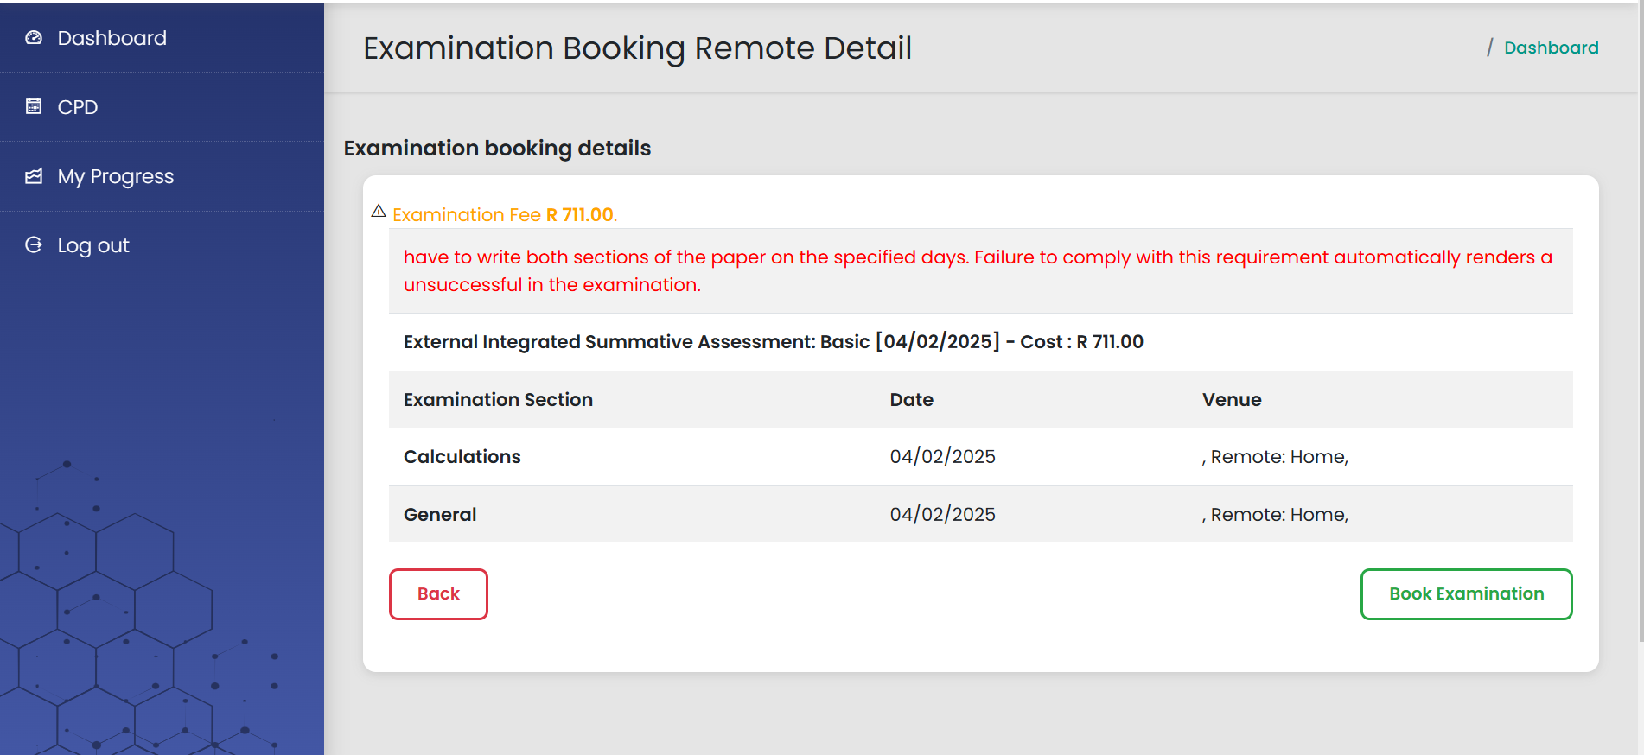
EXAMINATION BOOKING (CONT.)

Slide 41
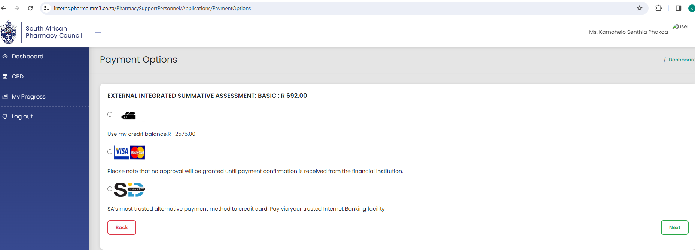
EXAMINATION BOOKING (CONT.)
Three payment methods:
1. Positive balance in SAPC account
2. SID – Immediate payment from banking app
3. Credit card

Slide 42
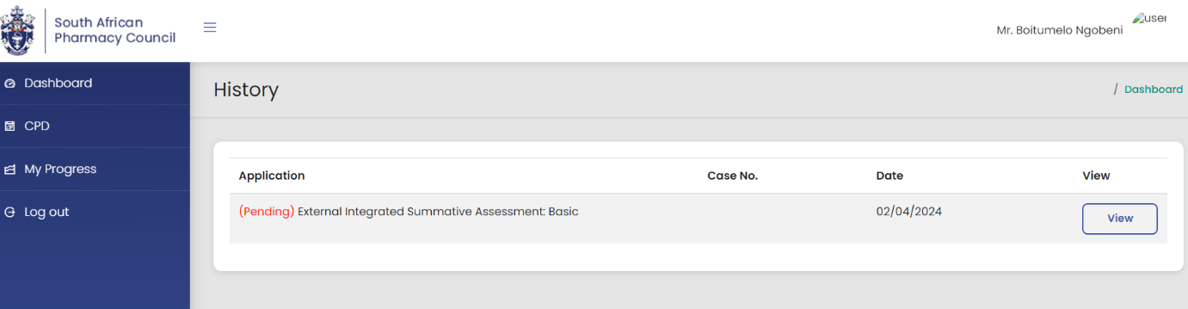
EXAMINATION BOOKING (CONT.)
If payment is successful, the record will appear pending as depicted below.
Once payment is verified, a case will be created and candidate will be added to the exam
If payment is declined, an SMS will be sent informing the candidate

Slide 43
PREPARING FOR THE EXAMINATION
Update your details on your SAPC profile
Cell phone number
Email address
Profile picture
You are notified via email and SMS when bookings are open

Slide 44
2026 DATES
PRACTICE EISA
10 February 2026 (Tuesday)
26 May 2026 (Tuesday)
11 August 2026 (Tuesday)
No fee
Open bookings | Close bookings | Late bookings | Close bookings | EISA dates
10 February 2026 | 24 February 2026 | 25 February 2026 | 10 March 2026 | 24 March (Tuesday)
09 June 2026 | 23 June 2026 | 24 June 2026 | 07 July 2026 | 21 July (Tuesday)
22 September 2026 | 06 October 2026 | 07 October 2026 | 20 October 2026 | 3 November (Tuesday)
Exam booking fee = R737.00 Late booking fee = R 1 104.00

Slide 45
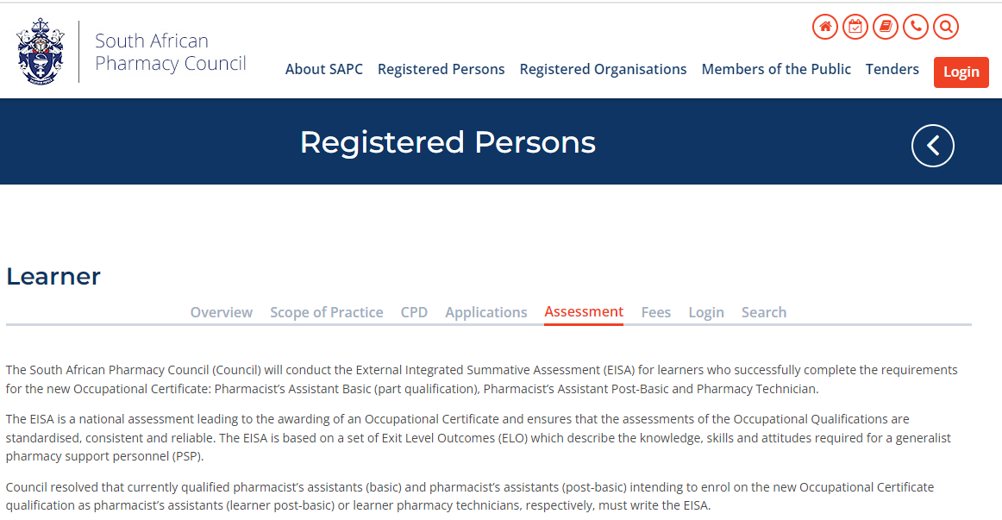
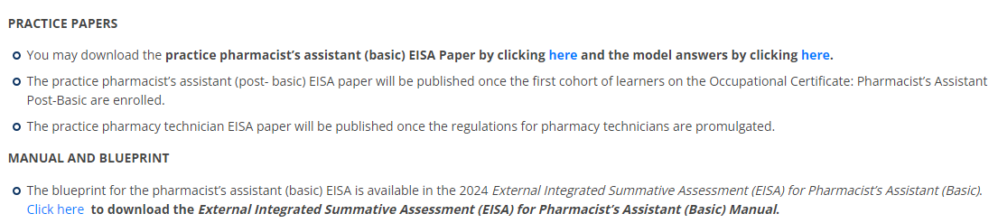
WHERE DO YOU FIND THE EISA MANUAL AND PRACTICE PAPERS?
https://www.sapc.za.org/
Notes:
SAPC

Slide 46
REMOTE EXAMINATION
RESIDENCE
SAPC
WORK PLACE
OTHER
VENUES FOR THE ASSESSMENT

Slide 47





REMOTE EXAMINATION
Find a quiet suitable workplace
Enough space for device and references
Keep calm
Communicate with your remote invigilator if you are experiencing any difficulty
Download electronic references before the examination date
Ensure you have the equipment you will need
i.e. calculator, paper for working out calculations
Notes:
SAPC

Slide 48








DEVICE AND CONNECTIVITY FOR CANDIDATES
SUGGESTED
DEVICES
OR
AND
DEVICE MUST HAVE A CAMERA OR A LINKED CAMERA WITH VIDEO CAPABILITIES
CONNECTIVITY (MINIMUM 3G)
BROWSERS

Slide 49



PROFILE PICTURE
Image uploaded on SAPC need to be:
a colour image
taken in last six (6) months
of your head and shoulders
PLEASE NOTE:
Profile picture is used by the invigilator to verify identity of candidate writing the exam

Slide 50
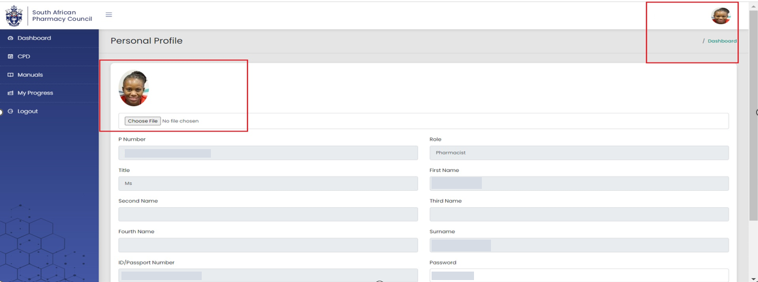
PROFILE PICTURE

Slide 51
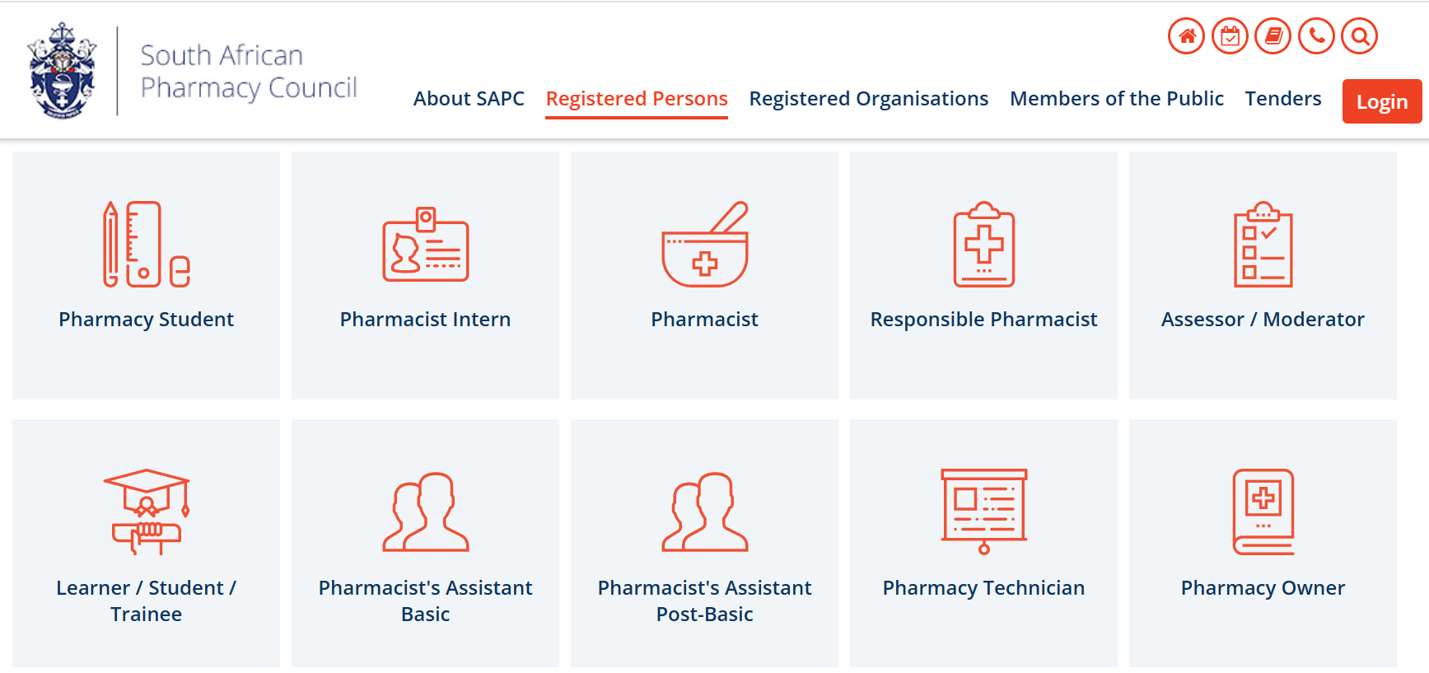
WHERE DO YOU FIND THE EXAMINATION?
https://www.sapc.za.org/
Notes:
SAPC

Slide 52
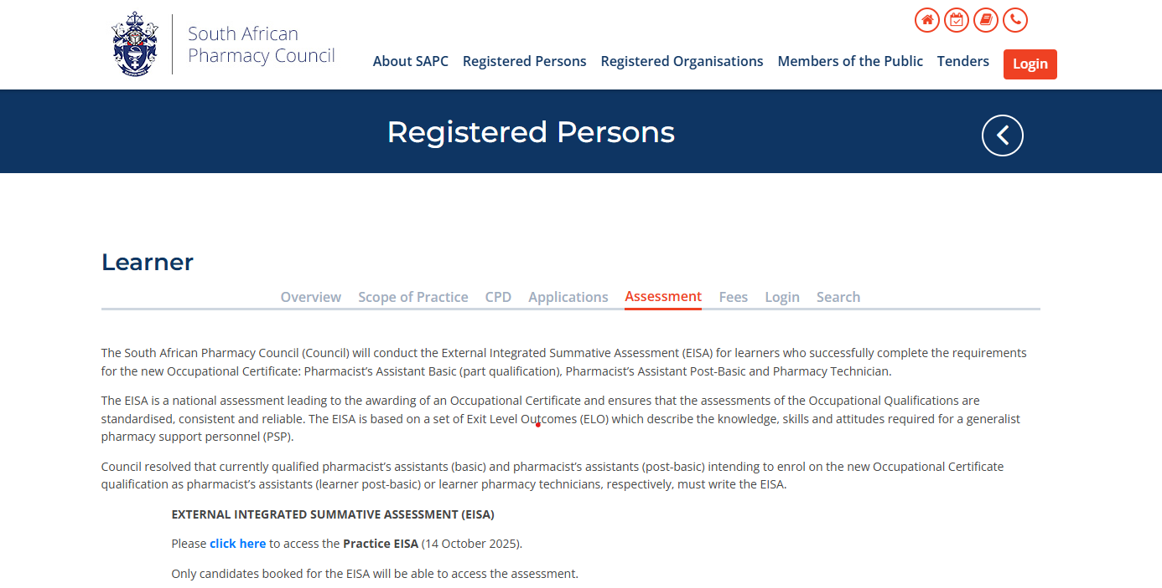
WHERE DO YOU FIND THE EXAMINATION?
Notes:
SAPC

Slide 53
DAY OF THE EXAMINATION
08h00
Login to the SAPC website & enter a one-time pin (cell phone) to enter the examination
Complete the declaration
Read the examination rules
Examination commences (remote invigilator)
Live invigilation through video streaming. Images taken to verify learner (periodically images will be taken throughout the exam)
Examination ends
09h00
12h30

Slide 54




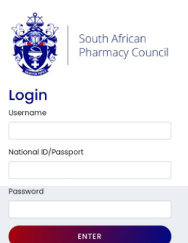
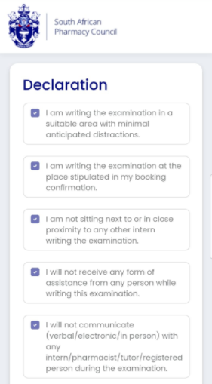
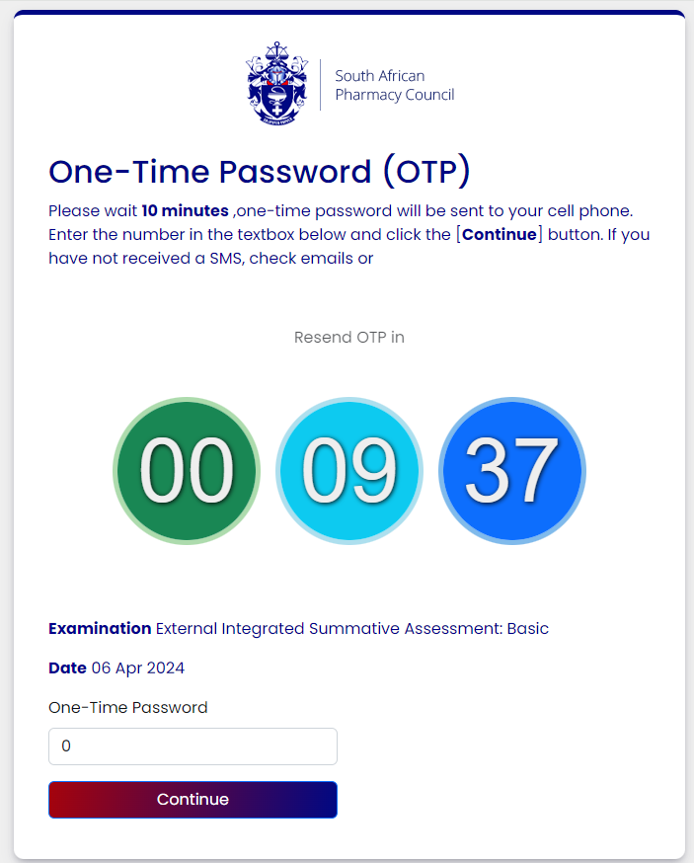

EXAMINATION PLATFORM
Same as SAPC secure site
P number
ID number
Password
Cell number and email on register system

Slide 55




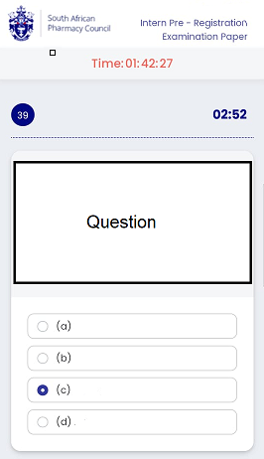
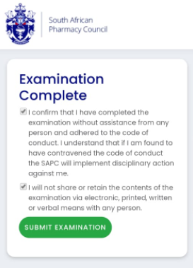
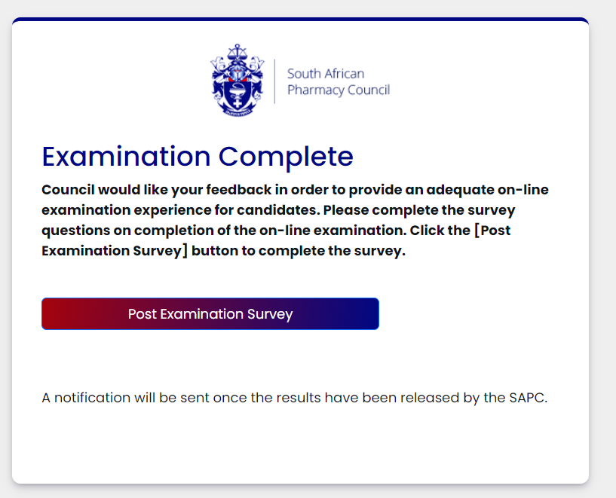
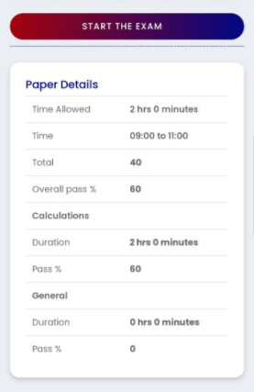
EXAMINATION PLATFORM

Slide 56
STEPS TO LOGIN AND ACCESS THE EXAMINATION PLATFORM ON THE SAPC WEBSITE

Slide 57
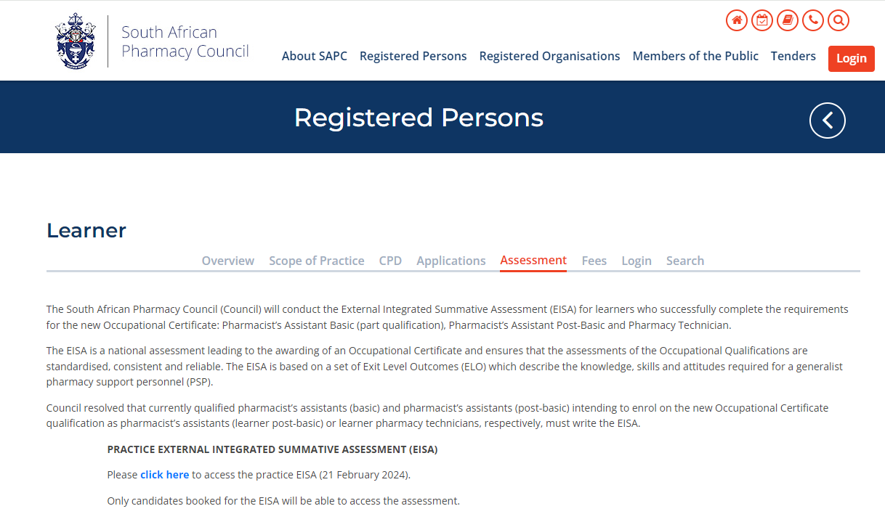
STEP 1: LOG INTO THE SAPC WEBSITE
Preferably use the following browsers: Google Chrome/Firefox/Microsoft Edge
The examination can be accessed on the SAPC website under Registered persons → Learner → Assessment. Alternatively use the below URL to connect: https://www.pharmcouncil.co.za/Learner_Assessment

Slide 58
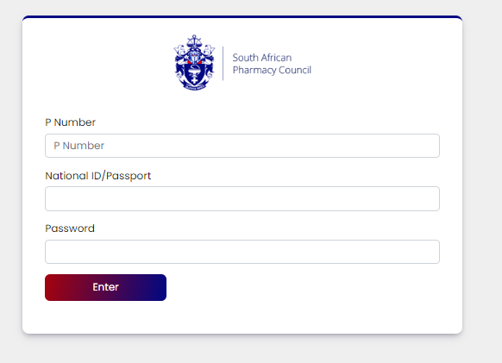
STEP 2: INSERT YOUR LOGIN CREDENTIALS

Slide 59

STEP 3: INSERT YOUR OTP
The OTP will be sent as an SMS to your cell phone and also via Email and will be valid for 10 minutes, if unused. A new OTP will be generated for each login.

Slide 60
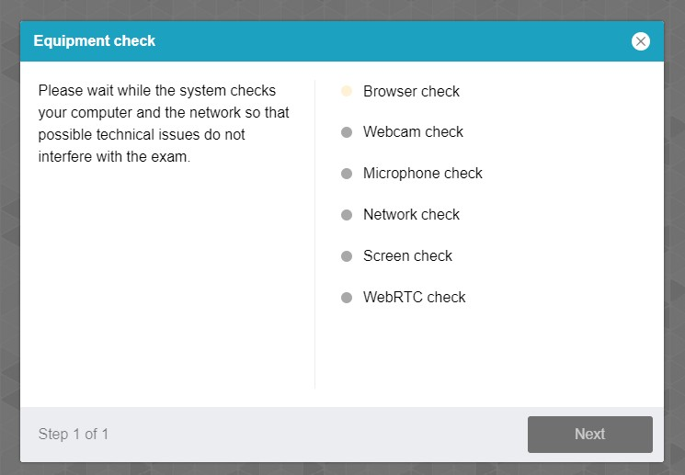
STEP 4: EQUIPMENT CHECK
The examination platform will conduct an equipment check to ensure your device is compatible to the examination platform.
Use the following link: https://proctoredu.com/check to test the compatibility of your laptop/desktop

Slide 61
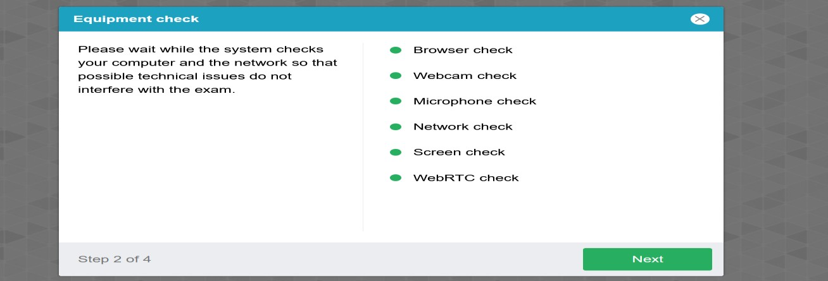
STEP 5: EQUIPMENT CHECK SUCCESSFULLY COMPLETED

Slide 62
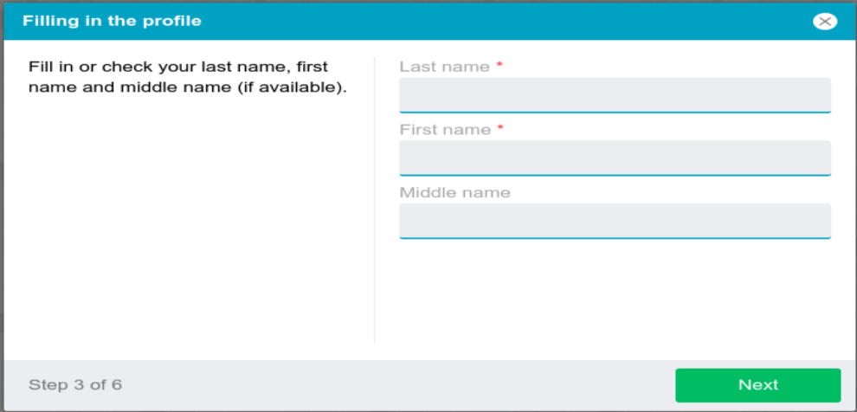
STEP 6: PROFILE CHECK
Click on NEXT when profile check is completed.

Slide 63
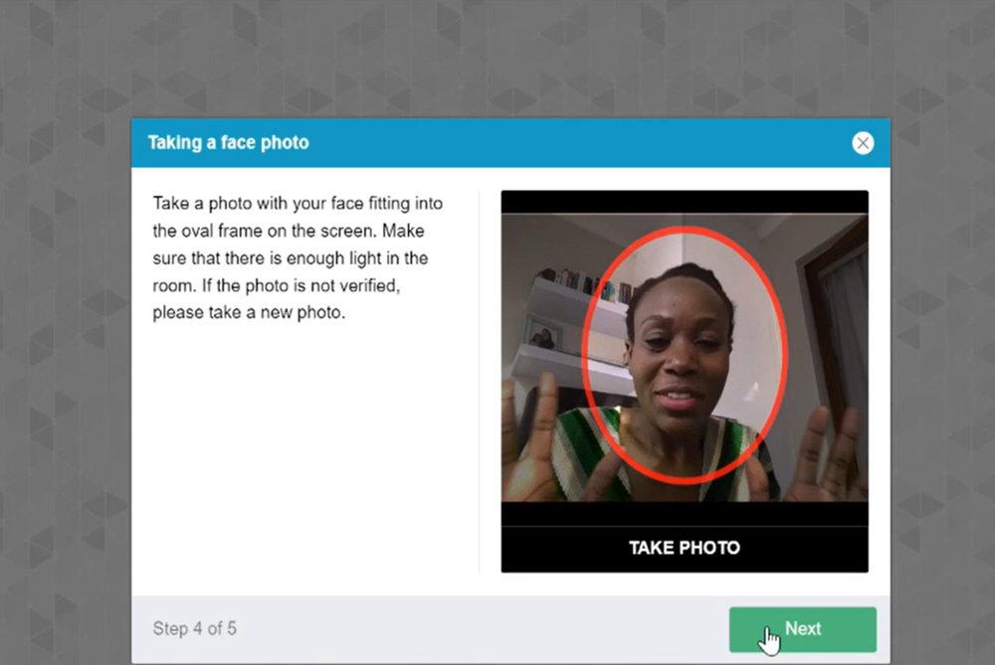
STEP 7: VERIFICATION OF THE PICTURE
Click on NEXT if satisfied with the photo

Slide 64
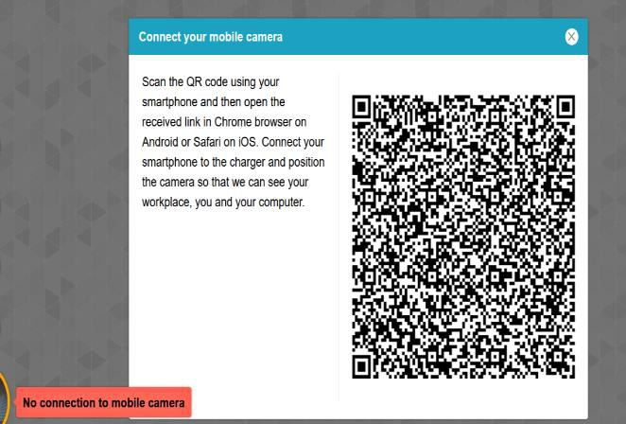
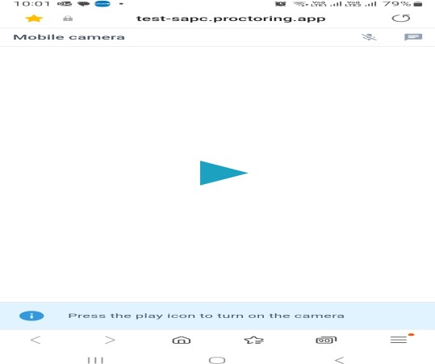
STEP 8: SCANNING OF THE QR CODE
Use a smartphone to scan the QR code to connect the phone to the examination platform for a better view of your workspace and examination room. Click on the play button to and record a short video of your room surroundings.

Slide 65
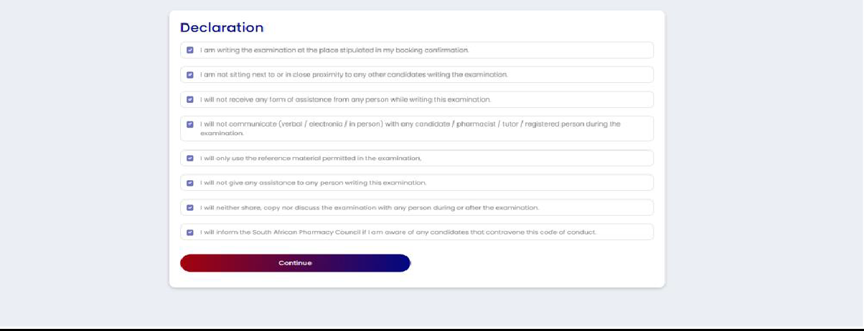
STEP 9: COMPLETE THE EXAMINATION DECLARATION

Slide 66
DECLARATION FOR THE ONLINE/REMOTE EISA
PRIOR TO START OF EXAMINATION
I am writing the examination in a suitable area with minimal anticipated distractions.
I am not sitting next to or in close proximity to any other candidate completing this examination.
I will not receive any form of assistance from any person while writing this examination.
I will not communicate (verbal / electronic / in person) with any registered person during the examination.
I will only use the reference material permitted in the examination.
I will not access any other reference material that has been prohibited including websites.
I will not give any assistance to any person completing this examination.
I will not share or retain the contents of the examination via electronic, printed, written or verbal means with any person.
I will inform the South African Pharmacy Council if I am aware of any candidate that contravenes the Examination Code of Conduct.
Notes:
SAPC

Slide 67
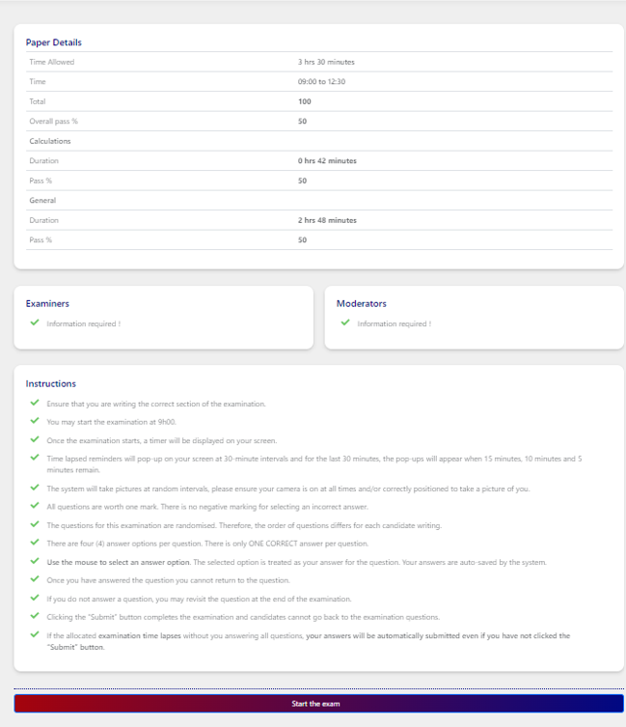
STEP 10: READ THE EXAMINATION INSTRUCTIONS
Only click on “start the examination” at 09h00 when the examination is schedule to start. SAPC will communicate if there are any delays in starting the examination.

Slide 68
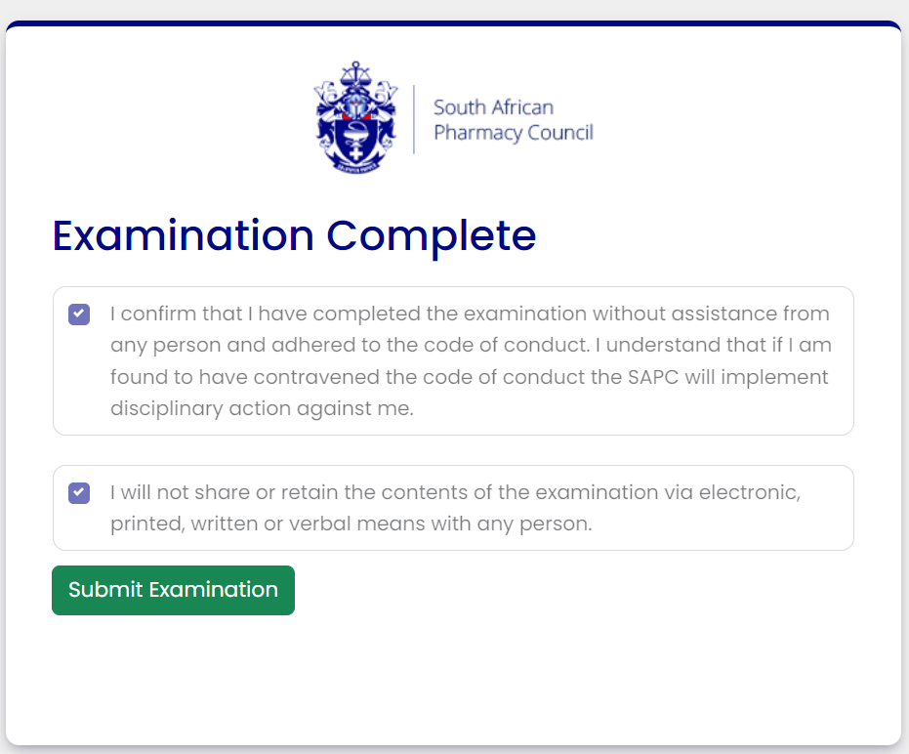
STEP 11: COMPLETE THE END OF EXAMINATION DECLARATION

Slide 69
DECLARATION FOR THE ONLINE/REMOTE EISA
END OF EXAMINATION
I confirm that I have completed the examination without assistance from any person and adhered to the Examination Code of Conduct. I understand that if it is found that I have contravened the Examination Code of Conduct, the SAPC will implement disciplinary action against me in terms of Chapter V of the Pharmacy Act.
I will not/ have not shared or retained the contents of the examination via electronic, printed, written or verbal means with any person.
Notes:
SAPC

Slide 70
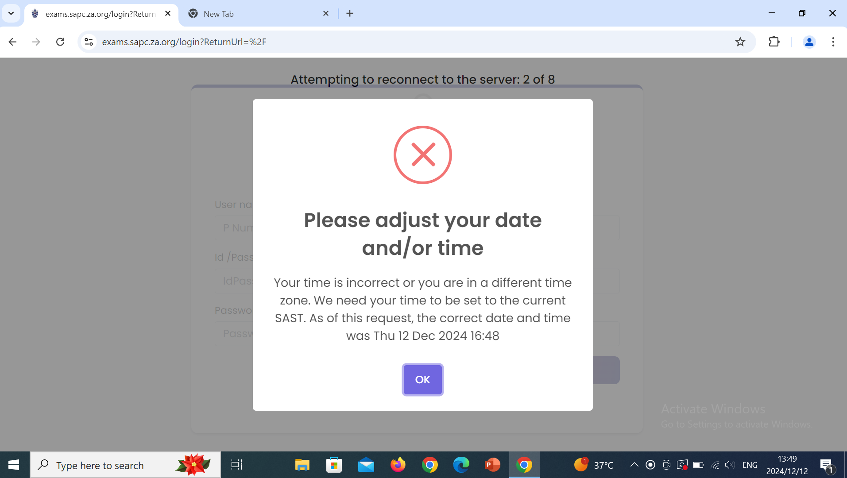
IMPORTANT MESSAGES TO TAKE NOTE OF:

Slide 71
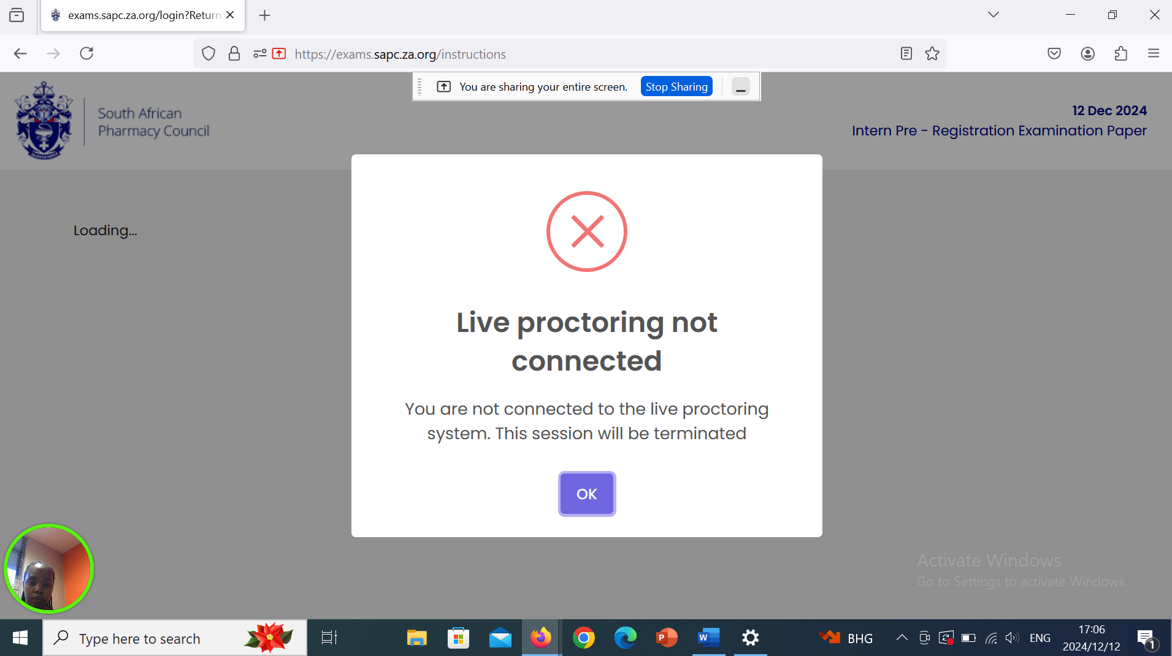
IMPORTANT MESSAGES TO TAKE NOTE OF:

Slide 72
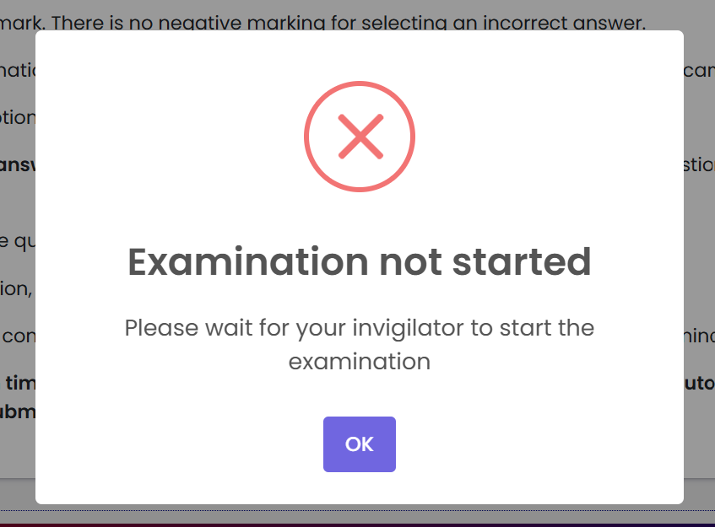
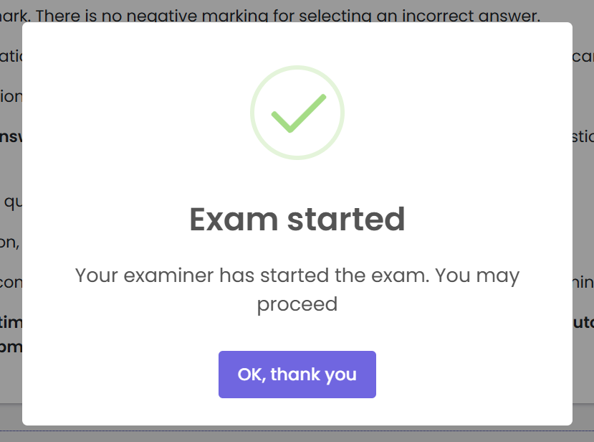
IMPORTANT MESSAGES TO TAKE NOTE OF:

Slide 73
EXAMINATION FORMAT
One question per page
Cannot select which questions to answer first
Randomisation of questions
Timed examination
Cannot revisit any question that has been answered
Unanswered questions may be revisited at the end of the examination
Notes:
SAPC

Slide 74
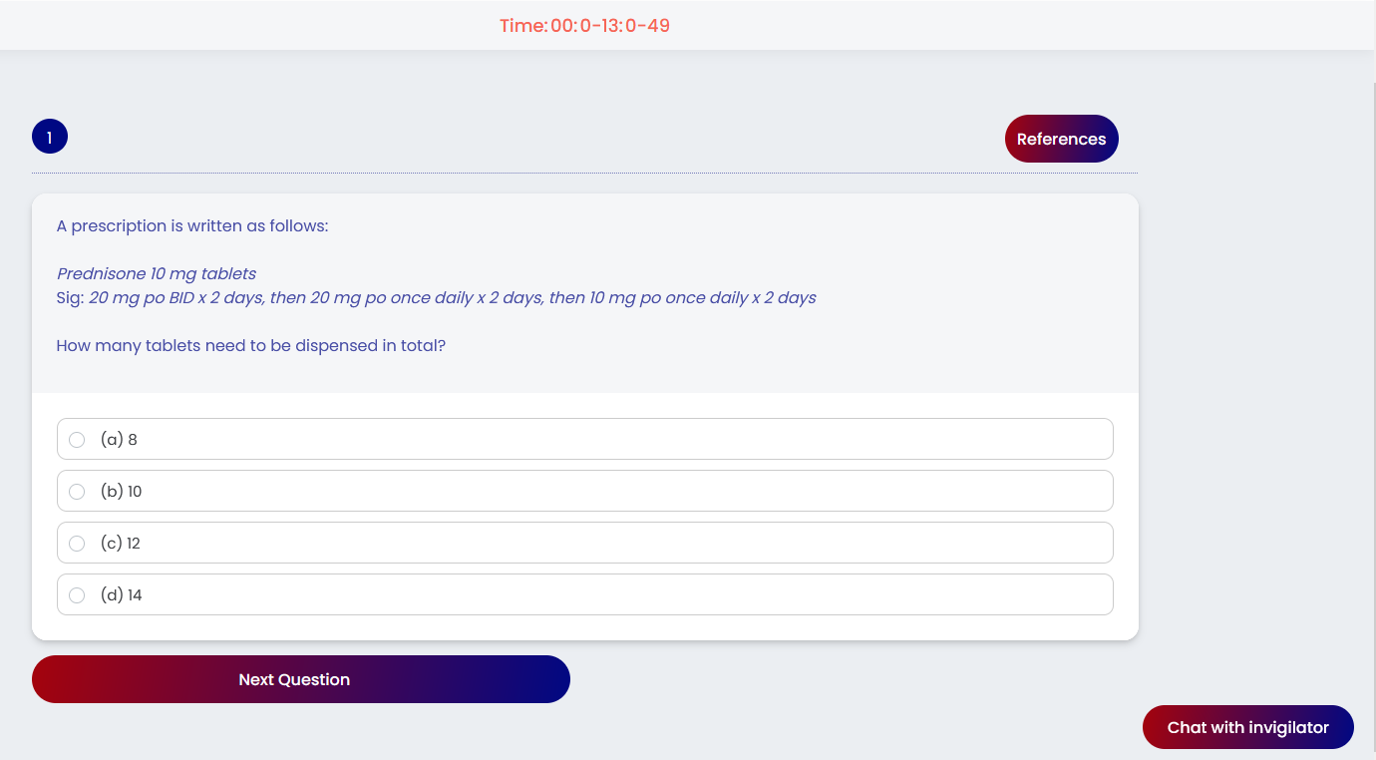
SINGLE BEST ANSWER MULTIPLE CHOICE QUESTIONS
QUESTION
OPTIONS
ANSWER
Notes:
SAPC

Slide 75
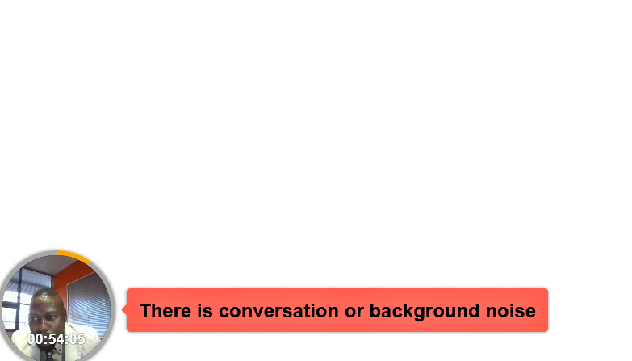
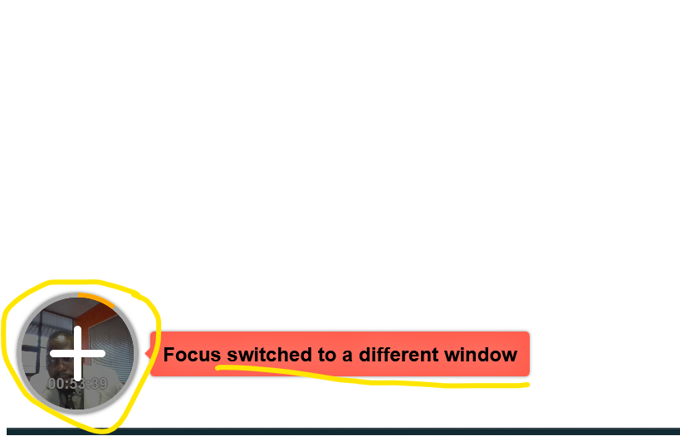

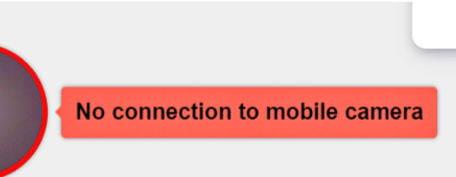

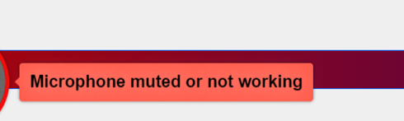
VIOLATION DURING EXAMINATION
Any action undertaken by the candidate to gain unfair academic advantage.
This may include, but not limited to cheating/copying, as well as possession of unauthorised materials
Google to access approved online reference material
Notes:
Violation is the act of breaching the exam disciplines and this slide shows the messages that may pop up when violations are suspected. If you engage in any misconduct during the exam, you may be dismissed
Outside the accessing approved online reference material

Slide 76
FREQUENTLY ASKED QUESTIONS (FAQS)
Notes:
SAPC

Slide 77

WHERE CAN I GET HELP?
Chat function
Type your question in the chat function
Your invigilator will respond via the chat
WhatsApp
Send a message to the invigilator on WhatsApp
Keep calm. The invigilator will respond to your message (give him/her a few minutes to respond)
Notes:
SAPC

Slide 78
WHAT IF THE INVIGILATOR NEEDS TO CONTACT ME?
Keep your cell phone next to you
ensure that it is fully charged, and
that you have data.
The invigilator may call or send you a message on the cell phone number you have provided to SAPC
Update your contact details on the website

Slide 79
WHAT TO DO IF YOU EXPERIENCE LOAD SHEDDING / LOSS IN ELECTRICITY?
Keep calm
Check your load shedding schedule and make an alternate plan
Ensure the laptop is fully charged before the examination
Ensure an alternative WiFi connection (if you are using a fibre connection)
If you are unable to find an alternative WiFi connection or need to be connected to a power supply, please find an alternative location. NB: Notify us via the WhatsApp number of changes
If loadshedding occurs during the exam, your work will be saved.
Notes:
SAPC

Slide 80
WHAT HAPPENS TO THE QUESTIONS YOU HAVE ANSWERED IF YOU LOSE CONNECTION?
Keep calm.
All questions are saved as you answered them.
When you log on again, you will only have access to questions you have not yet answered.
The questions will be randomised, and they may be renumbered (starting at 1). Continue to answer the questions as they appear.
Notes:
SAPC

Slide 81

WHAT SHOULD I DO IF MY INVIGILATOR NOTIFIES ME THAT THEY CANNOT SEE MY CELL PHONE VIEW DURING THE EXAM?
Scan the QR code again to ensure your smartphone is connected to the exam platform.

Slide 82
WHAT SHOULD I IF I NEED TO CHANGE EXAM VENUES?
All changes to the booking venue must be communicated via email to SAPC.

Slide 83
WHAT SHOULD I DO IF DISCONNECTED AND ON LOGIN BACK A POP-UP MESSAGE “ THIS PAGE WAS OPENED ELSEWHERE”?
Close all browsers to log in again.

Slide 84
WHERE YOU SIT IS IMPORTANT!
Images are taken of the candidate throughout the exam
Ensure there is sufficient lighting (for example, close curtains or blinds if sitting in front of a window)
Test the lighting beforehand (take a selfie of yourself)
Ensure your camera is on
Dress appropriately – images taken form part of your permanent record
If the invigilator cannot see the images taken, they will phone you on your cell phone

Slide 85
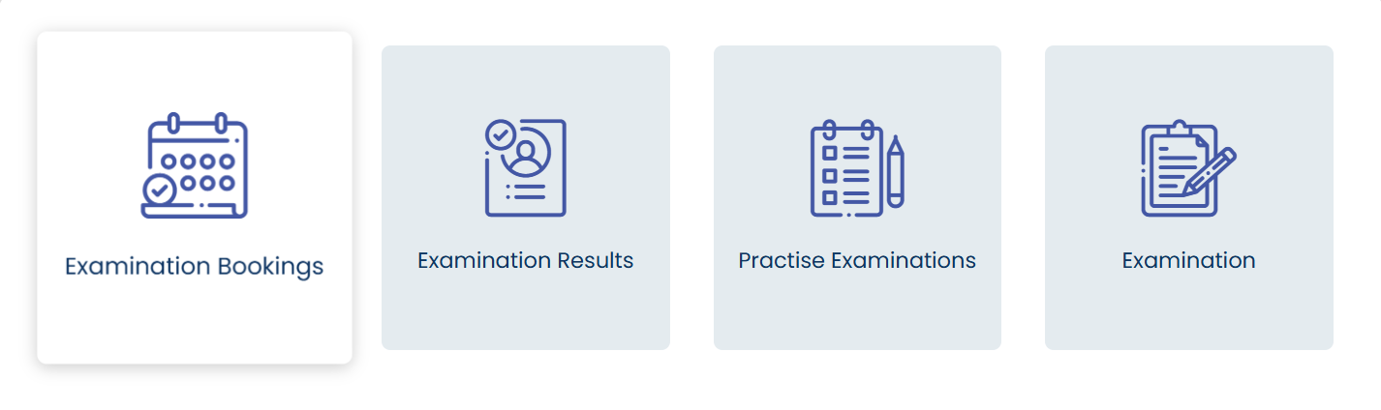
WHEN WILL YOU RECEIVE YOUR RESULTS? CAN YOU VIEW YOUR EXAM PAPER? CAN MY EXAMINATION BE REMARKED?
The exam results will be released once the results have been analysed and verified. This may take some time.
You may apply to review your examination (complete an application form and pay the applicable fee). You will be allowed to view the exam question and the answer you provided. The correct answer will be indicated. You may ask the facilitator for the reference or the steps to the calculation. You are permitted to make notes, however you may not take a copy or photos of the examination.
You may not apply for a remark. The results have been checked and verified before release.

Slide 86
DO YOU HAVE ANY QUESTIONS?
?
PSP.EISA@sapc.za.org

Slide 87

POST-WORKSHOP SURVEY
https://forms.office.com/r/HgF039r4XZ

Slide 88


Follow SAPC’s WhatsApp Channel
https://whatsapp.com/channel/0029Vb5U2BU1dAw313dtTS0a
Notes:
SAPC

Slide 89

4th National Pharmacy Conference (NPC)
The 4th National Pharmacy Conference will be held later this year under the following details:
Date: 11 – 13 October 2026
Venue: Inkosi Albert Luthuli International Convention Centre Complex (commonly known as “Durban ICC”)
Theme: “A Glimpse into the Future: Advancing Pharmacy Towards 2050”
Visit: www.sapcconference.co.za
Early Bird Registration closes 31 May 2026

Slide 90
Thank you!

