Slide 1
Tutor Training 2025
Intern Portfolio of Evidence

Slide 2
Outline
Introduction
Resources
What are PoE entries?
Role of a tutor
Administrative information
Portfolio of evidence - CPD cycle
Notes:
Stress that there is a lot of information in the presentation, and this is a great resource going forward for the tutor.

Slide 3
How are you feeling?
Or

Slide 4
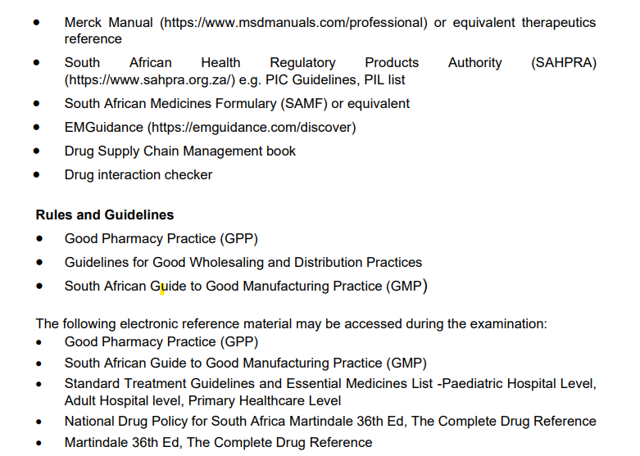
Important Resources
Refer to page 25 -26 of the 2025 Intern and Tutor Manual for the list of resources
Notes:
Make sure tutors realise manual is also for them

Slide 5
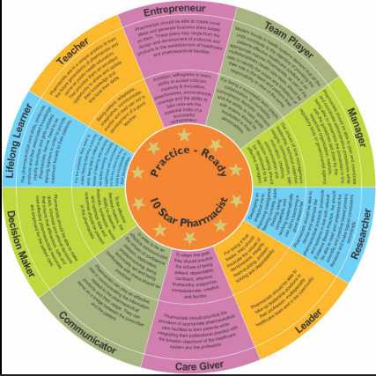
Introduction
Competence in the Portfolio of Evidence (PoE) is a precursor towards becoming a pharmacist.
PoE encompasses the Continuous Professional Development (CPD) cyclical process.
It is important for interns to fulfil the PoE process because:
WHO Model
How you can align to the 10 Star Pharmacist
Ensure competence in practice
Promote lifelong learning
Develop the interns professional skills
Enhance the interns career prospects
Support their regulatory compliance/understanding
Build confidence
Encourage ethical practice
Prepare them for future challenges
Ref _Leadership_in_Pharmacy_Education

Slide 6
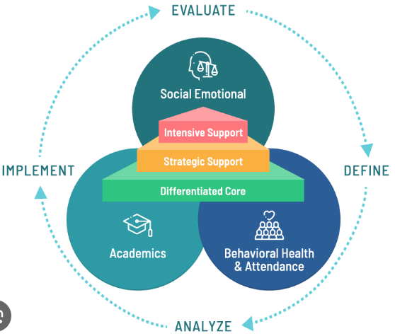
Roles of a tutor- mentor, coach and role model
How do tutors shape academic and personal growth?
Mentor
Coach
Role Model
Focuses on skill-building and problem-solving.
Encourages persistence and monitors progress.
Helps interns achieve measurable outcomes
Demonstrates professionalism, ethics, and integrity.
Inspires interns by setting an example.
Shows how to handle challenges and achieve goals.
You play a vital role as no intern is likely to succeed without a tutor who is
Competent and knowledgeable
Gives guidance
Interactive
Empathetic
Supportive
“A good teacher can inspire hope, ignite the imagination, and instil a love of learning.” – Brad Henry
Notes:
Mentor
Provides guidance, support, and career advice. Shares knowledge and inspires growth. Helps students set goals and think critically.

Slide 7
Tutors need to:
Be responsible to educate and train the new graduate
Provide the intern with the required:
equipment,
materials,
programmes, and
access to information systems and literature as necessary
Provide guidance on the performance of day-to-day tasks and aid in the development of an independent, responsible decision-maker on matters affecting the health of the public

Slide 8
The benefits of being a tutor include:
Supporting the future of the pharmacy profession
Diversifying skills
Strengthening pharmacy practice
Maintaining knowledge
The potential for future recruitment of a newly qualified pharmacist

Slide 9
Essentially as a tutor your role is to:
Learn
Share your Experience
Develop
Succeed
Become a true Life Long Learner

Slide 10
Reasons why a pharmacist may not be approved as tutor
NOT APPROVED AS A TUTOR
Non-participation in Continuing Professional Development
Incomplete forms, e.g., Section F to be filled in by Commissioner of Oaths
Non-payment of evaluation fees
Erasure from Register
Pharmacist who only practices part-time in a pharmacy
Pharmacist with a suspended sentence

Slide 11
Internship programme in hospital complexes (public sector hospital complexes)
Interns may be allowed to rotate in hospital complexes (i.e. where hospitals have been grouped together in health care complexes and/or provide health care services in collaboration with community health care centres or primary health care clinics) under the following conditions:
there must be at least one approved tutor to be responsible for the effective practical training of the Pharmacist Intern concerned;
facilities (hospital pharmacies) where the intern will be rotating must be approved and recorded by Council and each facility must have a pharmacist to supervise the internship;
the facility (hospital pharmacy) where such rotation would take place for purposes of practical training, the period(s) that such services would be provided, as well as the name of the pharmacist under whose supervision the intern would work, must be clearly indicated/described in the contract to be approved by Council BEFORE the internship commences;
the rotation must be for purposes of practical training only; Community Service Pharmacists may be used to supervise training of an intern where rotation takes place; and
on the delegation of training by an approved tutor. Nb 2.28.1(h)- on the absence
An approved tutor may not delegate his supervisory responsibilities to the Community Service Pharmacist.

Slide 12
Legislative requirements
No person may commence internship unless:
they are duly registered with the SAPC as a Pharmacist Intern;
a contract has been entered into between the tutor and the prospective pharmacist intern at the pharmacy or institution registered as a provider of a qualification in pharmacy (academic institution) at which the internship will take place; and
the tutor and the practical training premises have been approved by the SAPC (refer to the SAPC 2025 Intern and Tutor Manual)

Slide 13
Anticipated Tutor training Course
For more information please have a look at the Board Notice
BN318 of 2022: Tutor Training

Slide 14
Forms required during internship

Slide 15
Pre-registration evaluation components for interns
Successful in the pre-reg examination
Successful in six (6) PoE entries
Completed 365 practical training days
The tutor has submitted all required progress reports which are favourable

Slide 16
PoE requirements for the intern
POE entry submission deadlines for 2025
Portfolio of Evidence (POE) for interns
Six (6) PoE entries (one from each domain)
Select one competency standard (CS) from domains 1, 2, 3, 4, and 6
CS 5.3 (ethical and legal practice) is a compulsory
Fulfil at least 75% of the behaviours associated with the CS
NB CS 6.3 is recommended for academic interns
A fee of R316,00 is charged on submission of the 10th and subsequent PoE entries

Slide 17
Qualifying for the pre-reg exam
Submission of the PoE entries to qualify for admission into pre-registration exams
Please take note of the PoE submission dates for exam purposes
Interns are encouraged to ensure that they submit their PoE entries and succeed in them within the normal PoE submission cycle
Avoid submitting PoE entries after the normal PoE submission deadline as this will attract a late booking fee for the pre-registration examination
Deadlines for PoE submissions to qualify for exams, 2025

Slide 18
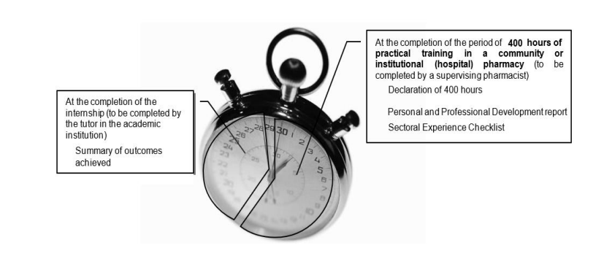
Progress report timelines
NB ! Academic, manufacturing and wholesale interns
Community, hospital, manufacturing and wholesale interns
Report | Report timeframe and description
First report | 12 weeks First personal and professional development report
Second report | 24 weeks 2nd personal and professional development report 1st sectoral experience checklist
Third Report | 36 weeks 3rd personal and professional development report
Fourth report | 45 weeks 4th personal and professional development report 2nd sectoral experience checklist Summary of outcomes achieved

Slide 19
Portfolio of Evidence (PoE)
PoE for Pharmacist Interns is based on the 2018 Competency Standards for Pharmacists in South Africa (Refer to Intern and Tutor Manual Annexure B)
They describe –
what a newly qualified pharmacists must be capable of at entry level to practice within their scope to meet patient needs.
The framework consists of six (6) domains
Each with :
various competency standards (e.g. 1.1, 1.2, 1.3, etc.)
behavioural statements (e.g. (a), (b), (c), etc

Slide 20
Continuing Professional Development

Slide 21
Continuing Professional Development
CPD is a cyclical activity
Definition: the process by which registered persons maintain and enhance their competence throughout their professional careers
Encompasses a range of activities including continuing education and supplementary training
CPD enables registered persons to develop in their area of practice and demonstrate competence
Notes:
For ALL pharmacists, not just interns

Slide 22
CPD Terminology that we use
Competency Standard
Behavioural Statement
Domain

Slide 23
Six Domains
Public Health
Safe and rational use of medicines and medical devices
Supply of medicines and medical devices
Organisational and management skills
Professional and personal practice (compulsory)
Education, critical analysis and research
Domains are organized clusters of competencies
Notes:
Developed for the SA context and for all practice settings

Slide 24
Competency Standards
Take note of how each CS is structured
Part of a domain
How does domain apply to you?
Introduction to domain
Competencies
Behavioural statements
Entry level
Intermediate practice
Advanced practice
Assessment tick box
For interns
Later
Notes:
Entry level = first 3 years of practice
Intermediate practice = between 3 and 7 years of practice
Advanced practice = more than 7 years of practice
Assessment tick box = must consider whether evidence presented shows that one can do all the behaviours

Slide 25
Competency framework example
Domain 5
5.3. Ethical and legal practice
Behavioural statements
a, b, c, d, e
Notes:
Shows that each domain has multiples CSs
Each CS has a different number of behavioural statements

Slide 26
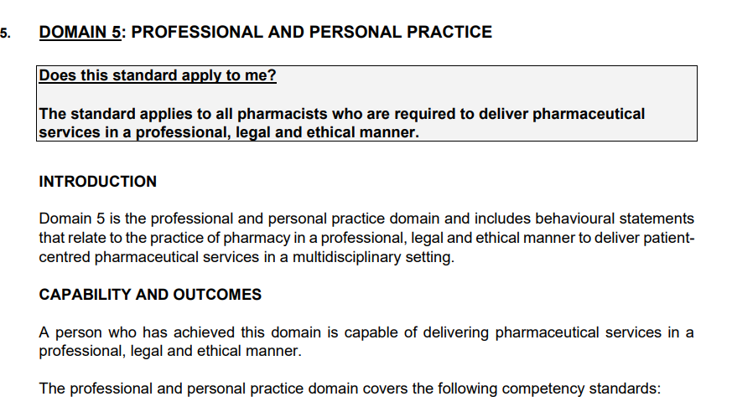
Structure of the Competency Standards

Slide 27
Ensuring and maintaining Quality
NB! SAPC Intern Manual says
Have a checklist to evaluate quality
Checklist
Relevance: Are the learning activities aligned with the intern’s role and goals?
Appraisal: Is there evidence of relevant knowledge and skill acquired?
Outcomes: Are the outcomes specific, measurable, and linked to professional improvement?
Completeness: Does the submission follow the required format and address all required sections?
Gain an in-depth understanding of the PoE process for interns.
Provide constructive feedback
Request evidence and check for confidentiality, calculation errors, legislation relevance, plagiarism, falsified evidence.
Suggest areas of further learning.
Provide post submission support
Discuss Feedback
Encourage Self-Assessment
Promote Iteration
Maintain quality assurance
Compare Submissions
Use Peer Review
Audit Regularly
Have fun when tutoring, make the learning continuous with the intern and not regimented
Notes:
feedback- encourage depth- go beyond surface-level observations and make suggestions
Arrange a one-on-one review session to discuss feedback and clarify any concerns
Ask interns to evaluate their own submissions against the feedback provided to foster self-awareness
Encourage interns to revise their submissions based on feedback, if needed, to achieve a higher standard.
Evaluate the intern’s PoE submission against previous ones to track progress and ensure growth
: Involve another tutor or experienced peer to cross-review the submission for additional insights.
Periodically audit PoE submissions across interns to identify common gaps and address them in future guidance.

Slide 28
PoE Requirements
Interns need to submit 6 PoE entries
One from each domain
And be successful in all 6 PoE entries
Encourage interns not to submit all 6 PoE entries at once
Encourage them to have sufficient time throughout the year for assessment submissions
This will increase their chances of success as they would obtain feedback from the assessor and moderator
From each Domain one competency standard must be chosen
Read all the behavioural statements carefully
1-3 behavioural statements = evidence is needed for ALL the statements (100%)
If there are ≥4 behavioural statements, provide evidence for at least 75%
NB: Consult the 2025 Intern Manual for details of the behavioural statements
NB: Every PoE entry must reflect the intern’s individual work
No group activities are acceptable
Each entry must be accompanied by suitable evidence
Notes:
No group activities = new for 2020
Interns must plan activities well in advance of PoE deadlines

Slide 29
Continuing Professional Development (CPD) Cycle
Reflection
Planning
Evaluation
Implementation

Slide 30
Step 1 Reflection
Decide on an appropriate Learning Title
Should be relevant to what they want to learn
NB: Don’t simply copy the wording of the CS
Verbatim copies of the wording = NYC
The learning title must be unique and describe your case study
Reflection

Slide 31
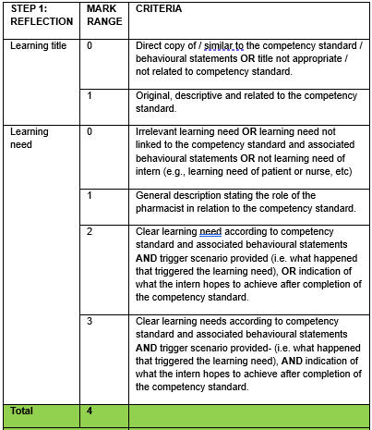
Reflection
Your role
Expectation from the Intern
What can you do?
Check – Is it their OWN learning need?
What reflective prompts can you provide to help interns think critically?
How can you create a safe space for open discussion about their growth?
Are you modelling good reflective practices yourself?
Are you actively assisting the intern to identify relevant learning needs
Practical Steps
Ask open-ended questions to deepen learners' reflections.
Use examples from your own CPD journey to inspire interns.
Encourage a growth mindset by focusing on progress and future potential.

Slide 32
Reflection
CHECKLIST | YES | NO
TITLE
Is there a title?
Is the title short, specific and related to the competency standard (CS)?
Is the title a concise statement in my own words (not just a copy of the CS)?
REFLECTION
Has the intern clearly stated what they need to know or learn?
Has the intern stated his/her learning need in the first person, e.g. “I need to know/learn…”?
Has the intern stated why he/she has identified this learning need for his or herself and not just stated that it is a required outcome?
Has the intern made sure not to include details of planning and implementation here?
Notes:
Checklist on Pg 33 of Manual

Slide 33
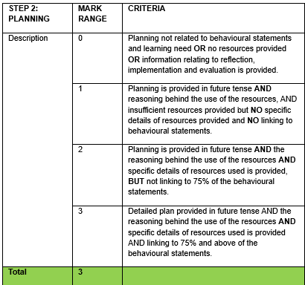
Step 2 Planning
Expectation from the intern
How, exactly am I going to learn this?
What are my options?
Link to the behavioral statements and structure planning accordingly
Mention relevant, current resources to be used with specific details e.g., page numbers, chapters etc.
Describe the reason for using the resource
What evidence can I submit to support my learning activity?
Planning is written in future tense (I will do…)
NB: Don’t only describe how you plan to proceed, but say what you are going to do, how and why you are going to do things this way, as well as when you are going to do

Slide 34
Planning
CHECKLIST | YES | NO
PLANNING
Has the intern clearly stated how they are going to learn?
Has the intern identified which resources he or she will be using?
Has the intern explained how he or she will be using the resources?
Has the intern made sure NOT to just write what he or she intends to do (which is implementation)?
Has the intern written this in the future tense?

Slide 35
What can you do to assist with the Planning?
Use reflective tools like self-assessment questionnaires or skill-gap analyses.
Suggest specific, measurable, achievable, relevant, and time-bound (SMART) goals.
Example: Instead of "Improve communication skills," suggest "Complete a course on patient counselling techniques by [date]."
Design Training Plan: Incorporate diverse learning methods (e.g., workshops, case studies, role-playing).
Implement Training: Provide clear instructions and demonstrate tasks.
Monitor Progress: Use a logbook or checklist for tracking milestones.
Reflect and Adjust: Gather feedback from the intern to refine the plan.
Use a variety of teaching methods to cater to different learning styles.
Encourage the intern to reflect on their progress and share insights.
Use tools like SWOT analysis (Strengths, Weaknesses, Opportunities, Threats)
Use reflection prompts (e.g., "What do I need to improve to deliver better patient care?").

Slide 36
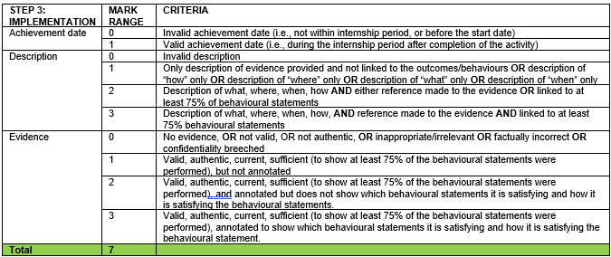
Step 3 Implementation
The intern must tell the story.
Keep it personal, use “I”
Describe what the intern did
The intern must provide the context
What, when, where, how
Link to the evidence
Remember to include ALL the behavioural statements of the chosen outcome
Implementation is written in the past tense (I did…)
EVIDENCE
More about this later!

Slide 37
Implementation
CHECKLIST | YES | NO
IMPLEMENTATION
Has the intern described exactly what he/she did?
Has the intern included where, when, what and how?
Has the intern written this in the past tense?
Has the intern referred to the labels of their evidence (i.e., the behavioural statements) in the text?
Has the intern checked that what he/she did matches his/her learning need?
Has the intern checked that what he/she did addresses all the behavioural statements of the CS?
Implementation must be supported by evidence!

Slide 38
Evidence
CHECKLIST | YES | NO
EVIDENCE
Has the intern checked that he/she has sufficient evidence i.e., has the intern covered at least 75% of the behavioural statements of the CS?
Has the intern annotated the evidence so that it is clear why he/she has included each piece?
Has the intern annotated the evidence with the behavioural statements, and does this match the behavioural statements mentioned under Implementation?
Is the evidence clear i.e., readable, not loaded upside down, loaded as a single file. etc.?
Has the intern made sure that all patient identifying details (such as name, surname, ID number) have been hidden?
Still more about this later!

Slide 39
Step 4 Evaluation
FOCUS HERE IS:
Learning outcome i.e., what has the intern learnt – related to evidence?
Application i.e., how has the knowledge been subsequently used
Impact i.e., how has this newly acquired knowledge changed their practice
Identification of further learning needs
NB! NOT “What did the intern do”
NB: Provide examples to substantiate this

Slide 40
Evaluation
CHECKLIST | YES | NO
EVALUATION
Has the intern clearly stated what he/she learnt from the action described under Implementation?
Has the intern checked that his/her learning matches the learning need and is relevant to the CS?
Has the intern clearly described how this learning has impacted on the way he/she practices?
Has the intern given a specific example of how he/she applied this learning i.e., something he/she did after the action described? Has the intern remembered that he/she doesn’t have to provide evidence for this, but just has to describe it?
Has the intern clearly noted their future learning needs?

Slide 41
Evidence criteria
EVIDENCE
Annotated
Authentic
Sufficient
Valid
Current

Slide 42
Annotated
What it is
Mechanism to give meaning to evidence
Legible/easy to read
Justifies why evidence is included
Must be planned and meaningful
Must provide links to behavioural statements
What it isn’t
Merely labels
Single words next to parts of evidence
Scribbles on evidence
Lacking links to behavioural statements
Must tell a story!
And the story is “What has been done to show behaviour”
Notes:
Stress that annotation must link to what is written under Implementation

Slide 43
Annotation of the date on a prescription
Meaningful annotation
20/01/2025
Annotation with no value
20/01/2025
For a prescription to be valid, it must be presented for dispensing within one month after it was written. This prescription is thus valid.
This is the date of the prescription.

Slide 44
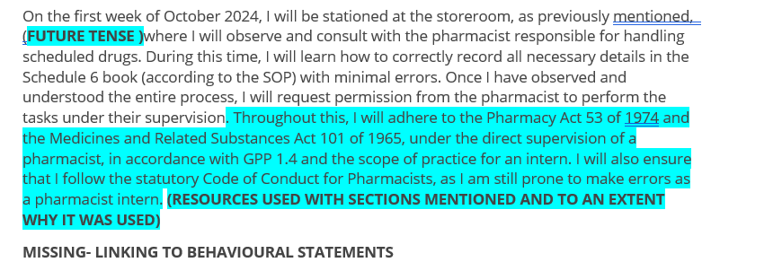
Example of a submission
Reflection
Planning

Slide 45
Example of a submission
Implementation
Notes:
3.2 Supply chain management (e)

Slide 46
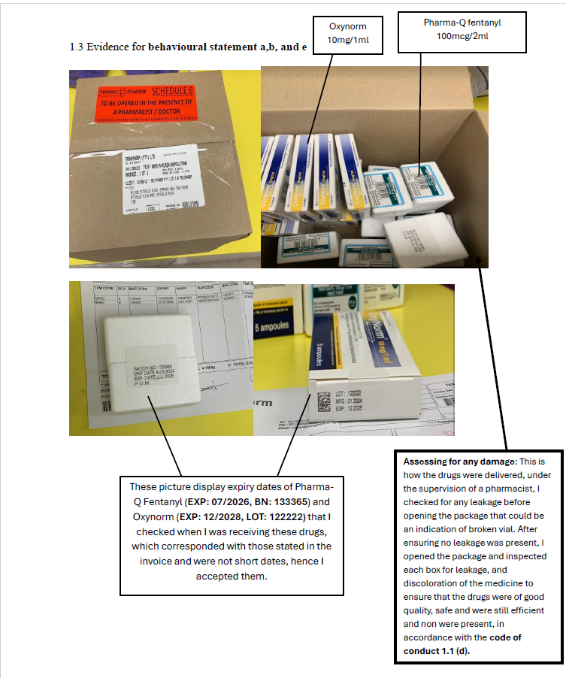
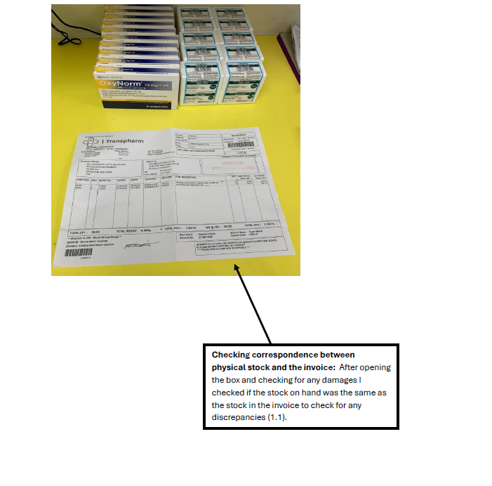
Example of a submission
Evidence

Slide 47
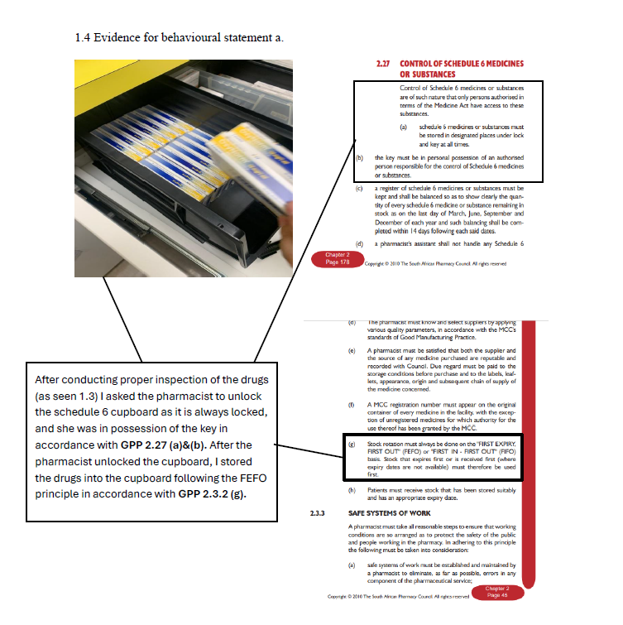
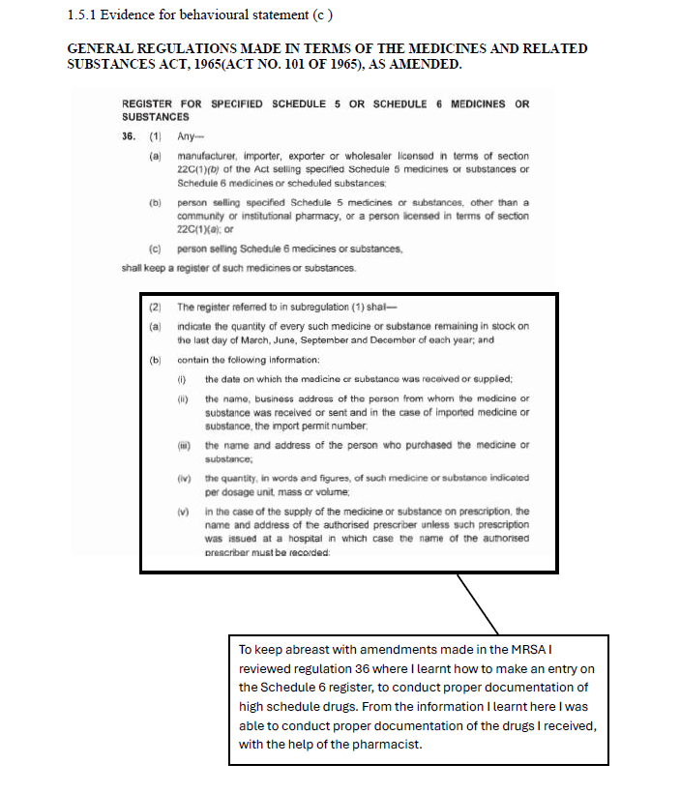
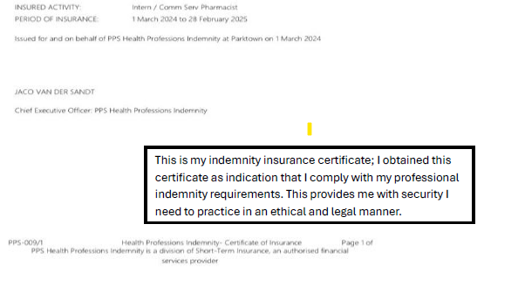
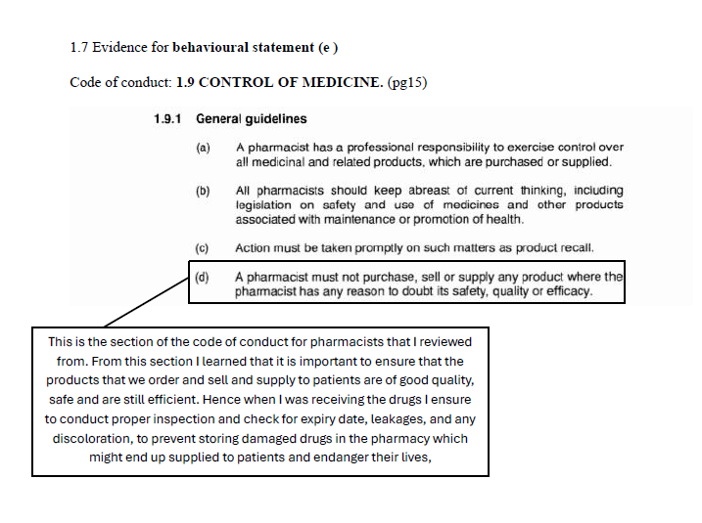
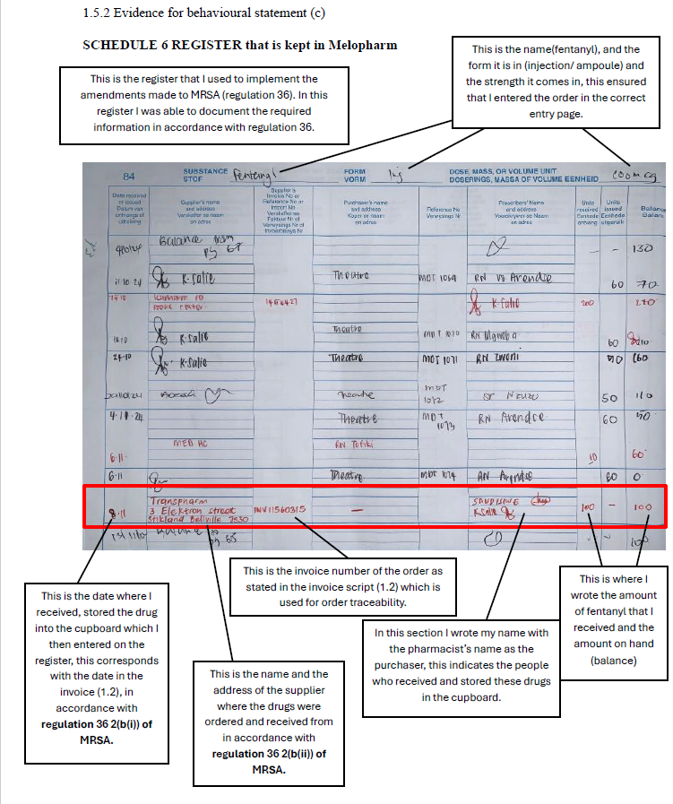
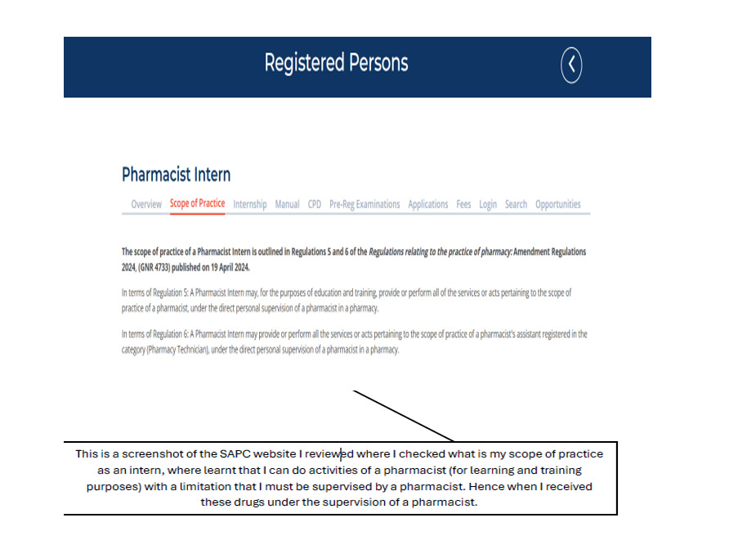

Slide 48
Example of a submission
Evaluation
Notes:
3.2 Supply chain management (e)

Slide 49
PoE entry must relate to exposure to CSs DURING the internship period
Evidence must therefore be collected DURING the internship year/s
Don’t include anything from undergraduate years
Current
EVIDENCE

Slide 50
Evidence must pertain to the specific competency being addressed
If factual and/or calculation errors occur in the evidence
Deemed NOT valid
EVIDENCE
Valid
NB: If evidence is not valid, the other 4 criteria do not count

Slide 51
For example…
If the competency is about how to make sushi and your evidence is about what is the best sauce to have with it, it is of no value
EVIDENCE
Valid

Slide 52
Authentic = own work
The evidence must be verified online by you
Tutor verification
Make sure you verify the entries
Authentic
EVIDENCE
Notes:
Notes for facilitator:
Evidence must be authenticated and must have tutor name, signature, designation, p-number and date
Intern must also sign evidence.
For academic interns and interns in manufacturing, evidence must be signed by supervisor and co-signed by tutor.

Slide 53
If there are 4 or more, then the evidence submitted must cover at least 75% of the behavioural statements. e.g., 4 behavioural statements- 3 pieces of evidence (0.75 x number of behaviour statements)
The same piece of evidence can’t be used for more than one CS
Do not submit an entire legislative document e.g., the entire Pharmacy Act.
Do not add evidence that may have clauses for intellectual property e.g., manufacturing interns who submit evidence that is confidential to that site
Sufficient
EVIDENCE
Make sure they have enough evidence
NB: Focus on the QUALITY not only on the QUANTITY of evidence

Slide 54
Evidence
HINT Put yourself in assessor’s shoes before submitting evidence.
Ask: What does it show?
Will probably point to need for more discussion and/or annotation
Photos | Pages from SAMF | Delivery notes
Check for a date stamp! Meaningless UNLESS authenticated AND the intern identifies themselves. Can be anyone in the photo! Maintain patient confidentiality. | Reference name, edition, page number, etc. What does this show? That you can use a scanner or photocopier? | What does this show? Stock was delivered, but received by whom? Signatures not annotated are meaningless.
Notes:
Notes for the facilitator:
NB: Stress annotation of evidence e.g. link to outcome subsections AND identify own signature
Facilitator to put forward such examples as photos, pages copied from GPP, package inserts for discussion
Evidence must be scanned in one document (and not upload separate documents)
Challenge interns to come up with good examples

Slide 55
Evidence
No highly glossy photos
Not uploaded upside down
The evidence must be clear and legible
The evidence must be in one document
Annotate, annotate, annotate!
Link evidence to a specific behavioural statement
Identify your own signature
Remember the assessor does not know you
Notes:
Notes for the facilitator:
- No highly glossy photos
- Not uploaded upside down
- Put all evidence in one document

Slide 56
What kind of evidence?
If providing information to a patient…
Prescription
+?
+?
But if providing evidence to a group…
Attendance register
Presentation
Reference materials used
Feedback
Attendance register + presenter name, date, venue
Only one presenter
Feedback on presentation – should reflect knowledge and understanding of audience after the presentation (it is not the rating of the presenter)
Remember to annotate and link to the behavioural statements

Slide 57
What kind of evidence?
If consulting with a patient
Patient history
Rx, request from patient, blue copy, label, reference material used
But what if consulting with a doctor?
Reason for consultation e.g. Rx
Reference material used
Telephone number of the doctor and time of the conversation
References – scientific, not Wikipedia
Must also be annotated and linked to the behavioural statements
Include page, edition e.g., for SAMF
Notes:
NB. Public sector doctor consults- may be different when engaging ( different doctor to script may be encountered).

Slide 58
What kind of evidence?
Sometimes I attend a meeting …
Agenda
Attendance register
Minutes of meeting
Most NB: own contribution to meeting

Slide 59
What kind of evidence?
I will also be working with data…
Reason for data collection
e.g. Screening report, data analysis

Slide 60
Evidence (reemphasis on checklist)
CHECKLIST | YES | NO
EVIDENCE
Has the intern checked that he/she has sufficient evidence i.e., has the intern covered at least 75% of the behavioural statements of the CS?
Has the intern annotated the evidence so that it is clear why he/she has included each piece?
Has the intern annotated the evidence with the behavioural statements, and does this match the behavioural statements mentioned under Implementation?
Is the evidence clear i.e., legible, not loaded upside down, etc.?
Has the intern made sure that all patient identifying details (such as name, surname, ID number) have been hidden?

Slide 61
Evidence… Summary
Evidence is proof of what was done
NOT merely reading an article
NOT theoretical scenario
NOT witnessing someone else
Must convince the assessor that he/she performed the activity
Must be professional
Neat, clear
Not a note scribbled on a Rx!

Slide 62
Stepwise approach to completing PoE entries
3. Check for feedback
2. Tutor verifies and submits online
1. Enter and submit online tutor verification
Make sure you verified and submitted the entries by the published deadlines
Complete annual declaration first!
Notes:
Stress – won’t be able to start CPD cycle until annual declaration completed
Emphasise the deadline and the need to submit a few days before.
Communication between intern and tutor emphasised

Slide 63
Assessment
0: Not yet met
1: Partially met
2: Met
3: Fully met
Done (mostly) on a scale of 0 to 3
To earn 3 marks, ALL requirements must be met
Follow Assessment Criteria for each of the 4 phases of the CPD cycle
In addition:
Must have used an appropriately professional communication style
Free of spelling and grammatical errors
Properly punctuated
Trade names capitalised
REMEMBER: spelling and grammar are not auto-corrected!
Check everything carefully before submitting
Check Manual pg. 29-30 for full details of how
0, 1, 2 or 3 marks allocated

Slide 64
Feedback from Assessors
What can you expect?
Comments, dated
Positive = acknowledgement of being on the right track
Negative = with specific pointers with regards to what was wrong and how to improve
Especially with regards to evidence annotation
Comments = guidelines for next entries, even if attached to entry assessed as Competent
Remember: Feedback sessions later in the year

Slide 65
Resubmission
If the entry is found ‘not yet successful’ the intern needs to resubmit a CS within that Domain.
Each resubmission is a standalone and is treated as a new submission.
NB. Assessors and moderators can view the previous submission/entry and comments.
See Guidelines for:
Conditions
Application procedure
Timeline
To maximise the chance to be eligible to write the intern examination:
Submit early
Submit regularly: on a monthly basis
Notes:
If it is only breech of confidentiality mention – that can be the only change to the evidence

Slide 66
Common errors seen on resubmission
Not following assessors / moderator comments
Making NO changes on the resubmission
Retrospectively falsifying of evidence to meet assessor comments
Not starting a new PoE entry unless the assessor has recommended that your PoE entry can be corrected (have a look at comment section)
Not checking all phases of the cycle to align to the new information provided
Notes:
e.g. submitting a training plan retrospectively
Or pictures of personnel and saying it is the public

Slide 67
Resubmissions
To prevent the need for further resubmission, make sure to follow the assessor’s recommendations/comments
Re-submitted PoE entries are sent to the same assessor
Don’t simply re-submit without attending to the reasons for the entry being deemed “not yet successful”
You are allowed to submit 9 PoE entries
i.e. 6 + 50% re-submissions
A fee is levied if 10 or more entries are submitted

Slide 68
Professionalism
PoE submissions are more than “just another hurdle”, they are an opportunity for you to further develop your professionalism.
Plagiarism- Turnitin report for submissions
PoE entries must reflect their own work
Any irregularities will be referred to the SAPC Professional Conduct Department
Penalties
Expect them to be applied
Expect them to be severe
NB!
Ethical rule 16 states that

Slide 69
Confidentiality
Must be maintained at all times
Rxs, trailer labels, S6 registers
Automatically not yet successful if confidentiality breached
Confidentiality applies only to patients
Not doctors, hospitals or other facilities
Not to staff attendance registers
Careful not to blank out all your evidence such as signatures
Make sure the name is completely obscured. Untidy scribbles are ineffective.
Mr Smith

Slide 70
Decision-making aid
A good choice Should present no problems for any intern
RECOMMENDED
Consider very carefully. Only choose if you are able to collect valid and sufficient evidence
POSSIBLE
Avoid!
Will be extremely difficult to complete with sufficient evidence
CHALLENGING
Notes:
Make sure that these differences are well understood. Esnure the behavioural statements align to your practice setting e.g. intellectual property in industry. ( out of box compared staying in the box)

Slide 71
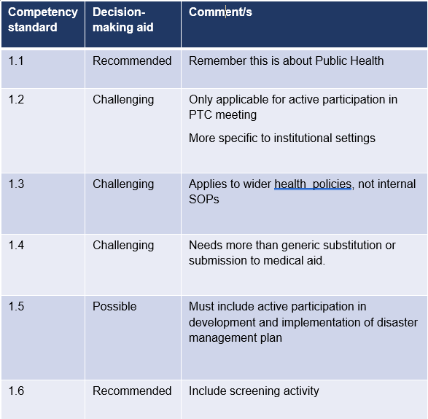
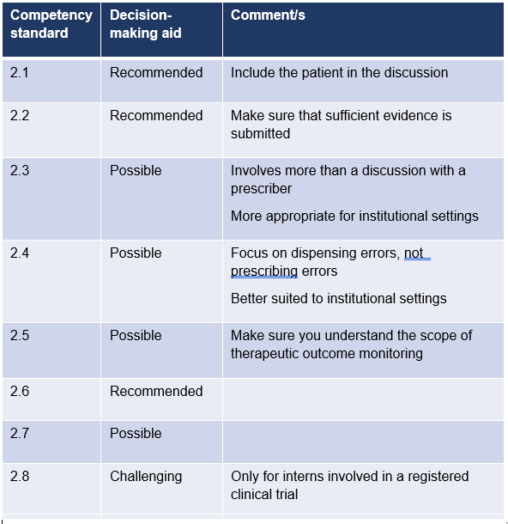
Domain 1 Domain 2
Notes:
Presenters: only spend time on stressing how to use these slides

Slide 72
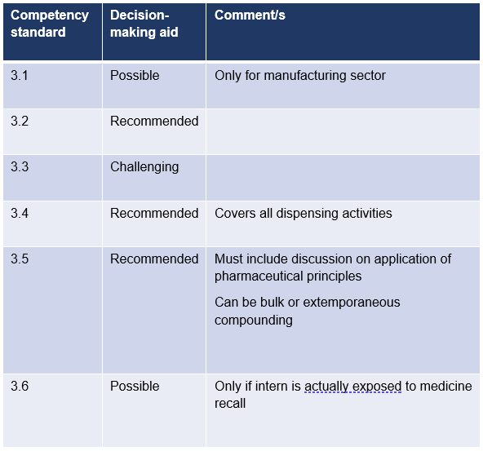
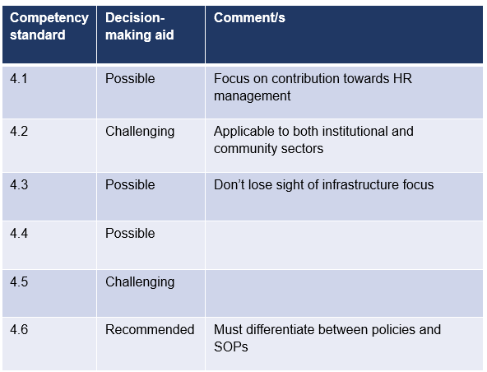
Domain 3 Domain 4
Notes:
Presenters: only spend time on stressing how to use these slides

Slide 73
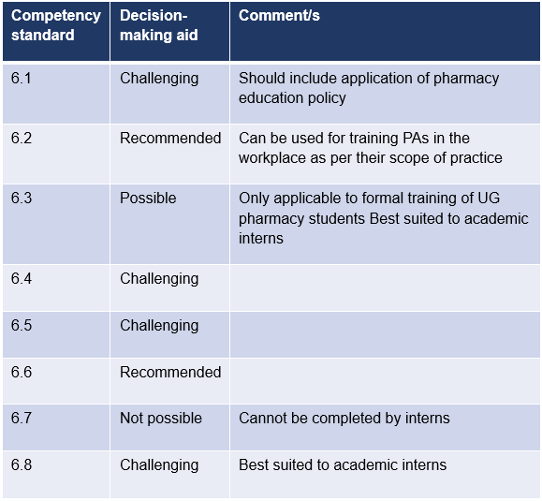
Domain 5 Domain 6
Competency standard | Decision-making aid | Comment/s
5.1 and 5.2 | Not allowed
5.3 | Compulsory | Only this CS is allowed for Domain 5
5.4 to 5.8 | Not allowed
Notes:
Presenters: only spend time on stressing how to use these slides

Slide 74
Now you are ready to complete the CPD cycle
Here are some guidelines pertaining to some of the evidence you might need for selected Competency Standards from each Domain
Notes:
Not necessary for presenter to spend time with this set of slides. NB. This does not get you 75% ( purely a guideline)
Stress to interns that they are included as a resource to be consulted before they start on their entries

Slide 75
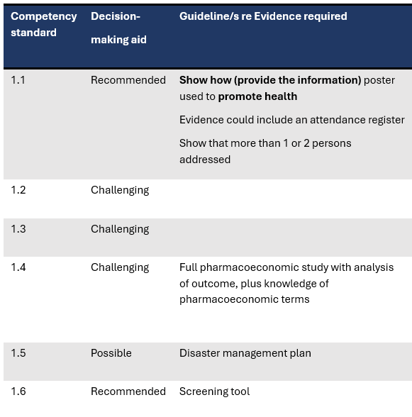
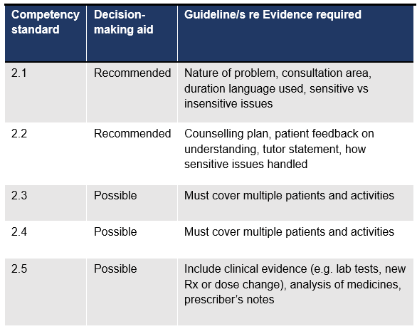
Domain 1 Domain 2
Notes:
Presenters: only spend time on stressing how to use these slides

Slide 76
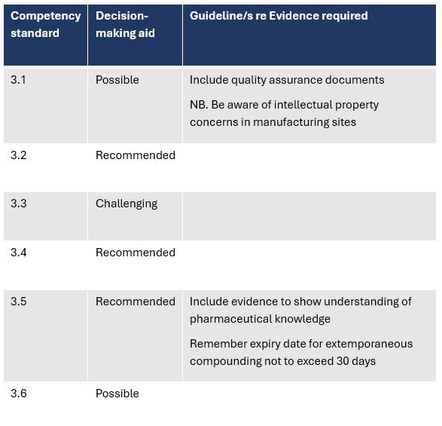
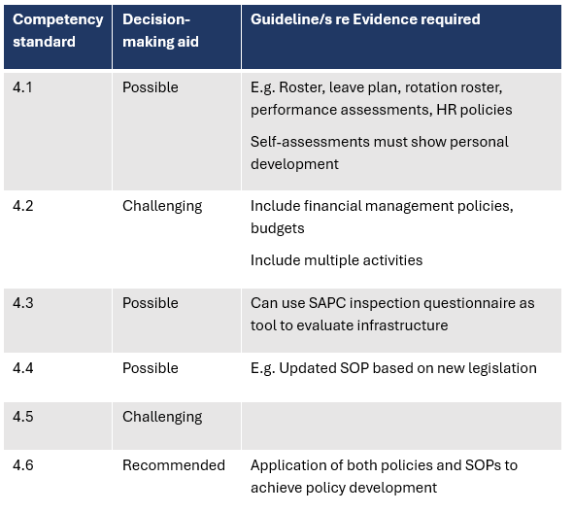
Domain 3 Domain 4
Notes:
Presenters: only spend time on stressing how to use these slides

Slide 77
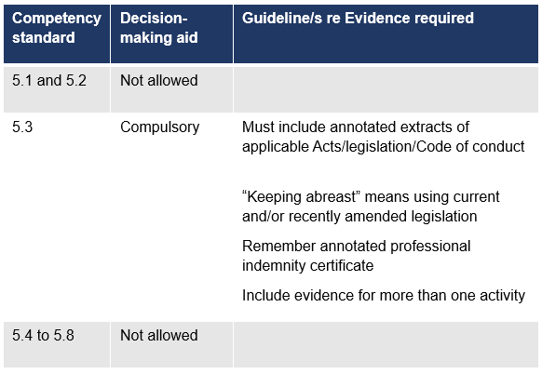
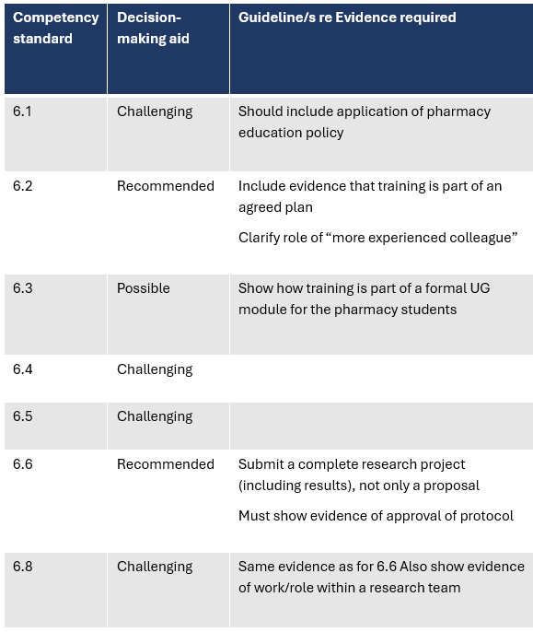
Domain 5 Domain 6
Notes:
Presenters: only spend time on stressing how to use these slides

Slide 78
Challenges
Core Competency development
Lack of Planning capabilities
Skills
Communication
Attitude
Lack of enthusiasm and initiative
Mental issues on the rise
Non-Independent thinking
Lack of Independent learning ability
Lack of comprehensive analysis capability
No Sense of responsibility
Lack of Passion
Generally unhappy
Low morale
Insufficient preparation
Adaptability
Creativity
Teamwork
Transparency
Time Management
Tutor challenges
Intern challenges
View poll results?
Limpopo Tutor’s perspective by Mr T.S. Rasekele
08 October 2024

Slide 79
Process challenges
Limpopo Tutor’s perspective by Mr T.S. Rasekele
08 October 2024

Slide 80
Tutor Verification Process
Evaluate the entire PoE entry
Make sure all elements of authentication are present
Most NB:
Check quality always
Interact/guide the intern to see how they can improve the PoE entry
Remember the mentor, coaching and role model value you can add
Verify online upon completion by intern
You can accept and release to SAPC or
Suggest how to improve PoE
Plagiarism? Confidentiality?

Slide 81
2023 and 2024 PoE outcome statistics
Year of internship | No. of interns | No. of interns successful in 6 PoE entries | No. of interns not yet successful in 6 PoE entries
2023 | 1146 | 790 (69%) | 356 (31%)
2024 | 1287 | 1026 (80%) | 261 (20%)

Slide 82
Please complete the attendance register/survey
Follow the link below which will be provided in the chat or scan the QR code
https://forms.office.com/r/8b7Df8bUYi

Slide 83
Any questions?

Slide 84
Contact Us
customercare@sapc.za.org
0861 7272 00
or
012 319 8500
@OfficialSAPC

Slide 85
Thank you!

