Slide 1

Intern/Tutor Training 2025
Intern portfolio of evidence on CPD System

Slide 2

Outline
Mostly aimed at interns.
There is a separate presentation for tutors
Competency standards
  Selecting a domain
  Selecting a competency standard
Portfolio of Evidence (PoE)
  CPD cycle
  Assessment criteria
  Evidence
  Example
Assessment
  Feedback from assessor
  Re-assessment
Professionalism
Confidentiality
Challenging competency standards
  Guidelines for choices and evidence
Notes:
Stress to tutors 2025 changes

Slide 3
Important Resources
The 2025 Intern and Tutor Manual (download from SAPC website)
For the pre-registration experience of pharmacist interns which includes:
  Criteria for assessment of a PoE entry (pages 35-37)
  Checklist for PoE entry (pages 41-42)
  Competency standards for pharmacists (pages 62-84)
Other resources
  Tutor
  SAPC website
Notes:
Make sure tutors realise manual is also for them

Slide 4
PoE Terminology that we use
Competency Standard
Behavioural Statement
Domain

Slide 5
Competency framework example
Domain 2
SAFE AND RATIONAL USE OF MEDICINES AND MEDICAL DEVICES
Competency standard 2.1
Patient consultation
Behavioural statements
a,b,c,d,e,f,g,h
Competency standard 2.2
Patient counselling
PLUS:
CS 2.3 to 2.8
Behavioural statements
a,b,c,d,e,f,g,h,i
Notes:
Shows that each domain has multiples CSs
Each CS has a different number of behavioural statements

Slide 6
Six Domains
Public Health
Safe and rational use of medicines and medical devices
Supply of medicines and medical devices
Organisational and management skills
Professional and personal practice
Education, critical analysis and research
Domains are organised clusters of competencies
Notes:
Developed for the SA context and for all practice settings

Slide 7

Competency Standards
Take note of how each CS is structured
Part of a domain
How does domain apply to you?
Introduction to domain
Competencies
Behavioural statements
Entry level
Intermediate practice
Advanced practice
Assessment tick box
For interns
Later
Notes:
Entry level = first 3 years of practice
Intermediate practice = between 3 and 7 years of practice
Advanced practice = more than 7 years of practice
Assessment tick box = must consider whether evidence presented shows that one can do all the behaviours

Slide 8
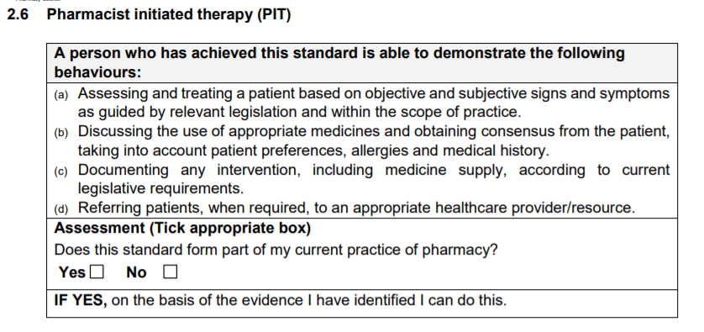
Terminology
(refer to intern manual CS 2.6)
Competency from domain 2
= 2.6
Behavioural statements
(a,b,c,d)

Slide 9

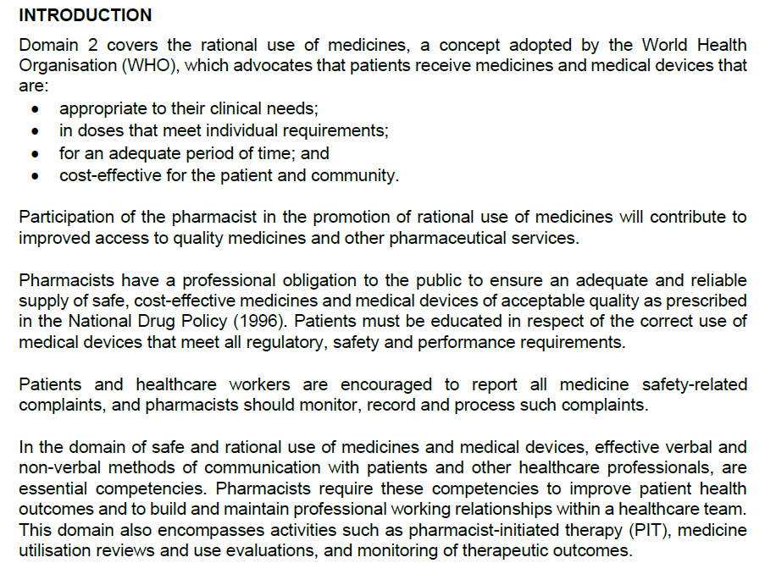
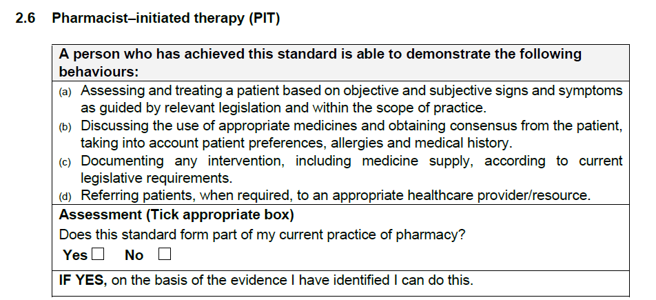
Structure of the Competency Standards
DOMAIN 2: SAFE AND RATIONAL USE OF MEDICINES AND MEDICAL DEVICES
COMPETENCIES
2.1 Patient consultation 2.2 Patient counselling 2.3 Patient medicine review and management 2.4 Medicine and medical device safety 2.5 Therapeutic outcome monitoring 2.6 Pharmacist–initiated therapy (PIT) 2.7 Pharmacovigilance 2.8 Clinical trials

Slide 10

Continuing Professional Development
FYI:
The term Portfolio of Evidence (PoE) is used to describe the activities of persons not yet considered a professional i.e., under-graduate (UG) students and interns

Slide 11

Continuing Professional Development
CPD is a cyclical activity
Definition: the process by which registered persons maintain and enhance their competence throughout their professional careers.
Encompasses a range of activities including continuing education and supplementary training.
CPD enables registered persons to develop in their area of practice and demonstrate competence.
Notes:
For ALL pharmacists, not just interns

Slide 12
Continuing Professional Development (CPD) Cycle
Reflection
Planning
Evaluation
Implementation

Slide 13
Assessment of phases of CPD cycle
0: Not yet met
1: Partially met
2: Met
3: Fully met
Done (mostly) on a scale of 0 to 3
To earn 3 marks, ALL requirements must be met
  Follow Assessment Criteria for each of the 4 phases of the CPD cycle
In addition
You must have used an appropriately professional communication style
  Free of spelling and grammatical errors
  Properly punctuated
  Trade names capitalised
REMEMBER: spelling and grammar are not auto-corrected!
Check everything carefully before submitting.
Check Manual pg 35-36 for full details of how marks allocated
NOTE: 2025 version has been updated

Slide 14
Step 1 Reflection
Decide on an appropriate Learning Title
  Should be relevant to what you want to learn
  Should describe what you are intending to do
  NB: Don’t simply copy the wording of the CS
  Verbatim copies of the wording = NYC
  The learning title must be unique and describe your case study
Reflection

Slide 15

Reflection
STEP 1: FRELECTION | *MARK RANGE | CRITERIA
Learning title | 0 | Direct copy of / similar to the competency standard / behavioural statements OR title not appropriate / not related to competency standard
 | 1 | Original, descriptive and related to the competency standard
Learning need | 0 | Irrelevant learning need OR learning need not linked to the competency standard and associated behavioural statements OR not learning need of intern (e.g. learning need of patient or nurse, etc.)
 | 1 | General description stating the role of the pharmacist in relation to the competency statement.
 | 2 | Clear learning need according to competency standard and associated behavioural statements AND trigger scenario provided (i.e. what happened that triggered the learning need), OR indication of what intern hopes to achieve after completion of the competency standard
 | 3 | Clear learning need according to competency standard and associated behavioural statements AND trigger scenario provided i.e. what happened that triggered the learning need) AND indication of what the intern hopes to achieve after completion of the competency standard
Ask yourself
  What do I need to learn? i.e. own learning need
  How do I know that’s what I need to learn?
  What will I do with what I have learned?
Describe this learning need
  Make it a personal reflection, i.e. use the personal pronoun “I”
  Be careful not to describe the learning need of the patient
  NB! The learning need must be related to the selected outcome
This will determine the choice of CS and behavioural statements

Slide 16
Assessment criteria for Reflection
STEP 1: REFLECTION | *MARK RANGE | CRITERIA
Learning title | 0 | Direct copy of / similar to the competency standard / behavioural statements OR title not appropriate / not related to competency standard
 | 1 | Original, descriptive and related to the competency standard
Learning need | 0 | Irrelevant learning need OR learning need not linked to the competency standard and associated behavioural statements OR not learning need of intern (e.g. learning need of patient or nurse, etc.)
 | 1 | General description stating the role of the pharmacist in relation to the competency statement.
 | 2 | Clear learning need according to competency standard and associated behavioural statements AND trigger scenario provided (i.e. what happened that triggered the learning need), OR indication of what intern hopes to achieve after completion of the competency standard
 | 3 | Clear learning need according to competency standard and associated behavioural statements AND trigger scenario provided i.e. what happened that triggered the learning need) AND indication of what the intern hopes to achieve after completion of the competency standard
Irrelevant or incorrect info
Minimally correct info
2 correct criteria
3 (all) correct criteria

Slide 17
Reflection
CHECKLIST | YES | NO
TITLE
Is there a title?
Is the title short, specific and related to the competency standard (CS)?
Is the title a concise statement in my own words (not just a copy of the CS)?
REFLECTION
Have I clearly stated what I need to know or learn?
Have I stated my learning need in the first person, e.g. “I need to know/learn…”?
Have I stated why I have identified this learning need for myself and not just stated that it is a required outcome?
Have I made sure not to include details of planning and implementation here?
Notes:
Checklist on Pg 33 of Manual

Slide 18
Step 2 Planning
NB: Don’t only describe how you plan to proceed, but say what you are going to do, how you are going to do it and why you are going to do things this way, as well as when you are going to do it.
How, exactly, am I going to learn this?
What are my options?
  Refer to the behavioural statement and structure planning accordingly
  Mention relevant resources to be used
  Include reason why each resource is chosen
  What evidence can I submit to support my learning activity?
  Planning is written in future tense (I will do…)
Carefully select primary learning trigger and activity
STEP 2: PLANNING | *MARK RANGE | CRITERIA
Description | 0 | Planning not related to behavioural statements and learning need OR no resources provided OR information elating to reflection, implementation and evaluation is provided
 | 1 | Planning is provided in future tense AND reasoning behind the use of resources AND insufficient resources provided but NO specific details of resources provided AND no linking to behavioural statements together with the reasoning behind the planning; NO specific details of resources to be used provided and NO linking to behavioural statement/s
 | 2 | Planning is provided tin future tense AND the reasoning behind the use of resources AND specific details of resources to be used are provided BUT not linking to 75% of the behavioural statements
 | 3 | Detailed plan provided in future tense AND the reasoning behind the use of resources AND specific details of resources to be used provided AND linking to 75% and above of the behavioural statements

Slide 19
Assessment criteria for Planning
STEP 2: PLANNING | *MARK RANGE | CRITERIA
Description | 0 | Planning not related to behavioural statements and learning need OR no resources provided OR information elating to reflection, implementation and evaluation is provided
 | 1 | Planning is provided in future tense AND reasoning behind the use of resources AND insufficient resources provided but NO specific details of resources provided AND no linking to behavioural statements together with the reasoning behind the planning; NO specific details of resources to be used provided and NO linking to behavioural statement/s
 | 2 | Planning is provided tin future tense AND the reasoning behind the use of resources AND specific details of resources to be used are provided BUT not linking to 75% of the behavioural statements
 | 3 | Detailed plan provided in future tense AND the reasoning behind the use of resources AND specific details of resources to be used provided AND linking to 75% and above of the behavioural statements
Irrelevant or incorrect info
Minimally correct info
2 correct criteria
3 correct criteria
4 (all) correct criteria

Slide 20

Planning
CHECKLIST | YES | NO
PLANNING
Have I clearly stated how I am going to learn?
Have I identified which resources I will be using?
Have I explained how I will be using the resources?
Have I made sure NOT to just write what I intend to do (which is implementation)?
Have I written this in the future tense?

Slide 21

Step 3 Implementation
Tell the story.
Keep it personal, use “I”
Describe what you actually did
  Provide the context
    What, when, where, how
  Link to the evidence
  Remember to include ALL the behavioural statements of the chosen outcome
  Implementation is written in the past tense (I did…)
More about this later!
EVIDENCE
STEP 3: IMPLEMENTATION | *MARK RANGE | CRITERIA
Achievement date | 0 | Invalid achievement date (i.e. not within the internship period, or before the start date)
 | 1 | Valid achievement date (i.e. during the internship period after completion of the activity)
Description | 0 | Invalid description
 | 1 | Only description of evidence provided but has no linkage to the behavioural statements OR description of “how” only OR description of “where” only OR description of “what” only OR description of “when” only
 | 2 | Description of what, where, when, how AND either reference made to the evidence OR linked to at least 75% of the behavioural statements
 | 3 | Description of what, where, when, how, AND reference made to the evidence AND linked to at least 75% of the behavioural statements

Slide 22
Assessment criteria for Implementation
STEP 3: IMPLEMENTATION | *MARK RANGE | CRITERIA
Achievement date | 0 | Invalid achievement date (i.e. not within the internship period, or before the start date)
 | 1 | Valid achievement date (i.e. during the internship period after completion of the activity)
Description | 0 | Invalid description
 | 1 | Only description of evidence provided but has no linkage to the behavioural statements OR description of “how” only OR description of “where” only OR description of “what” only OR description of “when” only
 | 2 | Description of what, where, when, how AND either reference made to the evidence OR linked to at least 75% of the behavioural statements
 | 3 | Description of what, where, when, how, AND reference made to the evidence AND linked to at least 75% of the behavioural statements
Irrelevant or incorrect info
Minimally correct info
2 correct criteria
3 (all) correct criteria

Slide 23

Assessment criteria for Evidence
Same hierarchy of criteria
STEP 3: IMPLEMENTATION | *MARK RANGE | CRITERIA
Evidence | 0 | No evidence, OR not valid OR not authentic OR inappropriate/irrelevant OR factually incorrect OR confidentiality breached
 | 1 | Valid, authentic, current, authentic, sufficient (to show at least 75% of the behavioural statements were performed) but NOT annotated
 | 2 | Valid, current, authentic, sufficient (to show at least 75% of the behavioural statements were performed) AND annotated but does not show which behavioural statements it is satisfying and how it is satisfying the behavioural statements
 | 3 | Valid, authentic, current, authentic, sufficient (to show at least 75% of the behavioural statements were performed), annotated to show which behavioural statements is satisfying AND how it is satisfying the behavioural statements
Irrelevant or incorrect info
Minimally correct info
2 correct criteria
3 (all) correct criteria

Slide 24
Implementation
CHECKLIST | YES | NO
IMPLEMENTATION
Have I described exactly what I did?
Have I included where, when, what and how?
Have I written this in the past tense?
Have I referred to the labels of my evidence (i.e. the behavioural statements) in the text?
Have I checked that what I did matches my learning need?
Have I checked that what I did addresses all the behavioural statements of the CS?
Implementation must be supported by evidence!

Slide 25

Evidence
CHECKLIST | YES | NO
EVIDENCE
Have I checked that I have sufficient evidence i.e. have I covered at least 75% of the behavioural statements of the CS?
Have I annotated my evidence so that it is clear why I have included each piece?
Have I annotated my evidence with the behavioural statements, and does this match the behavioural statements mentioned under Implementation?
Is my evidence clear i.e. readable, not loaded upside down, loaded as a single file. etc.?
Have I made sure that all patient identifying details (such as name, surname, ID number) have been hidden?
Still more about this later!

Slide 26

Step 4 Evaluation
FOCUS HERE IS
Learning outcome i.e. what have you learnt – related to evidence?
  NB! NOT “What I did”
Application i.e. how have you subsequently used your acquired knowledge
Impact i.e. how has your acquired knowledge changed your practice
Identification of further learning needs, related to competency, not the specific activity
NB: Provide specific example to substantiate this

Slide 27
Assessment criteria for Evaluation
Note different number of criteria
STEP 4: EVALUATION | *MARK RANGE | CRITERIA
Description | 0 | Any one of the following: what was learned in terms of the competency standard, OR influence of learning on practice OR example of application OR possible future leaning need (Examples need to be specific)
 | 1 | Combination of any two of the following: Only states what was learned in terms of the competency standard, OR influence of learning on practice OR gives an example of application OR identifies a possible future leaning need (Examples need to be specific)
 | 2 | Combination of any three of the following: Only states what was learned in terms of the competency standard, OR influence of learning on practice OR gives an example of application OR identifies a possible future leaning need (Examples need to be specific)
 | 3 | All four: What was learnt in terms of the competency standard AND how the learning influenced his/her way of practice AND application by means of practical/actual examples AND identifying a future learning need in relation to the skills that were learnt (examples need to be specific).
Minimally correct info
Only one criterion
2 correct criteria
3 correct criteria
4 (all) correct criteria

Slide 28
Evaluation
CHECKLIST | YES | NO
EVALUATION
Have I clearly stated what I learnt from the action described under Implementation?
Have I checked that my learning matches my learning need and is relevant to the CS?
Have I clearly described how this learning has impacted on the way I practice?
Have I given a specific example of how I applied this learning i.e. something I did after the action described? Have I remembered that I don’t have to provide evidence for this, but just have to describe it?
Have I clearly noted my future learning needs?

Slide 29

CPD Cycle
Reflection
Planning
Implementation
Evaluation
Each phase of the cycle must be completed for every PoE entry

Slide 30


Stepwise approach to completing PoE entries
Make sure your tutor has verified and submitted your entries by the published deadlines
7. Check for feedback
Tutor verifies and submits online
Enter and submit online tutor verification
Start CPD cycle
Read all behavioural statements
Select a Competency Standard (CS)
Select domain
This has 4 steps:
Reflection
Planning
Implementation
Evaluation
Focus on relevance to your practice setting
Complete annual declaration first!
Notes:
Stress – wont be able to start CPD cycle until annual declaration completed

Slide 31

Once you have chosen a Competency Standard
Check again that it is appropriate for your practice setting
Read all the behavioural statements
Decide on the appropriate and sufficient evidence
Follow through
  As you complete each phase of the CPD cycle, make sure what you write is relevant to the chosen outcome.
  REFER TO CHECKLIST!

Slide 32

Requirements
Each entry must be accompanied by suitable evidence
You need to submit 6 PoE entries
  One from each domain
  And be successful in all 6 PoE entries
  Please do not submit all 6 entries at once. Allow sufficient time throughout the year for assessment submissions. This will increase your chances of success as you would obtain feedback from the assessor and moderator.
For each Domain choose one competency standard
  Read all the behavioural statements carefully
  1-3 behavioural statements = evidence is needed for ALL the statements (100%)
  If there are ≥4 behavioural statements, provide evidence for at least 75%
  NB: Consult your Manual for details of the behavioural statements
  NB: Every PoE entry must reflect individual work
  No group activities are acceptable
Notes:
No group activities = new for 2020
Interns must plan activities well in advance of PoE deadlines

Slide 33
Evidence criteria
EVIDENCE
Annotated
Authentic
Sufficient
Valid
Current

Slide 34



Annotated
What it is
Mechanism to give meaning to evidence
Legible/easy to read
Justifies why evidence included
Must be planned and meaningful
Must provide links to behavioural statements
What it isn’t
Merely labels
Single words next to parts of evidence
Scribbles on evidence
Lacking links to behavioural statements
Must tell a story!
And the story is “What have I done to show behaviour”
Notes:
Stress that annotation must link to what is written under Implementation

Slide 35
Annotation of the date on a prescription
Meaningful annotation
20/01/2025
Annotation with no value
20/01/2025
For a prescription to be valid, it must be presented for dispensing within one month after it was written. This prescription is thus valid
This is the date of the prescription

Slide 36
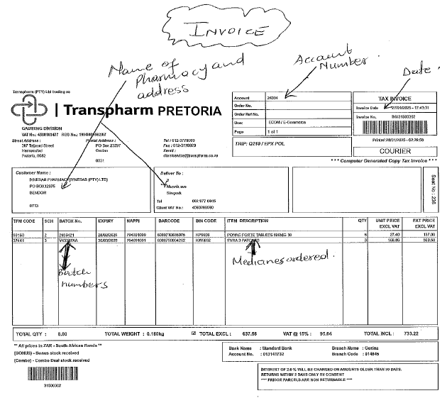
Annotation of evidence
How to annotate?
Notes:
3.2 Supply chain management (e)

Slide 37
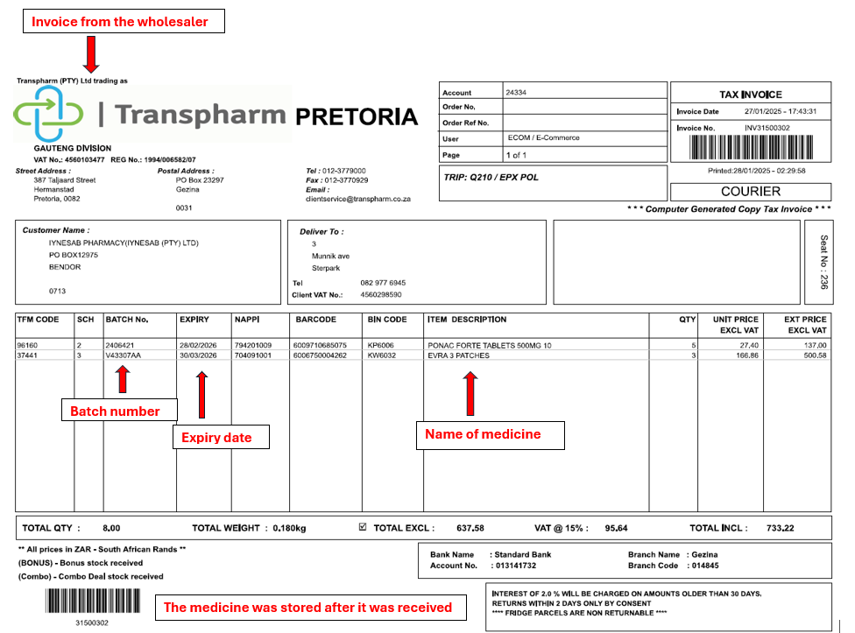
Annotation of evidence
Annotation good?
Notes:
3.2 Supply chain management (e)

Slide 38
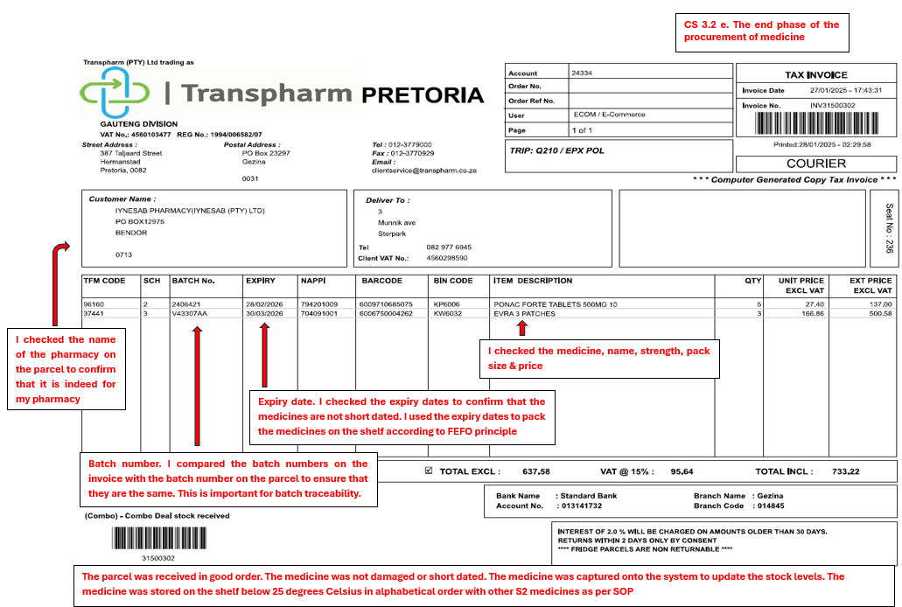
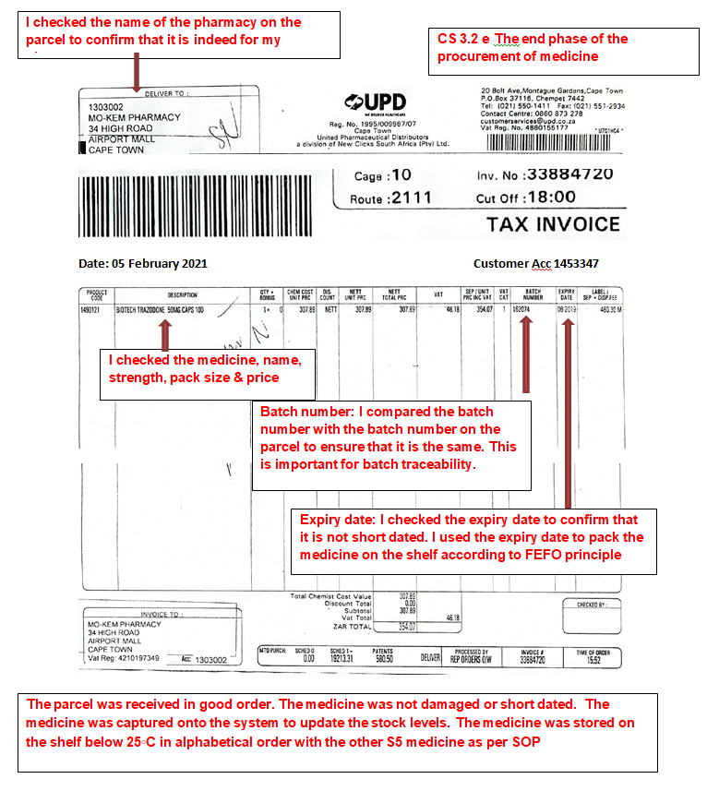
Annotation of evidence
Quality of annotation?
Notes:
Point out that annotation is more than for eg just labelling where the batch number appears on the invoice.
Here the annotation “tells the story” = what was done = checked batch number against medicine received

Slide 39
PoE entry must relate to exposure to CSs DURING the internship period
Evidence must therefore be collected DURING the internship year/s
Don’t include anything from your undergraduate years
Current
EVIDENCE

Slide 40
Evidence must pertain to the specific competency being addressed
If factual and/or calculation errors occur in the evidence
  Deemed NOT valid
EVIDENCE
Valid
NB: If evidence is not valid, the other 4 criteria do not count

Slide 41
For example…
If the competency is about how to fry an egg and your evidence is about how crispy the bacon is, it is of no value.
EVIDENCE
Valid

Slide 42
Authentic = own work
The evidence must be verified online by your tutor
Tutor verification
  Make sure your tutor verifies your entries
  Make it your responsibility to check
Authentic
EVIDENCE
Notes:
Notes for facilitator:
Evidence must be authenticated and must have tutor name, signature, designation, p-number and date
Intern must also sign evidence.
For academic interns and interns in manufacturing, evidence must be signed by supervisor and co-signed by tutor.

Slide 43
If there are 4 or more, then the evidence submitted must cover at least 75% of the behavioural statements. E.g 4 behavioural statements- 3 pieces of evidence (0.75X number of behavioural statements)
The same piece of evidence can’t be used for more than one CS
Do not submit an entire legislative document.e.g. the entire pharmacy act.
Do not add evidence that may have clauses for intellectual property e.g. manufacturing interns who submit evidence that is confidential to that site
Sufficient
EVIDENCE
Make sure you have enough evidence
NB: Focus on the QUALITY not only on the QUANTITY of evidence

Slide 44

POLL1: https://forms.office.com/r/kFGHdWbkc2
Question
If you choose a competency standard that has eight (8) behavioural statement (BS) and you need to supply evidence for at least 75% of the bs. How many pieces of evidence do you need?

Slide 45



Evidence
  HINT Put yourself in assessor’s shoes before submitting evidence.
  Ask: What does it show?
  Will probably point to need for more discussion and/or annotation
Photos | Pages from SAMF | Delivery notes
Add date stamp! Meaningless UNLESS authenticated AND you identify yourself Can be anyone in the photo! Maintain patient confidentiality | Reference name, edition, page number, etc. What does this show? That you can use a scanner or photocopier? | What does this show? Stock was delivered, but received by whom? Signatures not annotated are meaningless
Notes:
Notes for the facilitator:
NB: Stress annotation of evidence e.g. link to outcome subsections AND identify own signature
Facilitator to put forward such examples as photos, pages copied from GPP, package inserts for discussion
Evidence must be scanned in one document (and not upload separate documents)
Challenge interns to come up with good examples

Slide 46

Evidence
No highly glossy photos
Not uploaded upside down
The evidence must be clear and legible
The evidence must be in one document
Annotate, annotate, annotate!
  Link evidence to a specific behavioural statement
    Show how evidence satisfies the bs
  Identify your own signature
  Remember the assessor does not know you
Notes:
Notes for the facilitator:
- No highly glossy photos
- Not uploaded upside down
- Put all evidence in one document

Slide 47
What kind of evidence?
If I’m providing information to a patient…
Prescription
+?
+?
But if I’m providing evidence to a group…
Attendance register
Presentation
Reference materials used
Feedback
Attendance register -+ presenter name, date, venue
  Only one presenter
  Feedback on presentation – should reflect knowledge and understanding of audience after the presentation (it is not a rating of the presenter)
  Remember to annotate and link to the behavioural statements

Slide 48
What kind of evidence?
I’m consulting with a patient
Patient history
Rx, request from patient, blue copy, label, reference material used
But what if I’m consulting with a doctor?
Reason for consultation e.g. Rx
Reference material used
Telephone number of the doctor and time of the conversation
References – scientific, not Wikipedia
  Must also be annotated and linked to the behavioural statements
  Include page, edition e.g. for SAMF
Notes:
NB. Public sector doctor consults- may be different when engaging ( different doctor to script may be encountered).

Slide 49

What kind of evidence?
Sometimes I attend a meeting …
Agenda
Attendance register
Minutes of meeting
Most VIP: own contribution to meeting

Slide 50
What kind of evidence?
I will also be working with data…
Reason for data collection
e.g. Screening report, data analysis

Slide 51
Evidence ( re-emphasis on checklist)
CHECKLIST | YES | NO
EVIDENCE
Have I checked that I have sufficient evidence i.e. have I covered at least 75% of the behavioural statements of the CS?
Have I annotated my evidence so that it is clear why I have included each piece?
Have I annotated my evidence with the behavioural statements, and does this match the behavioural statements mentioned under Implementation?
Is my evidence clear i.e. readable, not loaded upside down, etc.?
Have I made sure that all patient identifying details (such as name, surname, ID number) have been hidden?

Slide 52

Evidence… Summary
Evidence is proof of what I did
  NOT merely reading an article
  NOT theoretical scenario
  NOT witnessing someone else
Must convince the assessor that I performed the activity
Must be professional
  Neat, clear
  Not a note scribbled on a Rx!

Slide 53

PoE Entry Example
Trigger incident
I was asked to participate in a public health campaign
Relevant Domain:
  Domain 1 Public Health
Relevant Competency:
  Competency standard 1.1 Promotion of health and wellness
  POLL 2: https://forms.office.com/r/45Q95g3tex

Slide 54

Structure of the Competency Standards
DOMAIN 1: PUBLIC HEALTH
COMPETENCIES
1.1 Promotion of health and wellness
REMEMBER:
Talking to individual patients DOES NOT constitute a public health campaign
Notes:
Emphasise that this CS is directed at public health information. Have a look at line 3 in the introduction to domain 1

Slide 55


Poll - Interns to attempt all polls before the next slide
POLL 3: Choose the most appropriate learning title (https://forms.office.com/r/0LN2WrkQyq)
POLL 4: Which is the best learning need based on the competency standard (https://forms.office.com/r/kR1svez87c)
Participation in COVID-19 health campaign at Steve Biko Academic hospital
Promotion of health and wellness
Promotion of COVID-19
I needed to learn how to provide advise and participate in public health campaigns
I needed to learn how to speak in public
I needed to learn how to teach

Slide 56
PoE Entry Example: Reflection
Learning title: Participation in COVID-19 health campaign at Steve Biko Academic Hospital
What triggered the learning: My pharmacy manager asked me to participate in a COVID-19 health campaign and I did not know what this entailed
Learning need: I needed to learn how to provide advice and participate in public health campaigns
What do I hope to achieve: I hope to be familiar with the steps required to plan and successfully participate in a public health campaign
Note: Content is out of date Worked example intended to show how to complete an entry
Notes:
Note the learning need and what I hope to achieve aligns to the skill and not the actual public campaign e.g. HIV/covid etc.

Slide 57
PoE Entry Example: Planning
Plan to make a poster using relevant (Valid, current, authentic, sufficient) sources (National Department of Health and WHO policies and guidelines, SAPC website)- add relevant details (e.g. chapter, page numbers).
I will include information on:
  health promotion (behavioral statement a)
  healthy lifestyles (behavioral statement c)
  disease prevention and control (behavioral statement b)
Verify the poster with my tutor
Use the poster in my health campaigns
Get feedback (e.g. attendance register and ) (behavioral statement d)
Obtain the participation letter (behavioral statement d)
I plan to participate in the COVID-19 screening using the screening tool (behavioral statement d)
Why?: I did all this in order to be able to participate in a public health campaign
Notes:
Details of the resources ( sections)
Attendance register not the only evidence for d. Need to submit other types of evidence e.g. surveys. Remember to add the attendance register as evidence
NB can use WHO poster etc

Slide 58
PoE Entry Example: Implementation
Description : How :I consulted the following sources – National Department of Health (evidence a/1.1a) and WHO policies and guidelines (evidence b/1.1b), SAPC website (evidence c/1.1c)
What :I formulated the poster to use in the campaign (evidence d/1.1 a-c)
How/when/where: I presented the poster at the COVID-19 screening area at the entrance of the hospital on a busy outpatient day (evidence e – attendance register maintain patient confidentiality/1.1d)
How :I did the screening using the screening tool (evidence f/1.1d)
I received the feedback from my supervisor and obtained the letter of participation from the health and safety manager (evidence g/1.1d)

Slide 59
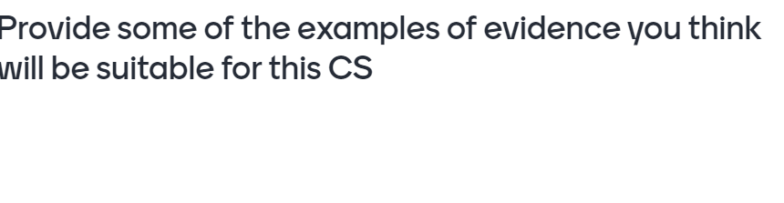

Poll 5
https://forms.office.com/r/ypJAFjTpAx

Slide 60
PoE Entry Example: Possible evidence
Source document(s): specific with annotations e.g. GPP (chapter, page number).
Health education tool(s)
  A detailed poster
  Pamphlet
  Presentation
Letter of participation (highlighting your role)
Attendance register (maintain patients confidentiality)
Where does it fit in above? How many
behavioural statements are covered?
Notes:
75% evidence needs to be covered. These are some of the suggested evidence – you can be creative and send evidence that aligns to the behavrial statements. Emphasise the value of annotatiions

Slide 61
PoE Entry Example: Evaluation
What was learned :I learned how to provide advice and participate in public health campaigns
How the learning influenced practice I would like to learn more on providing advice to other health care workers
Applications in practice:I subsequently participated in a diabetic screening day and I am more aware of public health issues
Future learning need:I am now more confident
to volunteer to participate in public health campaigns

Slide 62
Feedback from Assessors
What can you expect?
  Comments, dated
  Positive = acknowledgement of being on the right track
  Negative = with specific pointers with regards to what you did wrong and how to improve
  Especially with regards to evidence annotation
  Comments = guidelines for next entries, even if attached to entry assessed as Competent
Remember: Feedback sessions later in the year

Slide 63
Resubmission
If you were found ‘not yet successful’ you need to resubmit a PoE within that Domain.
Each resubmission is a standalone and is treated as a new submission.
On resubmitting –
  Start a new PoE entry unless the assessor has recommended that your PoE entry can be corrected (have a look at comment section)
See Guidelines for:
  Conditions
  Application procedure
  Timeline
To maximise your chance to be eligible to write the intern examination:
Submit early
Submit regularly on a monthly basis
Notes:
If it is only breech of confidentiality mention – that can be the only change to the evidence

Slide 64
Resubmissions
To prevent the need for further resubmission, make sure to follow your assessor’s recommendations /comments
Re-submitted PoE entries are sent to the same assessor
  Don’t simply re-submit without attending to the reasons for the entry being deemed “not yet successful”
  Assessors can see previous submissions and comments

Slide 65

Professionalism
PoE submissions are more than “just another hurdle”, they are an opportunity for you to further develop your professionalism.
Plagiarism
  Plagiarism software has been implemented from 2025
  See Manual for more information (page 31-32)
AI-generated content not allowed
Obviously your PoE entries must reflect your own work
  Any irregularities will be referred to the SAPC legal department
  Penalties
    Expect them to be applied
    Expect them to be severe

Slide 66

Confidentiality
Must be maintained at all times
  Rxs, trailer labels, S6 registers
Automatically not yet successful if confidentiality breached
Confidentiality applies only to patients
  Not doctors, hospitals or other facilities
  Not to staff attendance registers
  Careful not to blank out all your evidence such as signatures
Make sure the name is completely obscured. Untidy scribbles are ineffective.
Mr Smith

Slide 67
You are now ready to start the stepwise approach to completing your PoE entries
Remember…
  Step 1: Choose domain
  Step 2: Choose Competency Standard
But first, here are some tips and comments to assist you in choosing an appropriate Competency Standard from each Domain
Notes:
Not necessary for presenter to spend time with this set of slides
Stress to interns that they are included as a resource to be consulted before they start on their entries
Also stress that these are only guidelines and not absolute (with the exception of Domain 5 and a few other that they cannot choose, like 6.7 or where there are limitations in terms of practice setting - like 3.1 for manufacturing sector only

Slide 68

Decision-making aid
A good choice should present no problems for any intern
RECOMMENDED
Consider very carefully. Only choose if you are able to collect valid and sufficient evidence
POSSIBLE
Avoid!
Will be extremely difficult to complete with sufficient evidence
CHALLENGING
NB: Make sure your chosen CS is appropriate for your practice setting
Notes:
Make sure that these differences are well understood. Ensure the behavioural statements align to your practice setting e.g. intellectual property in industry. ( out of box compared staying in the box)

Slide 69
Domain 1
Competency standard | Decision-making aid | Comment/s
1.1 | Recommended | Remember this is about Public Health
1.2 | Challenging | Only applicable for active participation in PTC meeting More specific to institutional settings
1.3 | Challenging | Applies to wider health policies, not internal SOPs
1.4 | Challenging | Needs more than generic substitution or submission to medical aid.
1.5 | Possible | Must include active participation in development and implementation of disaster management plan
1.6 | Recommended | Include screening activity
Notes:
Presenters: only spend time on stressing how to use these slides

Slide 70
Domain 2
Competency standard | Decision-making aid | Comment/s
2.1 | Recommended | Include the patient in the discussion
2.2 | Recommended | Make sure that sufficient evidence is submitted
2.3 | Possible | Involves more than a discussion with a prescriber More appropriate for institutional settings
2.4 | Possible | Focus on dispensing errors, not prescribing errors Better suited to institutional settings
2.5 | Possible | Make sure you understand the scope of therapeutic outcome monitoring
2.6 | Recommended
2.7 | Possible
2.8 | Challenging | Only for interns involved in a registered clinical trial
Notes:
Presenters: only spend time on stressing how to use these slides

Slide 71
Domain 3
Competency standard | Decicion-making aid | Comment/s
3.1 | Possible | Only for manufacturing sector
3.2 | Recommended
3.3 | Challenging
3.4 | Recommended | Covers all dispensing activities
3.5 | Recommended | Must include discussion on application of pharmaceutical principles Can be bulk or extemporaneous compounding
3.6 | Possible | Only if intern is actually exposed to medicine recall
Notes:
Presenters: only spend time on stressing how to use these slides

Slide 72
Domain 4
Competency standard | Decision-making aid | Comment/s
4.1 | Possible | Focus on contribution towards HR management
4.2 | Challenging | Applicable to both institutional and community sectors
4.3 | Possible | Don’t lose sight of infrastructure focus
4.4 | Possible
4.5 | Challenging
4.6 | Recommended | Must differentiate between policies and SOPs
See pg 40 in manual for definitions and a list of policies
Notes:
Presenters: only spend time on stressing how to use these slides

Slide 73
Domain 5
Competency standard | Decision-making aid | Comment/s
5.1 and 5.2 | Not allowed
5.3 | Compulsory | Only this CS is allowed for Domain 5
5.4 to 5.8 | Not allowed
Notes:
Presenters: only spend time on stressing how to use these slides

Slide 74
Domain 6
Competency standard | Decision-making aid | Comment/s
6.1 | Challenging | Should include application of pharmacy education policy
6.2 | Recommended | Can be used for training PAs in the workplace as per their scope of practice
6.3 | Possible | Only applicable to formal training of UG pharmacy students Best suited to academic interns
6.4 | Challenging
6.5 | Challenging
6.6 | Recommended
6.7 | Not possible | Cannot be completed by interns
6.8 | Challenging | Best suited to academic interns
Notes:
Presenters: only spend time on stressing how to use these slides. Note the difference between learner and student.

Slide 75
Now you are ready to complete the CPD cycle
Remember…
  Step 4: Complete the CPD cycle
Here are some guidelines pertaining to some of the evidence you might need for selected Competency Standards from each Domain
Notes:
Not necessary for presenter to spend time with this set of slides. NB. This does not get you 75% ( purely a guideline)
Stress to interns that they are included as a resource to be consulted before they start on their entries

Slide 76
Domain 1
Competency standard | Decision-making aid | Guideline/s re Evidence required
1.1 | Recommended | Show how (provide the information) poster used to promote health Evidence could include an attendance register Show that more than 1 or 2 persons addressed
1.2 | Challenging
1.3 | Challenging
1.4 | Challenging | Full pharmacoeconomic study with analysis of outcome, plus knowledge of pharmacoeconomic terms
1.5 | Possible | Disaster management plan
1.6 | Recommended | Screening tool
Notes:
Presenters: only spend time on stressing how to use these slides

Slide 77
Domain 2
Competency standard | Decision-making aid | Guideline/s re Evidence required
2.1 | Recommended | Nature of problem, consultation area, duration language used, sensitive vs insensitive issues
2.2 | Recommended | Counselling plan, patient feedback on understanding, tutor statement, how sensitive issues handled
2.3 | Possible | Must cover multiple patients and activities
2.4 | Possible | Must cover multiple patients and activities
2.5 | Possible | Include clinical evidence (e.g.lab tests, new Rx or dose change), analysis of medicines, prescriber’s notes GPP can be used
2.7 | Possible | Monitoring and reporting. Include ADR form, post-marketing surveillance
2.6 | Recommended | Could include information pamphlet relating to condition, and referral letter (to whom, reason for referral)
Notes:
Presenters: only spend time on stressing how to use these slides

Slide 78
Domain 3
Competency standard | Decision-making aid | Guideline/s re Evidence required
3.1 | Possible | Include quality assurance documents NB. Be aware of intellectual property concerns in manufacturing sites
3.2 | Recommended
3.3 | Challenging
3.4 | Recommended
3.5 | Recommended | Include evidence to show understanding of pharmaceutical knowledge Remember expiry date for extemporaneous compounding not to exceed 30 days
3.6 | Possible
Notes:
Presenters: only spend time on stressing how to use these slides

Slide 79
Domain 4
Competency standard | Decision-making aid | Guideline/s re Evidence required
4.1 | Possible | E.g: Roster, leave plan, rotation roster, performance assessments, HR policies Self-assessments must show personal development
4.2 | Challenging | Include financial management policies, budgets Include multiple activities
4.3 | Possible | Can use SAPC inspection questionnaire as tool to evaluate infrastructure
4.4 | Possible | E.g: Updated SOP based on new legislation
4.5 | Challenging
4.6 | Recommended | Application of both policies and SOPs to achieve policy development
See pg 40 in the manual for definitions and a list of policies
Notes:
Presenters: only spend time on stressing how to use these slides

Slide 80
Domain 5
Competency standard | Decision-making aid | Guideline/s re Evidence required
5.1 and 5.2 | Not allowed
5.3 | Compulsory | Must include annotated extracts of applicable Acts/legislation/Code of conduct “Keeping abreast” means using current and/or recently amended legislation Remember annotated professional indemnity certificate Include evidence for more than one activity
5.4 to 5.8 | Not allowed
Notes:
Presenters: only spend time on stressing how to use these slides

Slide 81
Domain 6
Competency standard | Decision-making aid | Guideline/s re Evidence required
6.1 | Challenging | Should include application of pharmacy education policy
6.2 | Recommended | Include evidence that training is part of an agreed plan Clarify role of “more experienced colleague”
6.3 | Possible | Show how training is part of a formal UG module for the pharmacy students
6.4 | Challenging
6.5 | Challenging
6.6 | Recommended | Submit a complete research project (including results), not only a proposal Must show evidence of approval of protocol
6.8 | Challenging | Same evidence as for 6.6 Also show evidence of work/role within a research team
Notes:
Presenters: only spend time on stressing how to use these slides

Slide 82
CS 4.6 Policy development
Recommended CS but interns typically have trouble with this CS
2024 Manual now includes extra information to facilitate differentiation between policies and SOPs
  Definition of a policy:
    “A set of guidelines …………..”
  Definition of an SOP:
    “A set of written instructions ………….”
  List of applicable policies:
    NDP (see Chapter 7 of the manual)
    Sanitation policy
    Health safety policy
    Security policy
    Post-exposure policy
    HIV and AIDS policy
See pg 40 in manual for complete definitions
NB:
GPP is NOT
a policy

Slide 83




Intern Challenges
As identified by tutors
  Lack of Planning capabilities
  Non-Independent thinking
  Lack of Independent learning ability
  Lack of comprehensive analysis capability
  Insufficient preparation
  Communication
  Adaptability
  Creativity
  Teamwork
  Transparency
  Time Management
  Lack of enthusiasm and initiative
  No Sense of responsibility
  Lack of Passion
  Generally unhappy
  Low morale
  Mental issues on the rise
Core Competency development
Skills
Attitude
Limpopo Tutor’s perspective by Mr T.S. Rasekele
08 October 2024
Notes:
Don’t discuss in detail
Merely bring up the concept of the probability of every intern experiencing some issues during the year
These are the challenges identified by tutors
Poll: What challenges do the interns identify?

Slide 84


And finally…
Learn
Experience
Develop
Succeed
Become a true Life Long Learner

Slide 85

Please complete the attendance register/survey
https://forms.office.com/r/MmA7nNzv1Q

Slide 86

Any questions?

Slide 87



Contact Us
customercare@sapc.za.org
0861 7272 00
or
012 319 8500
@OfficialSAPC

Slide 88
Thank you!

